Slide 1
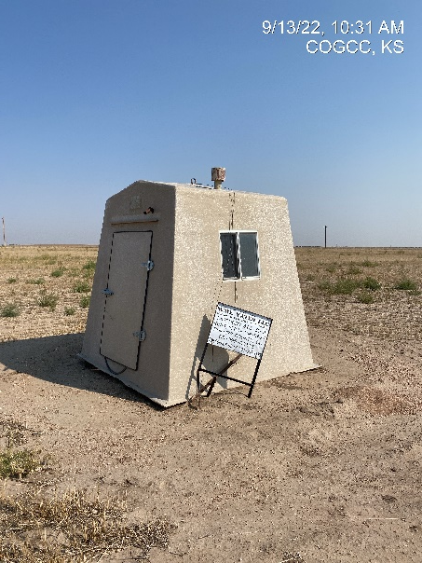
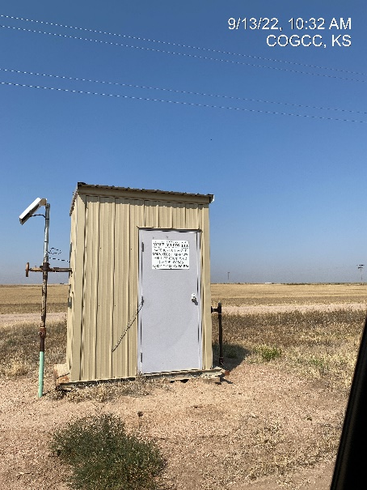
Operator: WME YATES
Location ID: 05-095-06331
Amherst Field SAGEHORN 843-31-11
WELLHEAD – PM - SIGN
MR - SIGNAGE

