Slide 1
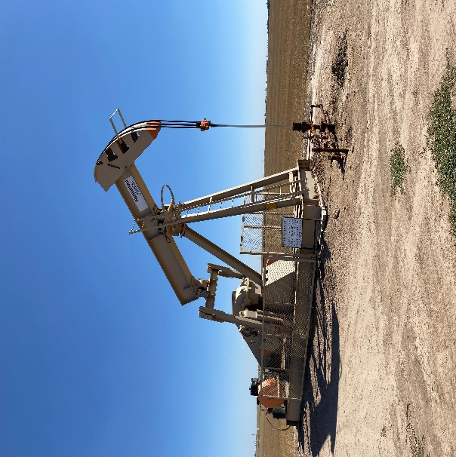
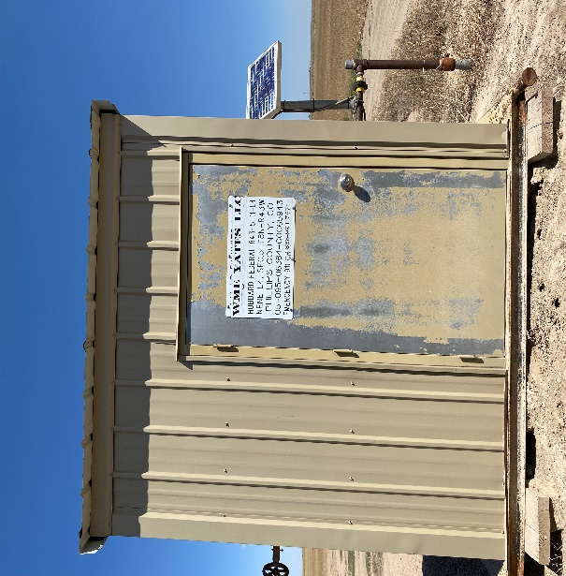
Operator: WME YATES
Location ID: 05-095-06364
Amherst Field Hubbard Federal L-4
WELLHEAD – PJ – PM - SIGN
MR - SIGNAGE

