Slide 1
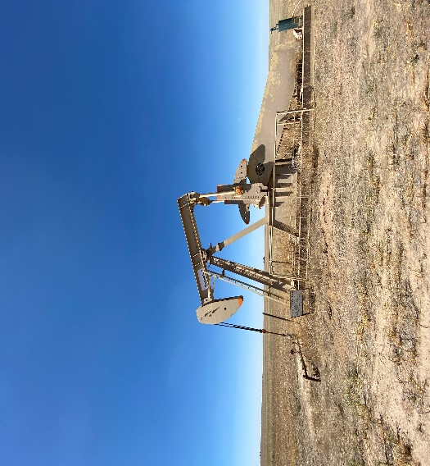

Operator: WME YATES
Location ID: 05-095-06244
Amherst Field FLATLAND 944-35-43
WELLHEAD
SIGNAGE

