Slide 1
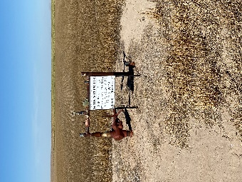
Operator: WME YATES
Location ID: 05-095-06419
Amherst Field SJR – L7
WELLHEAD
SIGNAGE

