Slide 1
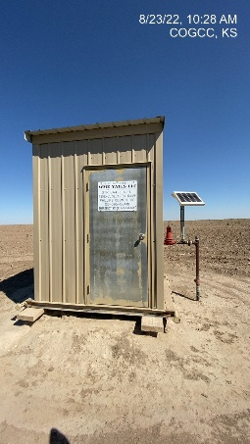
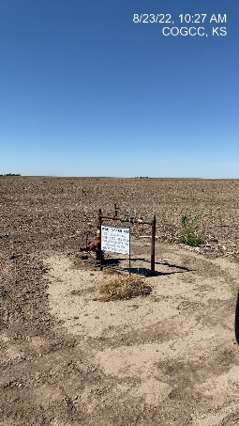
Operator: WME YATES
Location ID: 05-095-06418
Amherst Field STR – L1
MR - SIGNAGE
WELLHEAD - SIGNAGE

