Slide 1
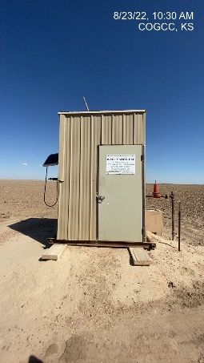
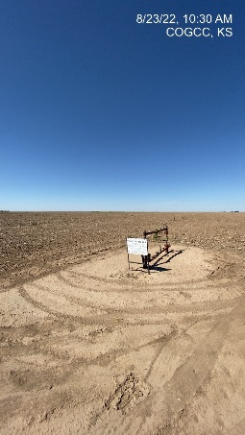
Operator: WME YATES
Location ID: 05-095-06206
Amherst Field STR – L2
MR - SIGNAGE
WELLHEAD - SIGNAGE

