Slide 1
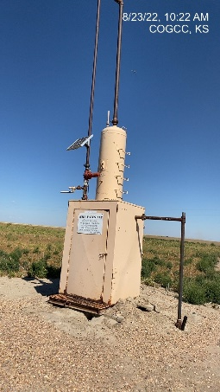
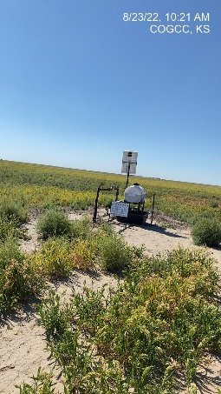
Operator: WME YATES
Location ID: 05-095-06243
Amherst Field Claymon 6-33
MR - SIGNAGE
WELLHEAD - SIGNAGE

