Slide 1
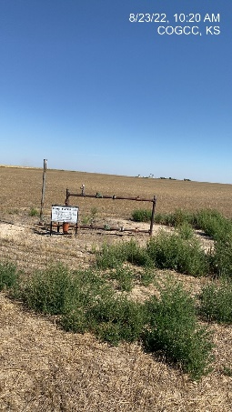
Operator: WME YATES
Location ID: 05-095-06314
Amherst Field Claymon L10
WELLHEAD
SIGNAGE

