Slide 1
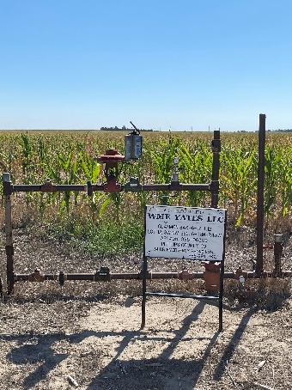
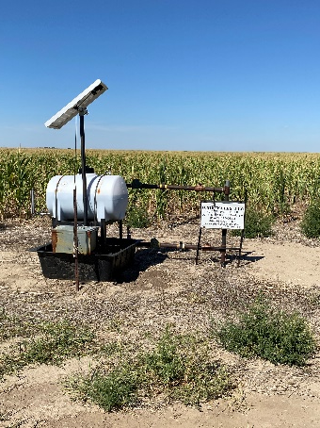
Operator: WME YATES
Location ID: 05-095-06309
Amherst Field Claymon L12
WELLHEAD
SIGNAGE

