Slide 1
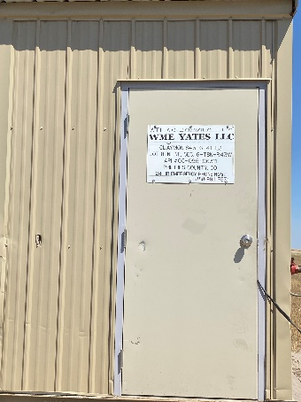
Operator: WME YATES
Location ID: 05-095-06311
Amherst Field Claymon L8
MR
SIGNAGE

