Slide 1
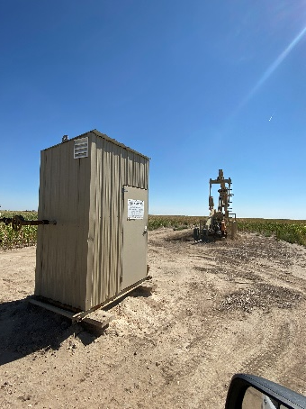
Operator: WME YATES
Location ID: 05-095-06316
Amherst Field Claymon L6
Wellhead-PJ-PM-Signage
MR

