Slide 1
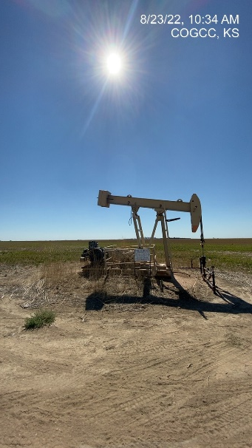
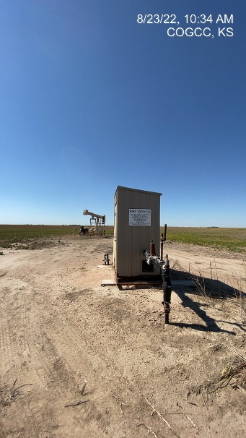
Operator: WME YATES
Location ID: 05-095-06088
Amherst Field Oltjenbruns 3-6
Wellhead-PJ-PM-Signage
MR

