Slide 1
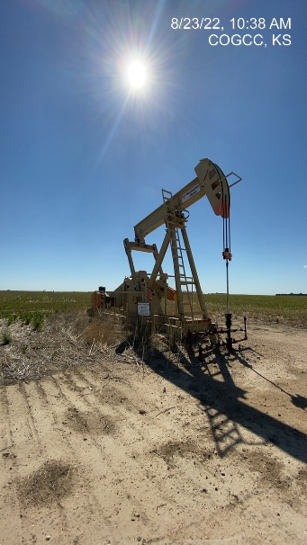
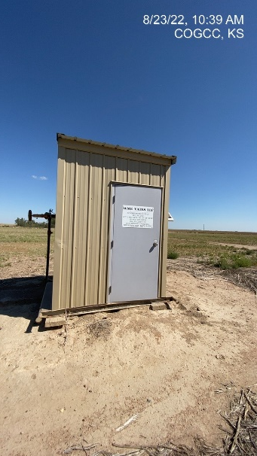
Operator: WME YATES
Location ID: 05-095-06352
Amherst Field Oltenbruns L2
Wellhead-PJ-PM-Signage
MR

