Slide 1
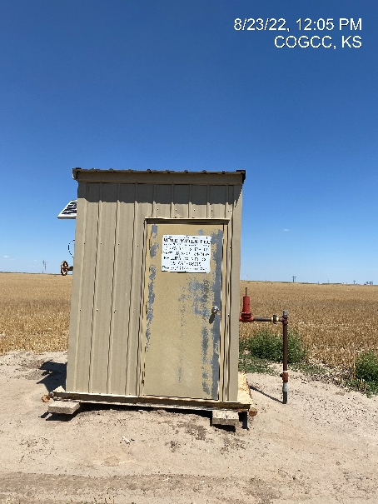
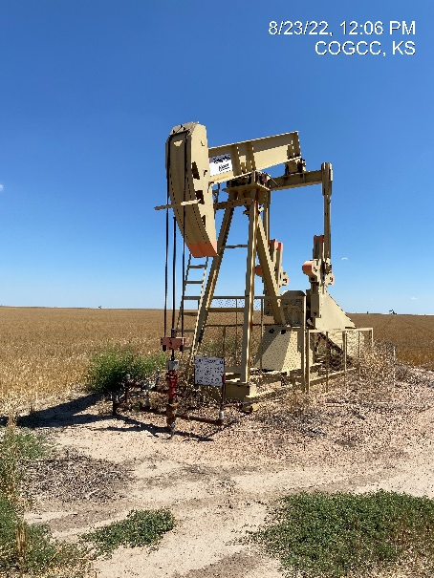
Operator: WME YATES
Location ID: 05-095-06215
Amherst Field Dirks 843-3-12-L12
MR – Calibration cert in place
Wellhead – PJ - PM

