Slide 1
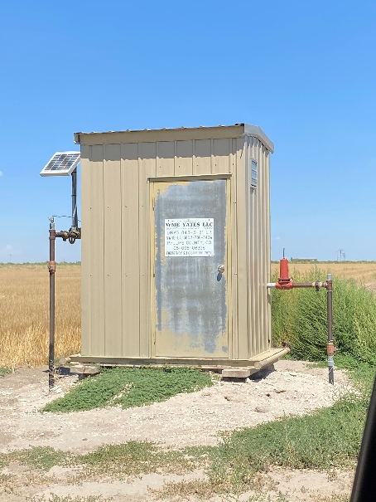
Operator: WME YATES
Location ID: 05-095-06396
Amherst Field Dirks 843-3-31-L7
Calibration cert in place
MR

