Slide 1
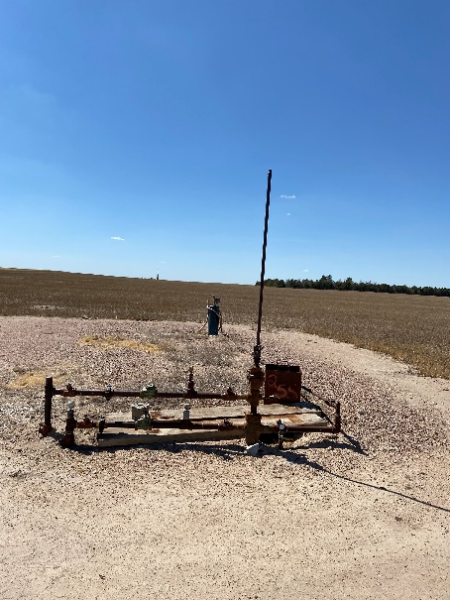
Operator: WME YATES
Location ID: 427414 05-095-06422
Amherst Field #2480 STATE 844-36-44
WELLHEAD
WELLHEAD

