Slide 1
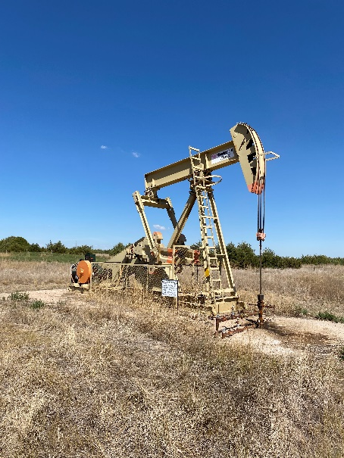
Operator: WME YATES
Location ID: 219870 05-095-06379
Amherst Field #2480
Signage @ wellhead
PJ @ wellhead

