Slide 1
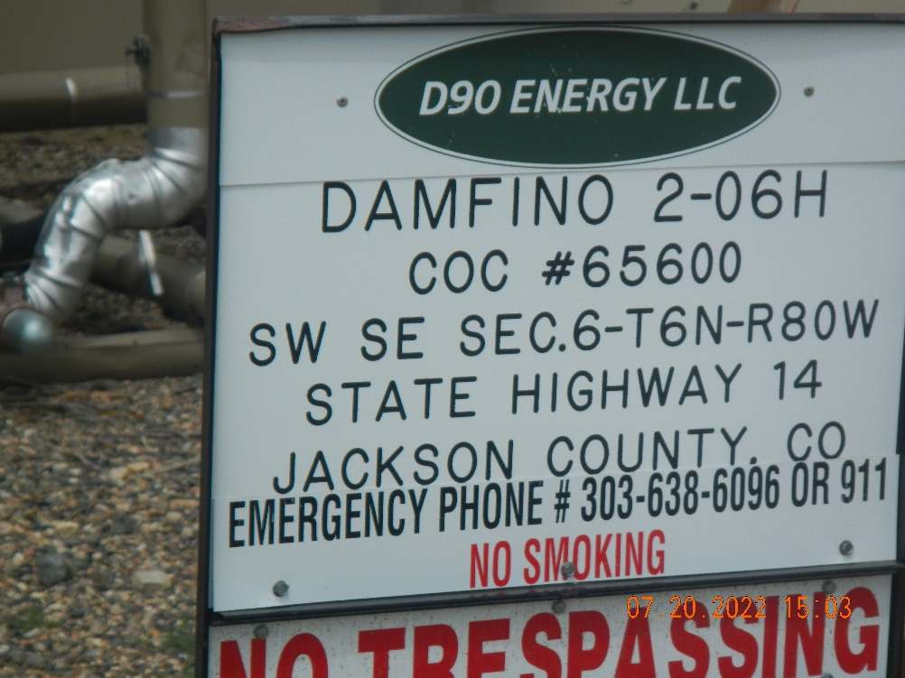
Inspection Photos location 416625
Inspection Date: 7/20/2022
All Photos taken by Kris Neidel
Photo #1 sign at tank battery

Slide 2
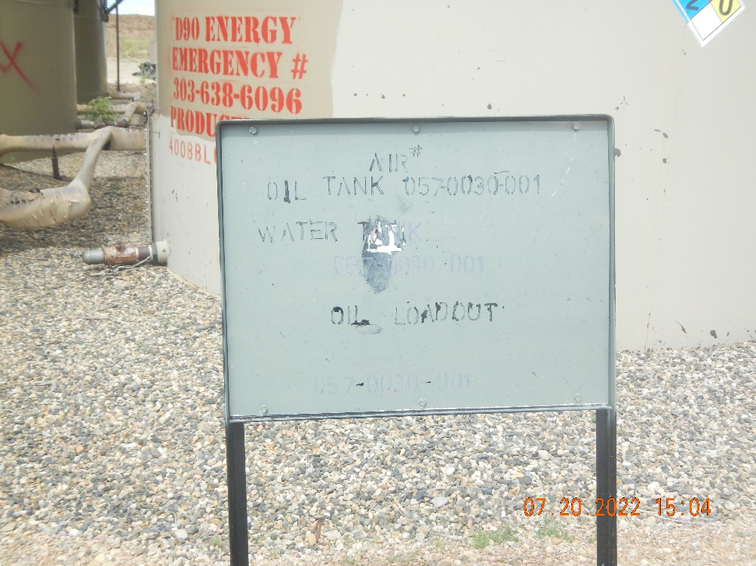
Inspection Photos location 416625
Inspection Date: 7/20/2022
All Photos taken by Kris Neidel
Photo #2 sing at tank battery

Slide 3
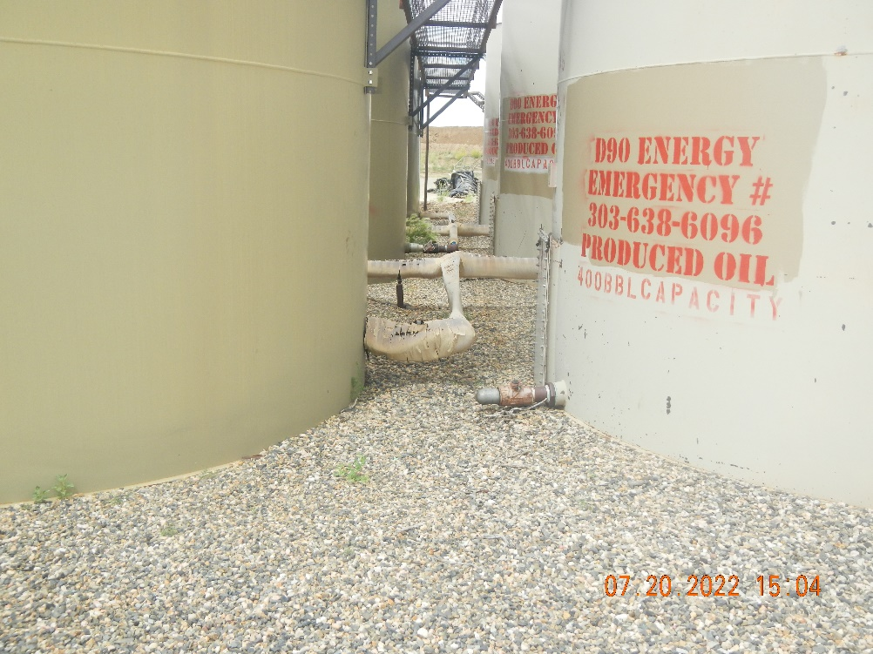
Inspection Photos location 416625
Inspection Date: 7/20/2022
All Photos taken by Kris Neidel
Photo #3 view of tank battery looking north-northeast.

Slide 4
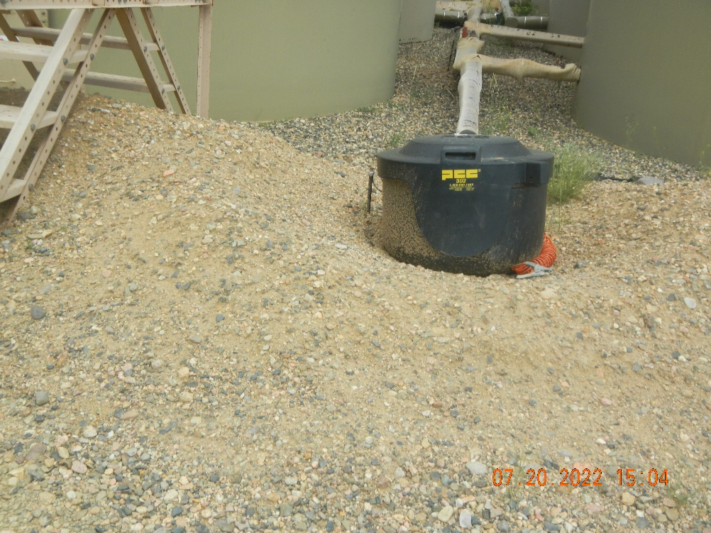
Inspection Photos location 416625
Inspection Date: 7/20/2022
All Photos taken by Kris Neidel
Photo #4 low spot in berm

Slide 5
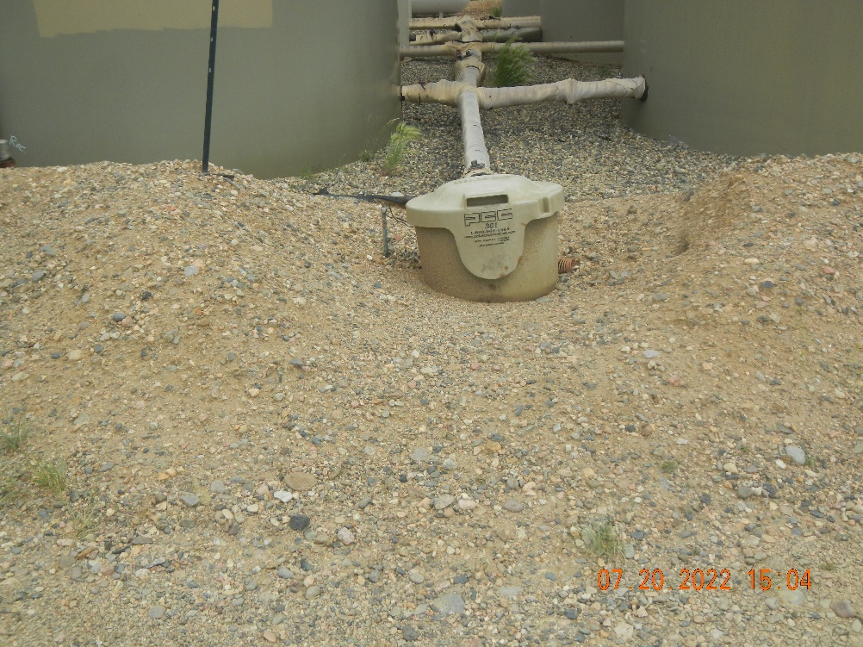
Inspection Photos location 416625
Inspection Date: 7/20/2022
All Photos taken by Kris Neidel
Photo #5 low spot in berm

Slide 6
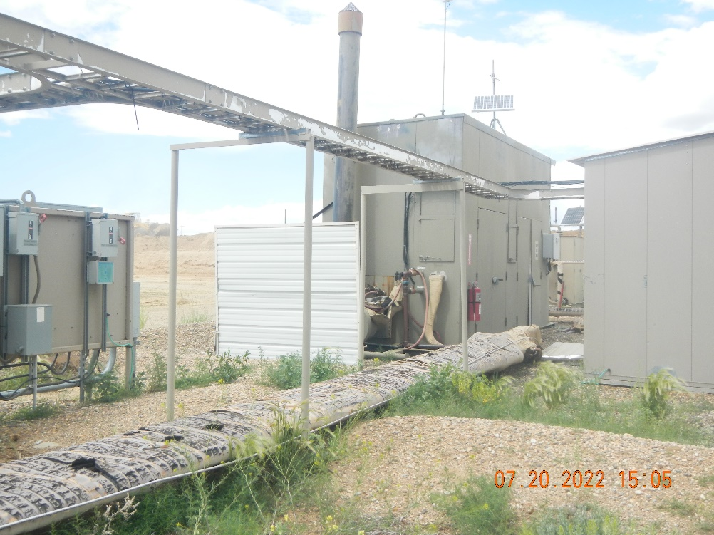
Inspection Photos location 416625
Inspection Date: 7/20/2022
All Photos taken by Kris Neidel
Photo #6 production equipment and weeds

Slide 7
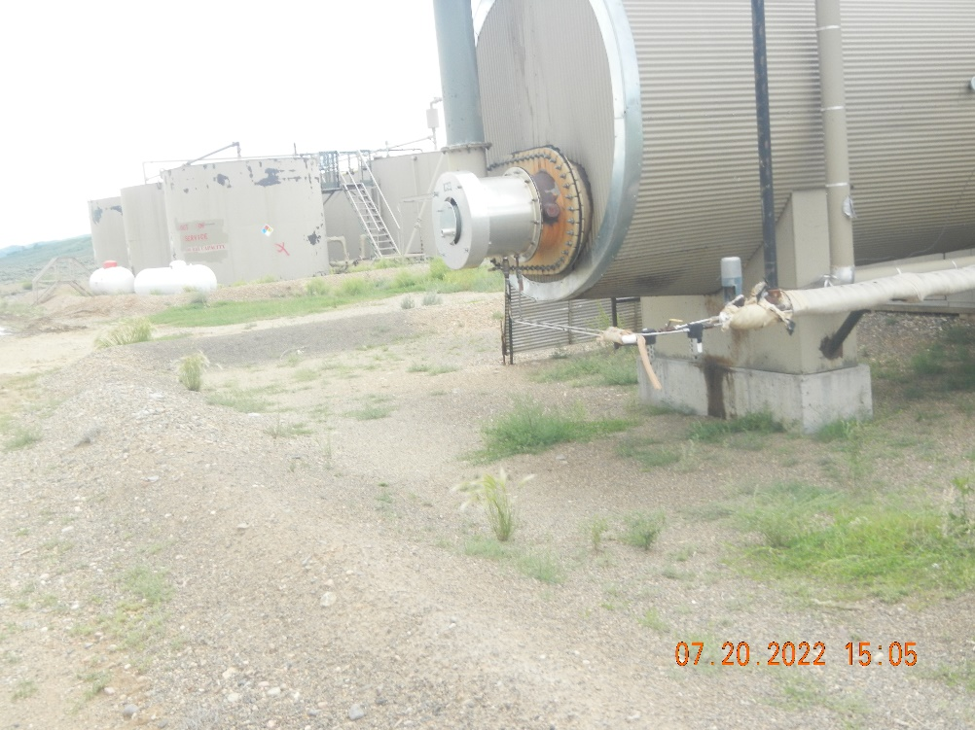
Inspection Photos location 416625
Inspection Date: 7/20/2022
All Photos taken by Kris Neidel
Photo #7 Production equiptment

Slide 8
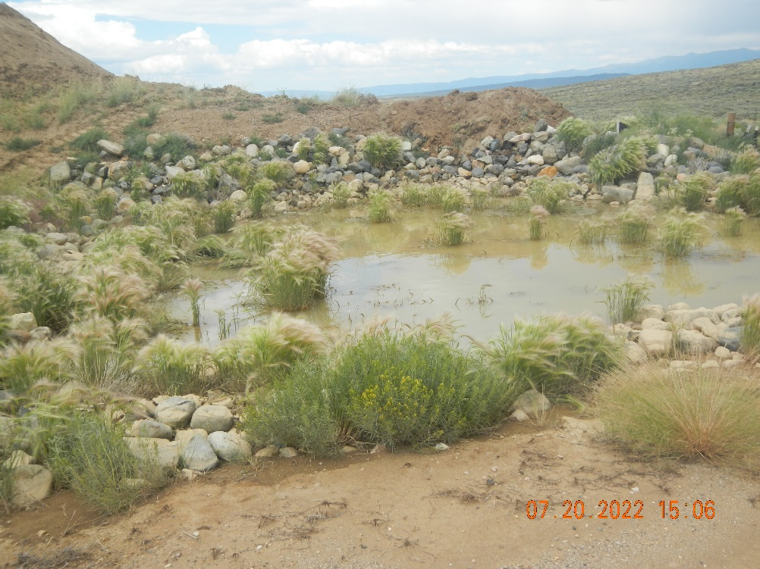
Inspection Photos location 416625
Inspection Date: 7/20/2022
All Photos taken by Kris Neidel
Photo #8 Stormwater discharge, settling/sediment pond, weeds

Slide 9
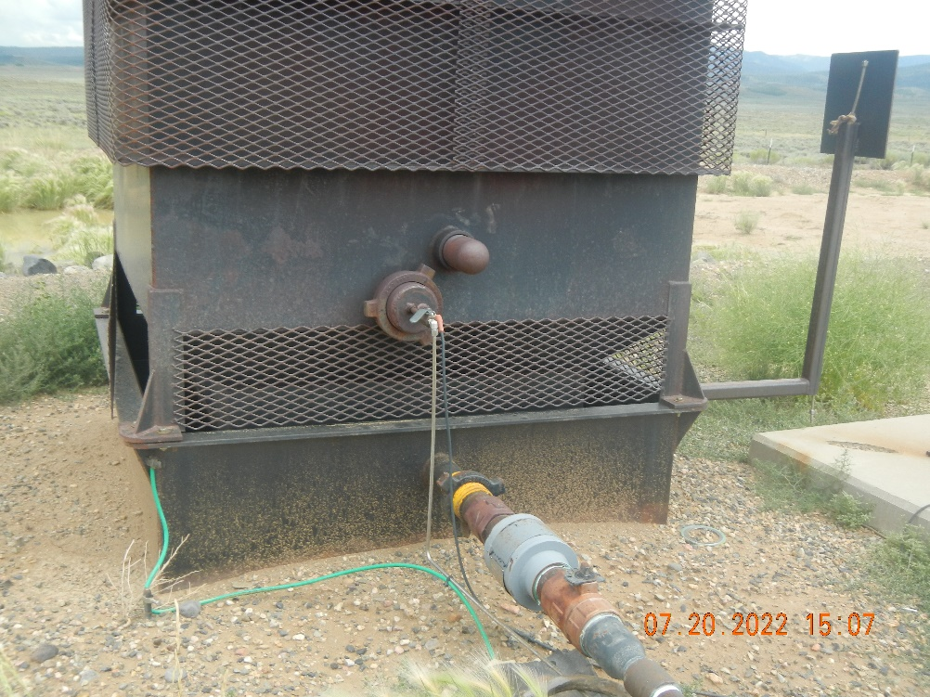
Inspection Photos location 416625
Inspection Date: 7/20/2022
All Photos taken by Kris Neidel
Photo #9 emissions control device, this was lit at the time of inspection, inspector could feel the heat.

Slide 10
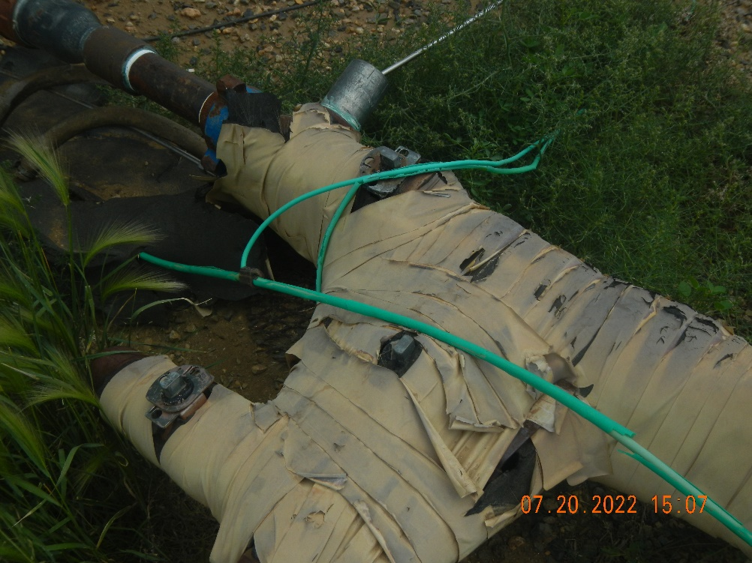
Inspection Photos location 416625
Inspection Date: 7/20/2022
All Photos taken by Kris Neidel
Photo #10 close up of photo #11 see bottom of #11

Slide 11
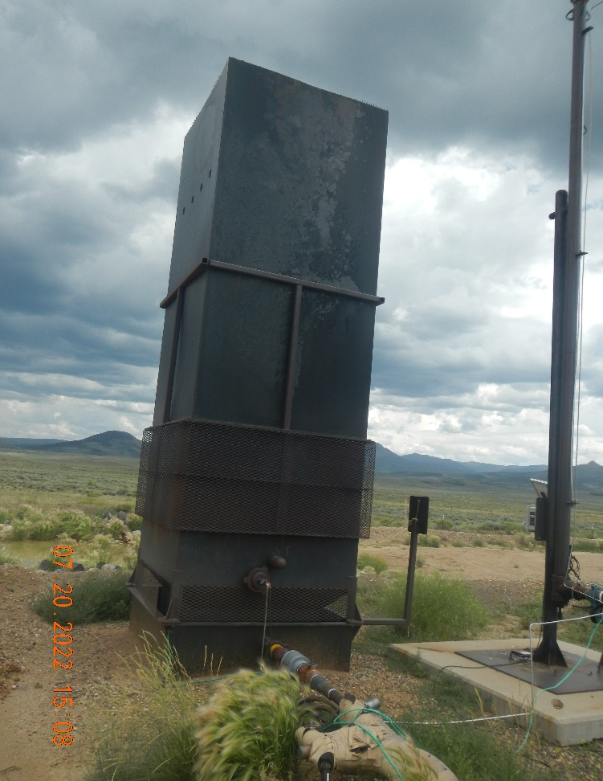
Inspection Photos location 416625
Inspection Date: 7/20/2022
All Photos taken by Kris Neidel
Photo #11 emission control device and weeds

Slide 12
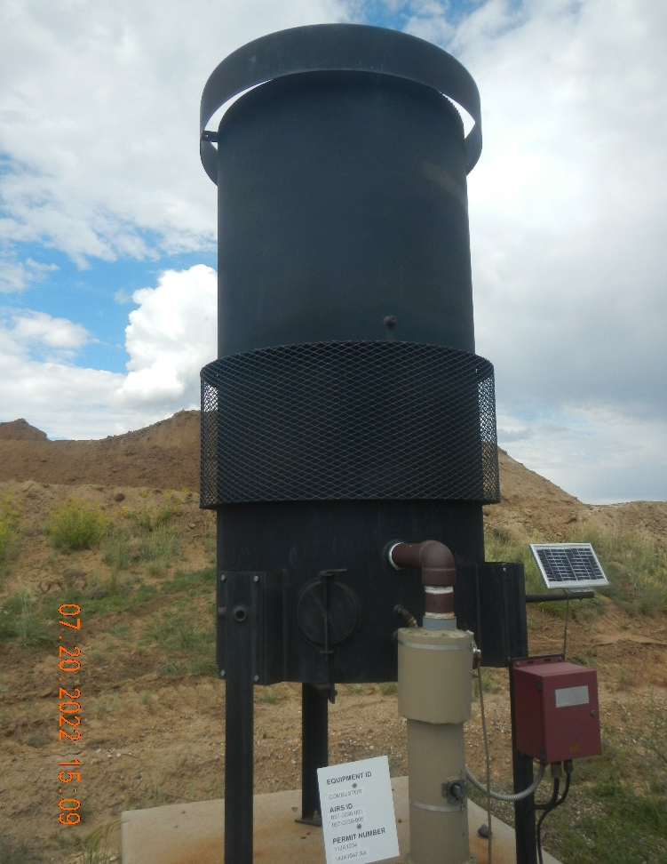
Inspection Photos location 416625
Inspection Date: 7/20/2022
All Photos taken by Kris Neidel
Photo #12 Combustor, was not lit at time of inspection.

Slide 13
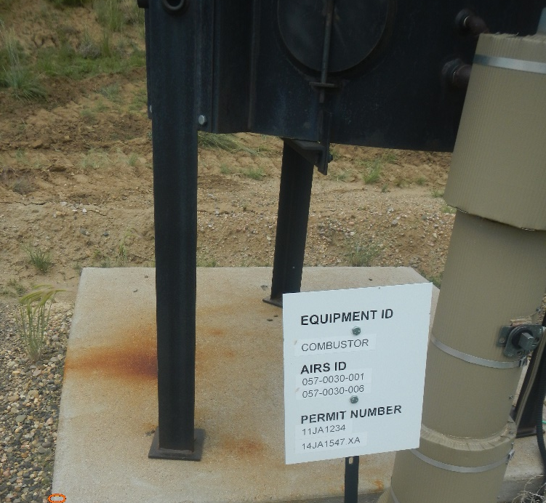
Inspection Photos location 416625
Inspection Date: 7/20/2022
All Photos taken by Kris Neidel
Photo #13 close up of sign in photo #12

Slide 14
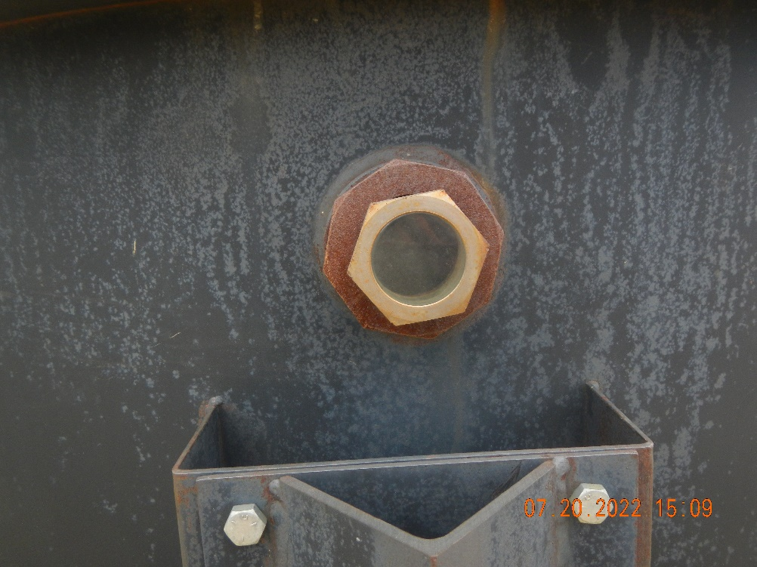
Inspection Photos location 416625
Inspection Date: 7/20/2022
All Photos taken by Kris Neidel
Photo #14 close up of photo #12 glass. Buster was not lit.

