Slide 1
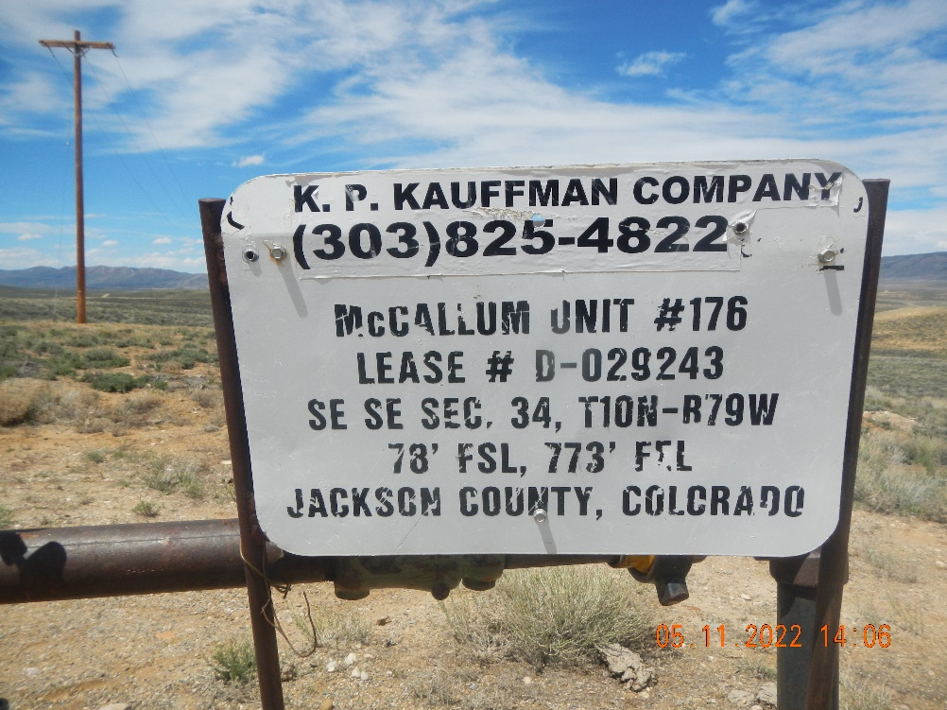
Inspection Photos
057-06427
Inspection Date: 5/11/2022
All Photos taken by Kris Neidel
Photo #1 Sign at wellhead.

Slide 2
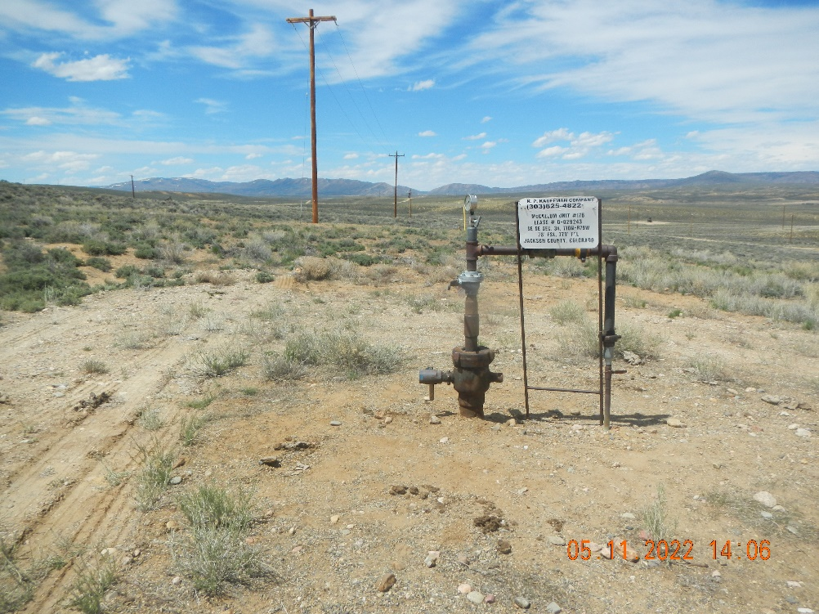
Inspection Photos
057-6427
Inspection Date: 5/11/2022
All Photos taken by Kris Neidel
Photo #1 wellhead on pad, no other equipment. MIT was for continued SH status

Slide 3
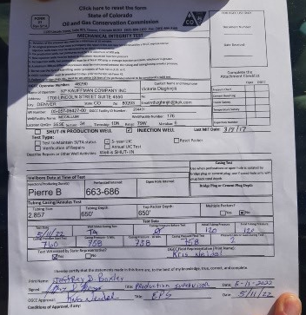
Inspection Photos
057-06427
Inspection Date: 5/11/2022
All Photos taken by Kris Neidel
Photo #3 Date of Test 5/11/22 status during test TA, starting Casing P=0, Initial tubing P=120 Final Tubing P=120. Casing P start test=760, Casing annual 5 min 758, Casing annual 10 min =758, Casing annual 15 min= 758, Pressure Lost during Test=2

