Slide 1

GMT Exploration Company LLC, Marble 6-65 24-12 1HN
039-06693
Inspection #688312591
4/25/2022
Surface Cementing/Spill Inspection

Slide 2
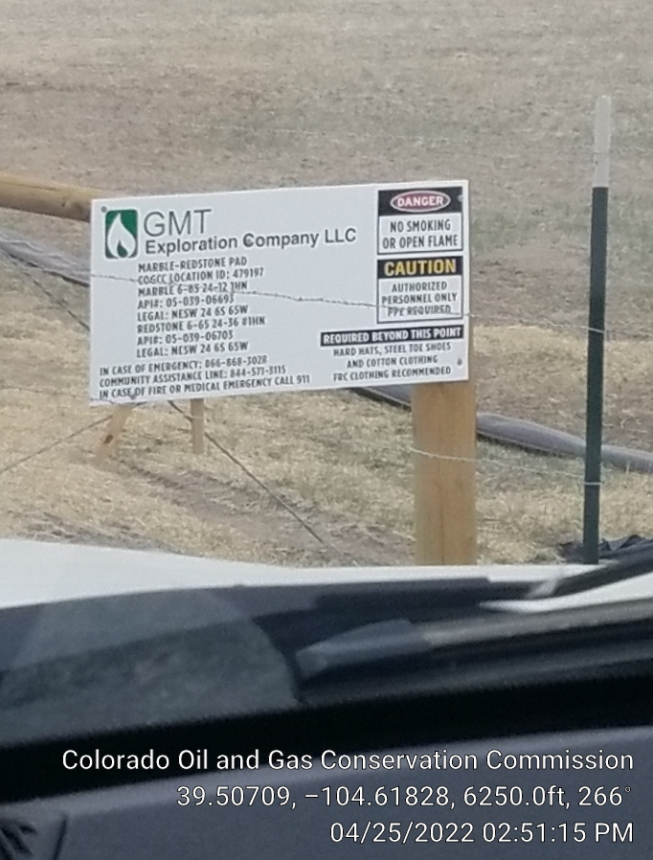

Slide 3
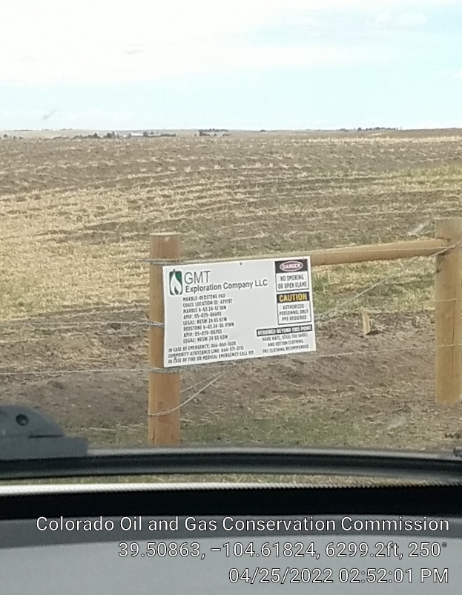

Slide 4
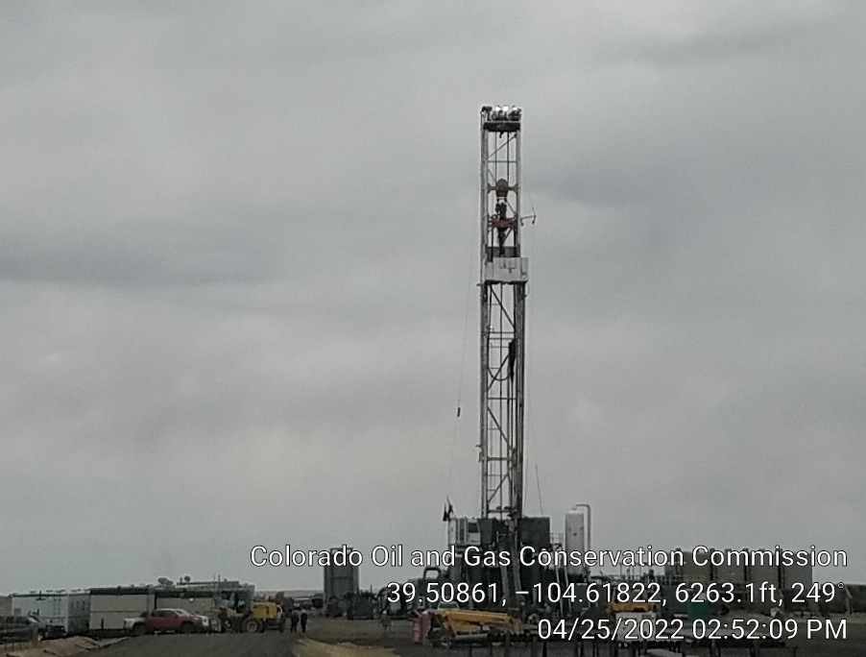
Ensign 161 rig

Slide 5
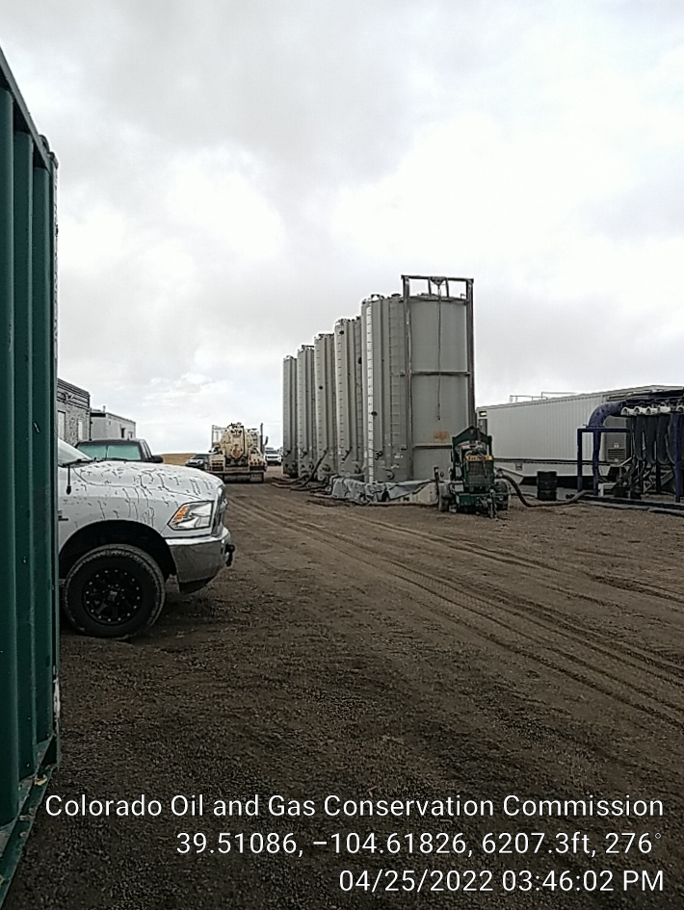
Four water tanks and one D822 tank (closest to me). Labeling needed on all (done) and containment for D822 tank.

Slide 6
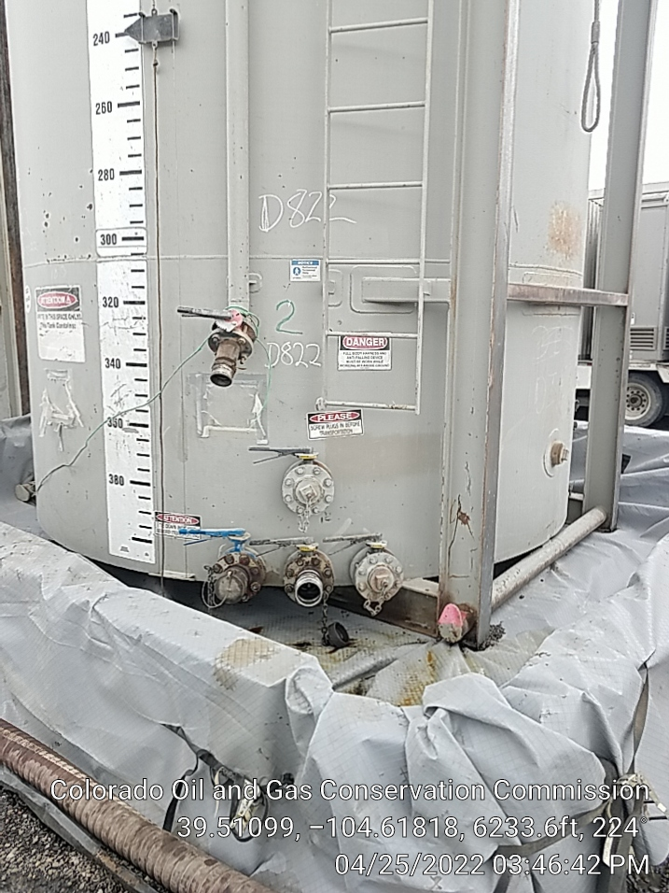

Slide 7
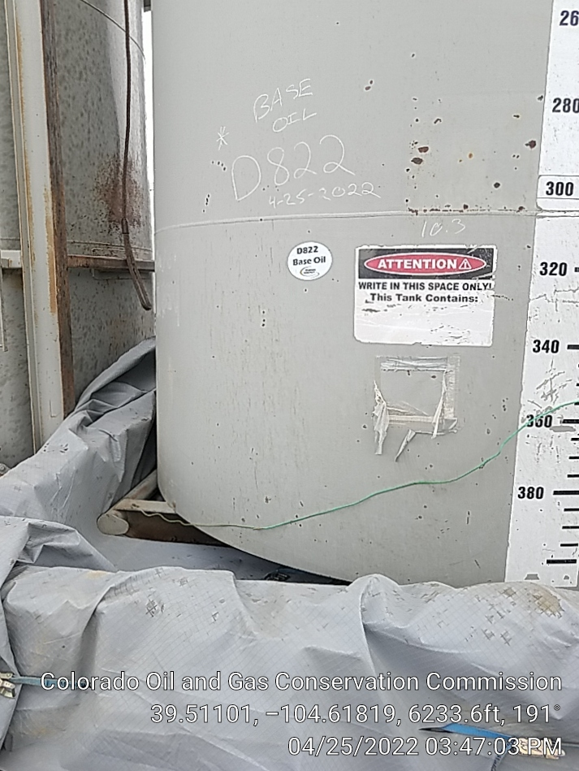

Slide 8
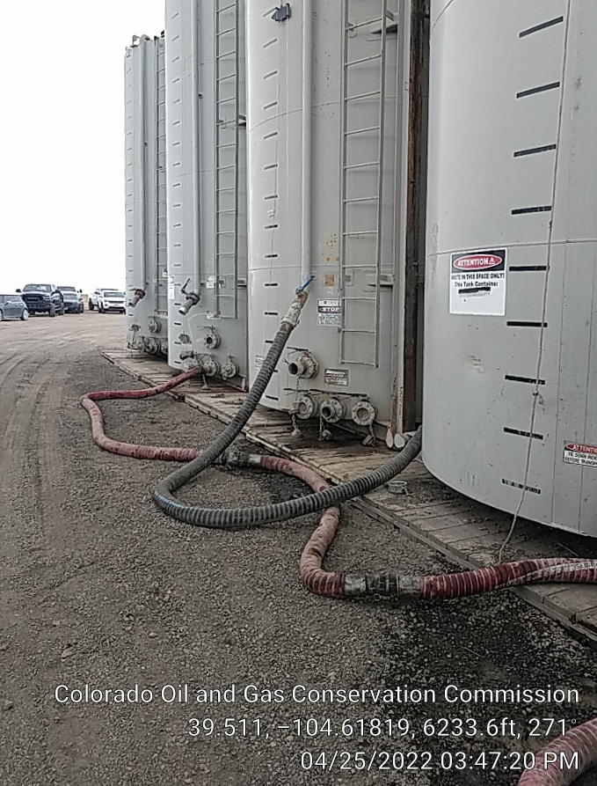

Slide 9
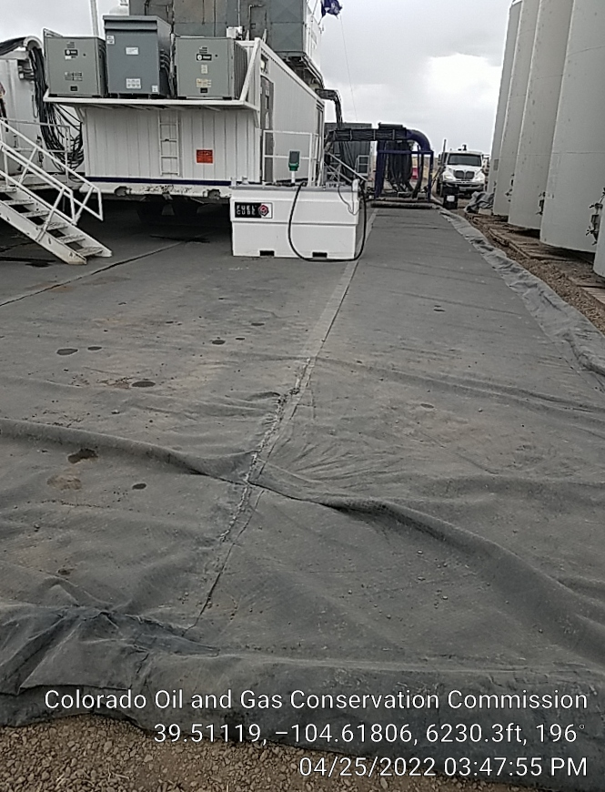
Shows backside of water and D822 tanks.

Slide 10
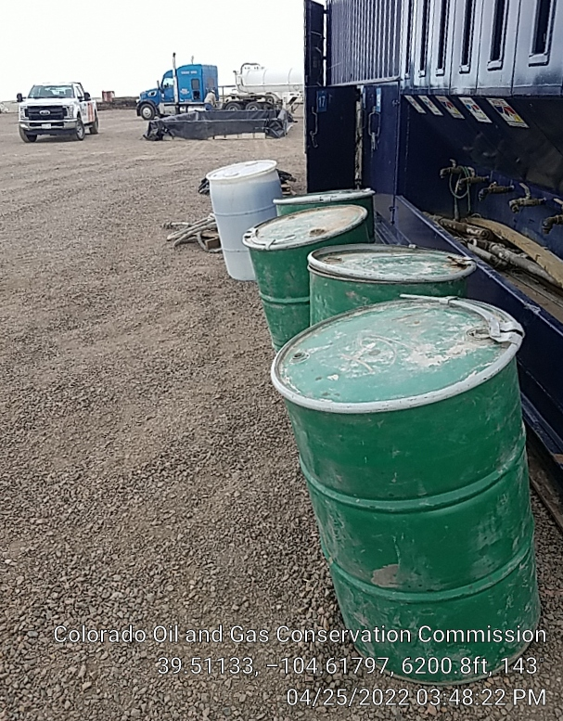
These drums were maintained ASAP.

Slide 11
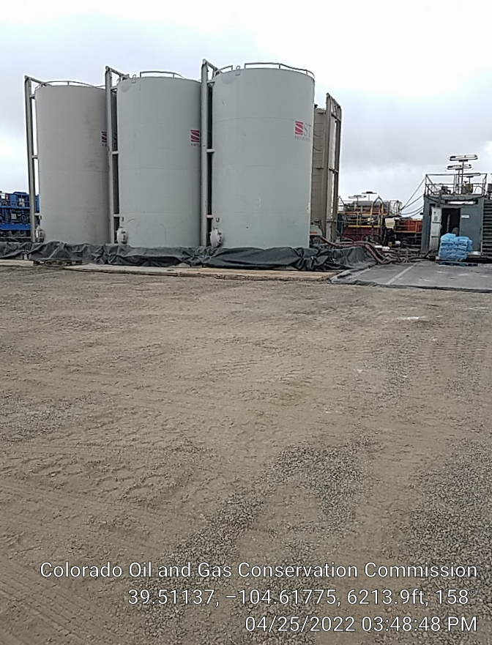
Mud tanks.

Slide 12
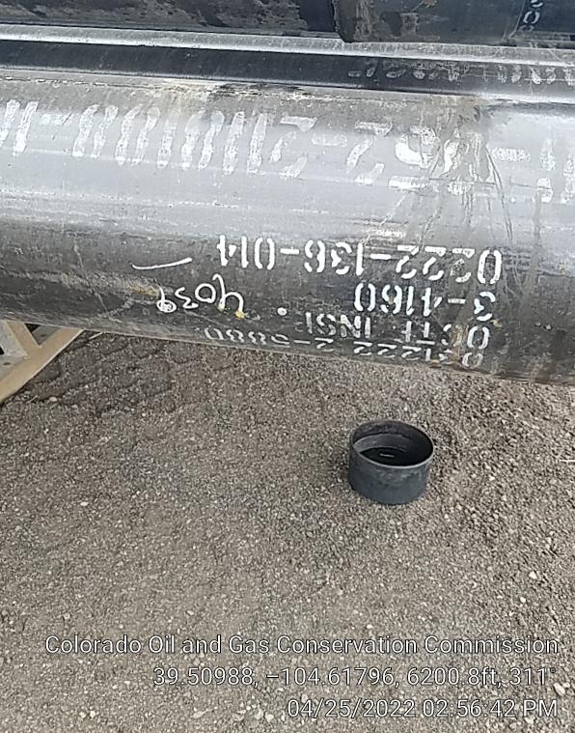
Surface casing 9 5/8”, J-55 LTC pipe. 12 ½” hole.

Slide 13
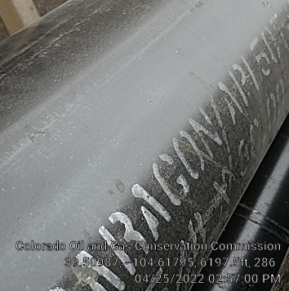
Surface casing.

Slide 14
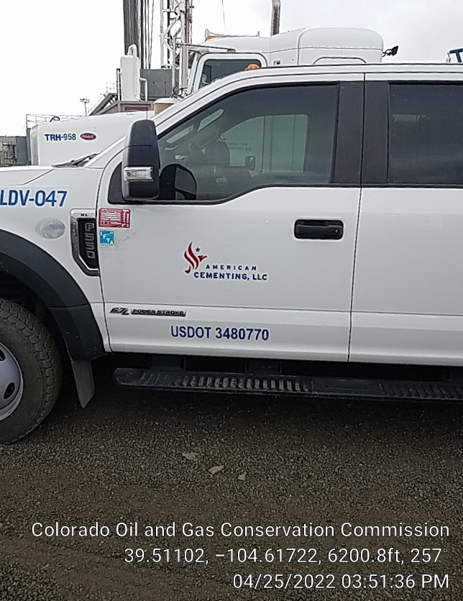

Slide 15


