Slide 1
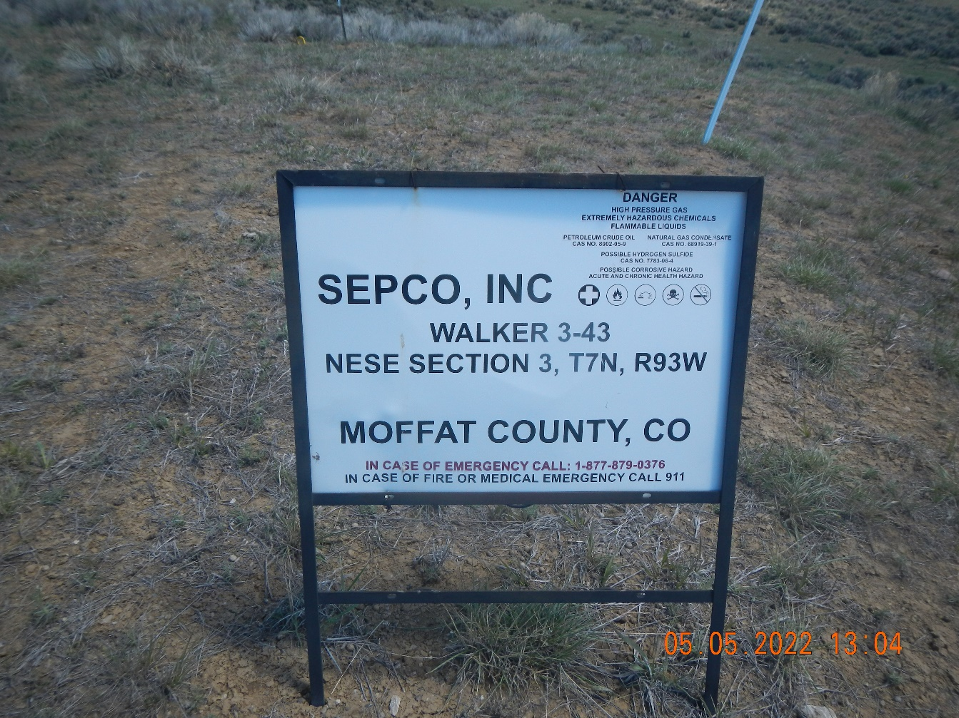
Inspection Photos
081-07156
Inspection Date: 5/5/2022
All Photos taken by Kris Neidel
Photo #1 sign at location.

Slide 2
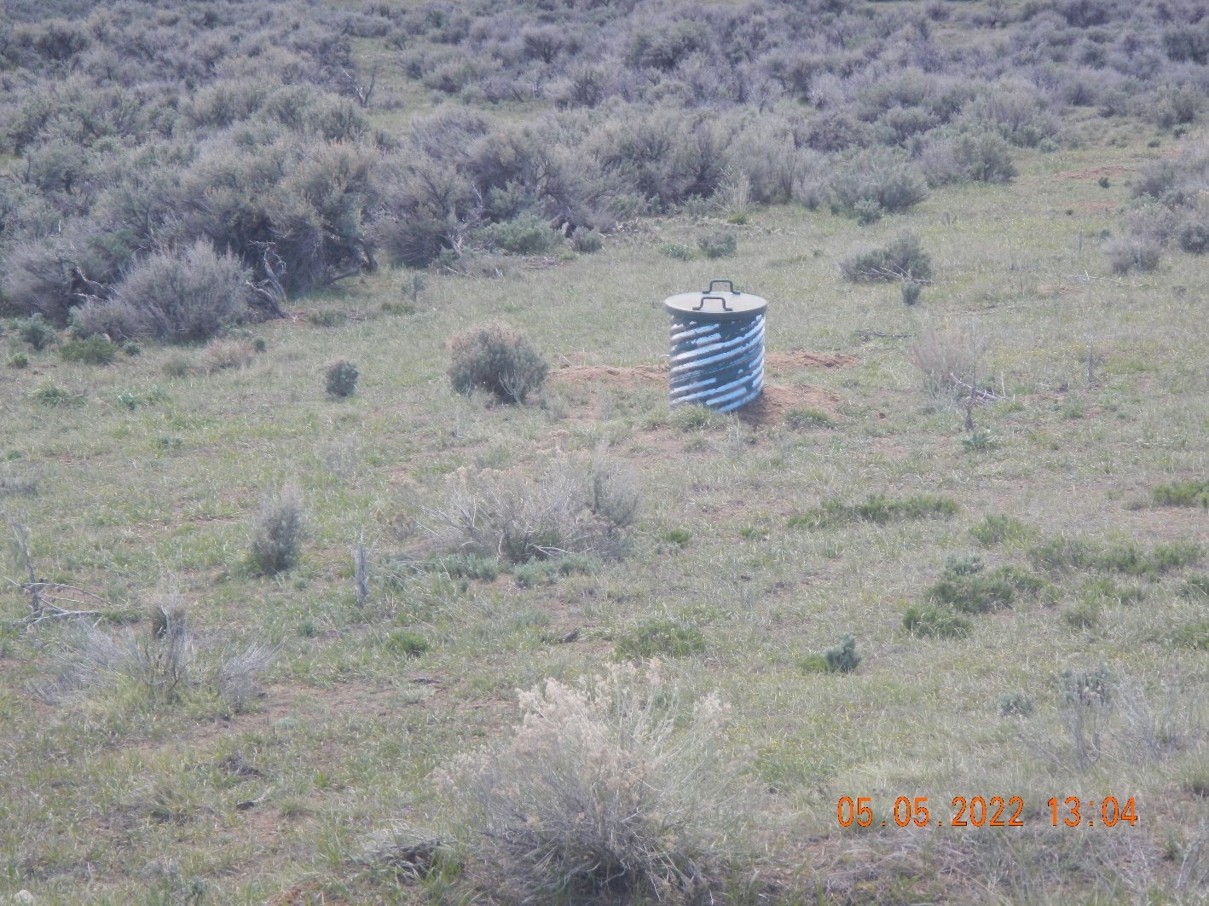
Inspection Photos
081-07156
Inspection Date: 5/5/2022
All Photos taken by Kris Neidel
Photo #2 valve box off location in obvious flowline right of way.

Slide 3
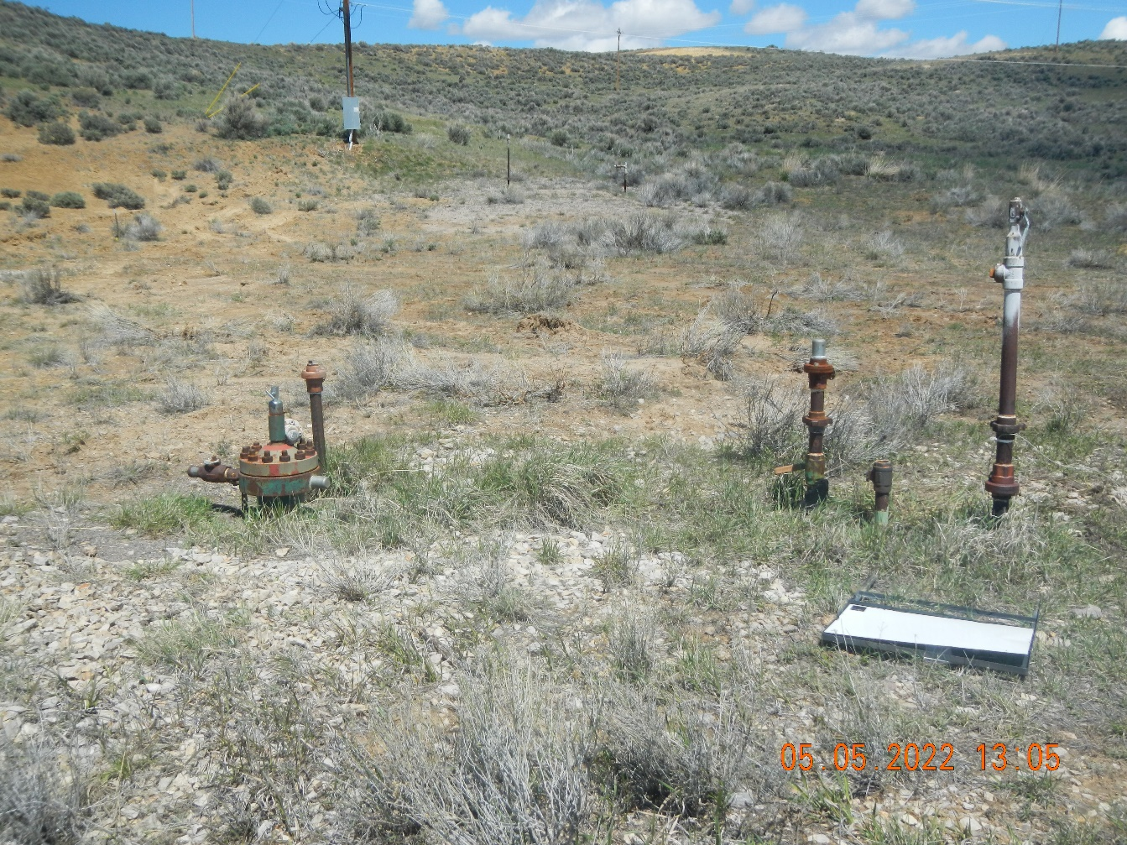
Inspection Photos
081-07156
Inspection Date: 5/5/2022
All Photos taken by Kris Neidel
Photo #3 wellhead and buried flowlines.

Slide 4
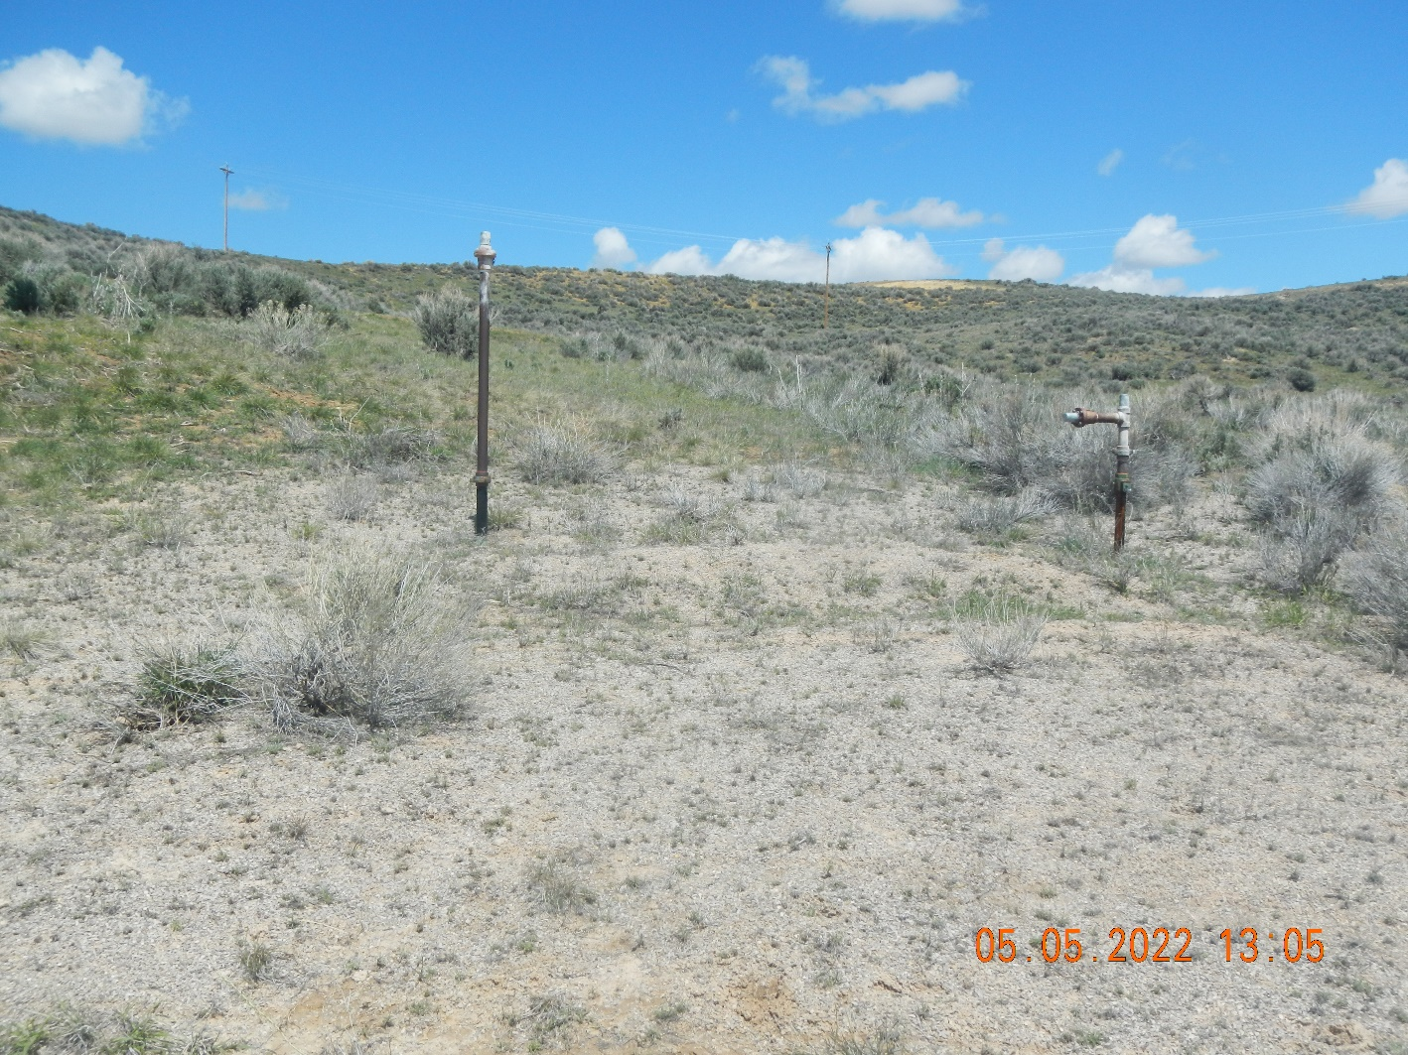
Inspection Photos
081-07156
Inspection Date: 5/5/2022
All Photos taken by Kris Neidel
Photo #4 flowline risers from removed equipment. The Form 27 should include an investigation in this area.

Slide 5
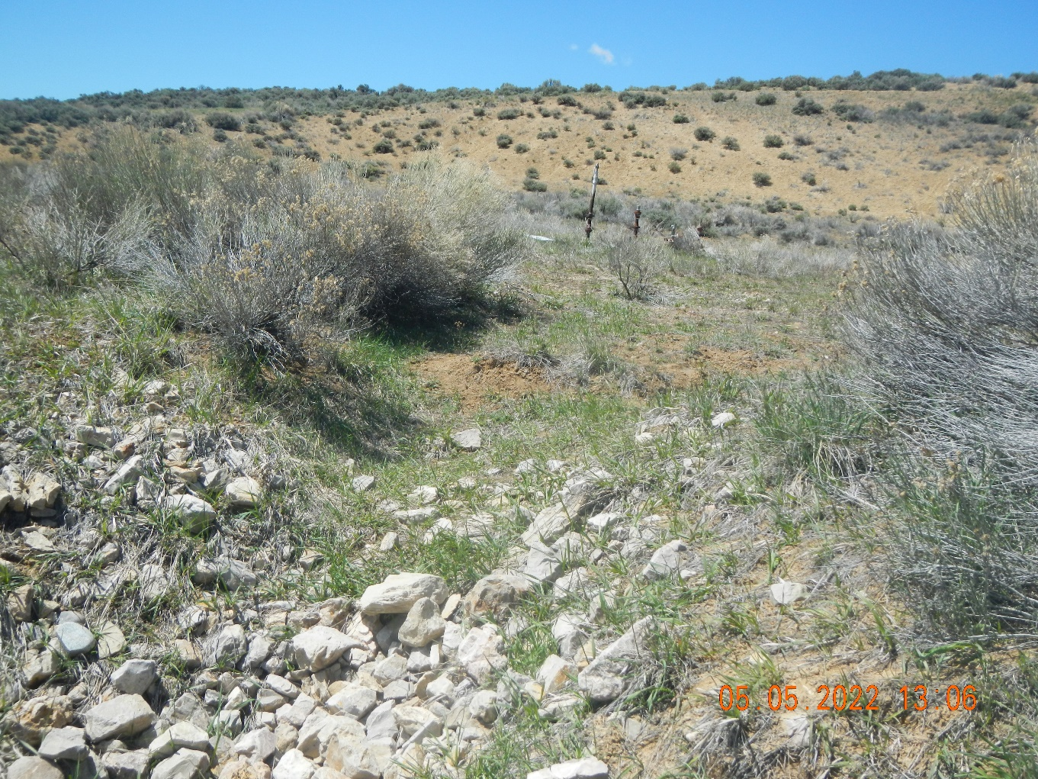
Inspection Photos
081-07156
Inspection Date: 5/5/2022
All Photos taken by Kris Neidel
Photo #5 this appears to be a surface water diversion off the side of the location to adjacent grazing land.

Slide 6
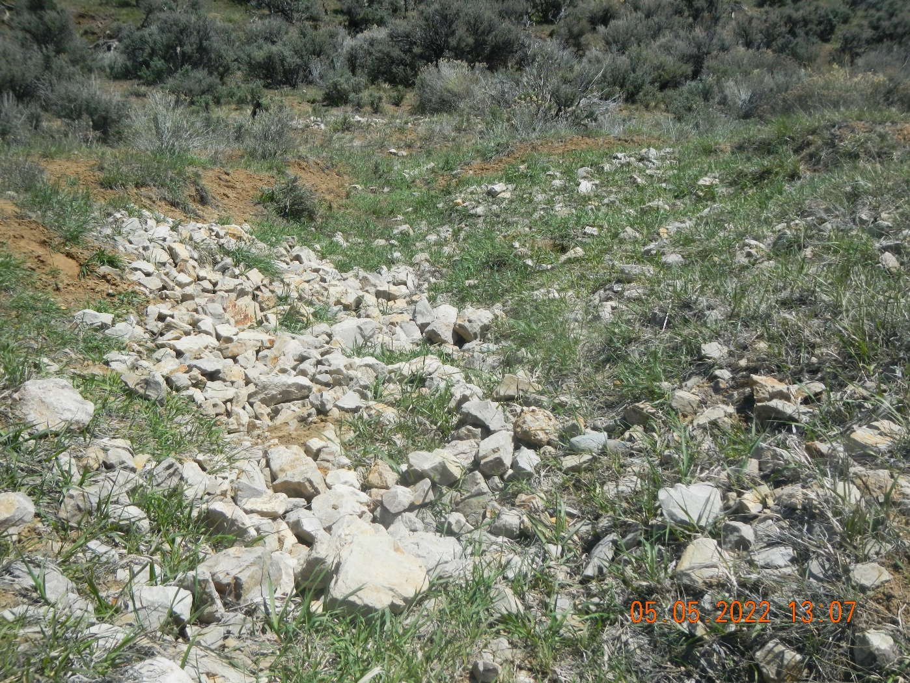
Inspection Photos
081-07156
Inspection Date: 5/5/2022
All Photos taken by Kris Neidel
Photo #6 another view of Photo #5

Slide 7
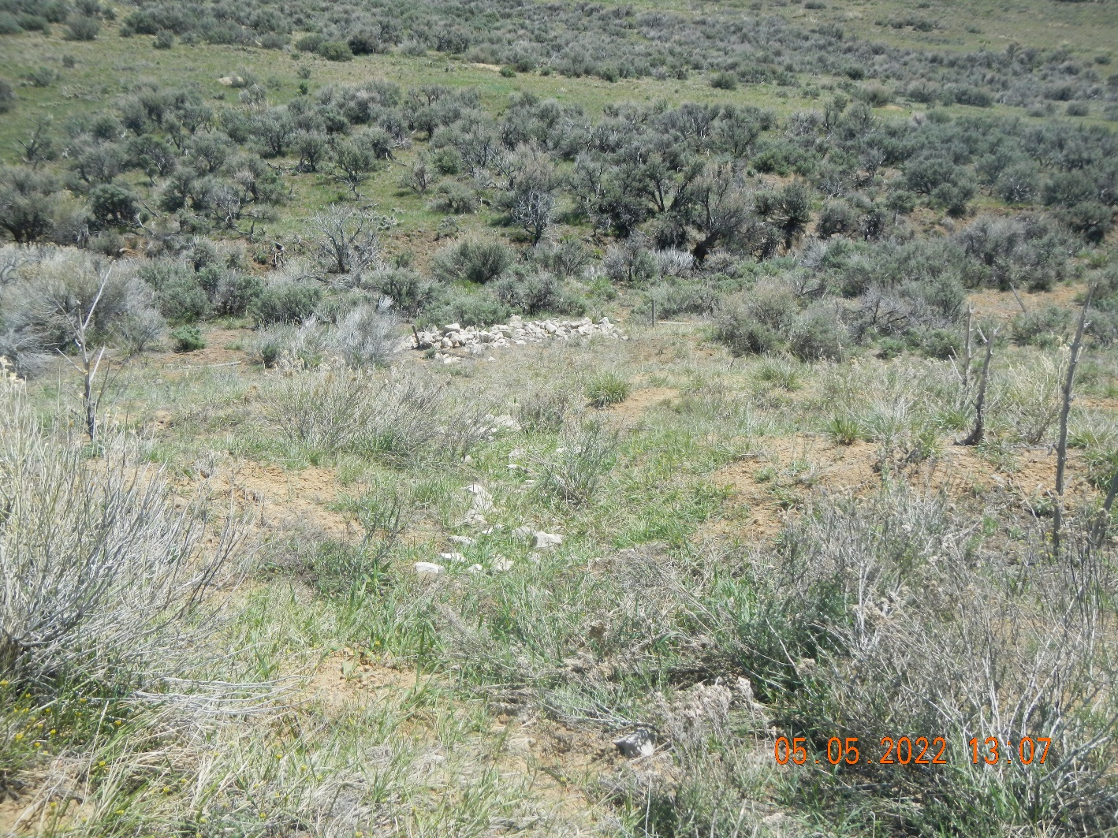
Inspection Photos
081-07156
Inspection Date: 5/5/2022
All Photos taken by Kris Neidel
Photo #7 appears to be a second surface water discharge from location to adjacent land.

