Slide 1
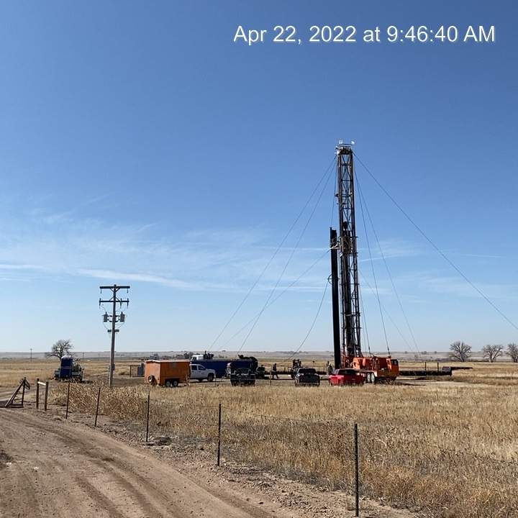
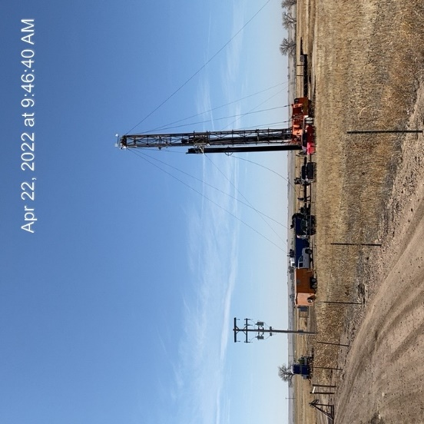
Operator: Citation Oil and Gas Corp.
Location ID: 075-09326
Dubois 5
WO – Rig On Site – MIRU preparing to PA.
WO- Rig On Location

