Slide 1
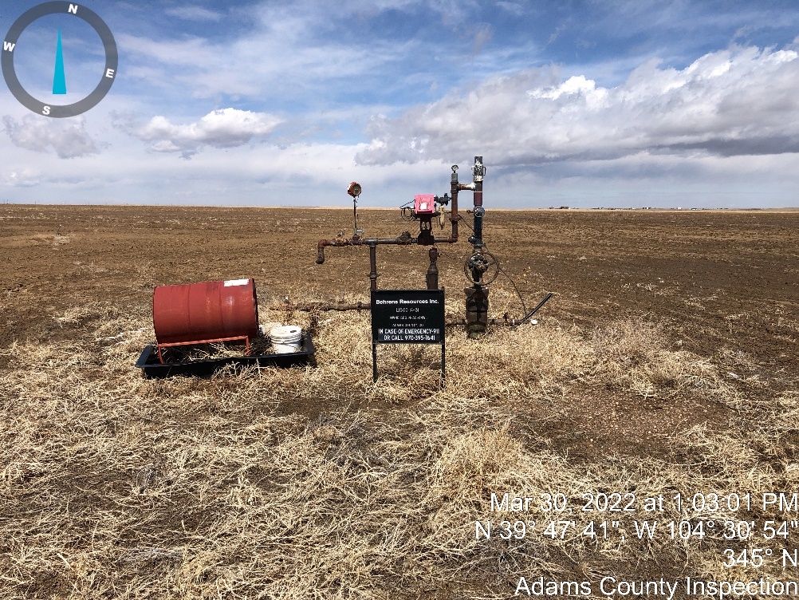
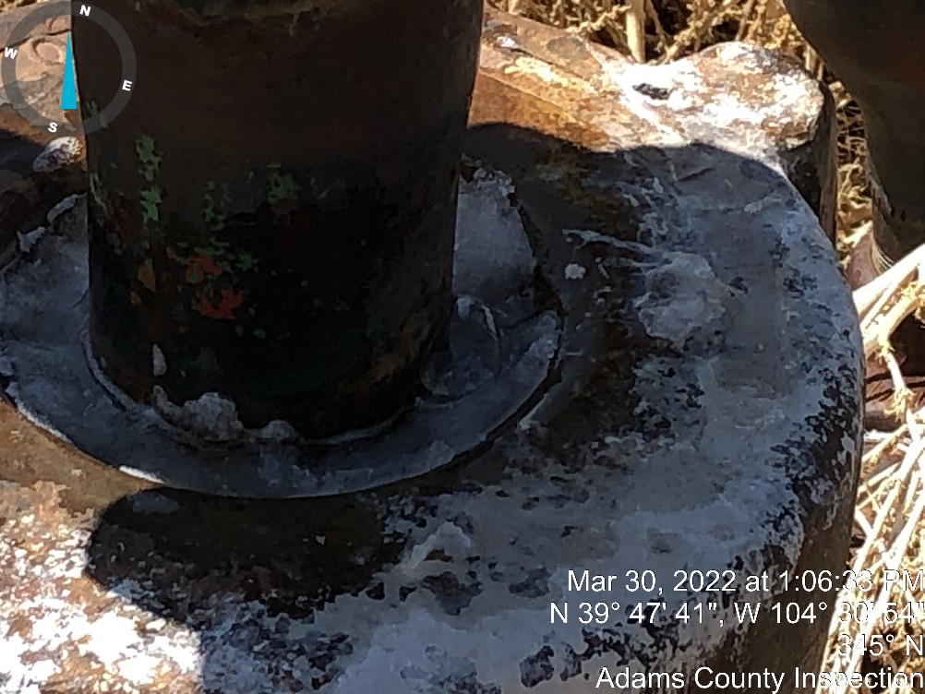
Inspection Photos
Location Name: C Lisco 14-31
Location ID:320104
Photo #1 Well Head and chemical Barrel.
Photo #2 well head leaking at packing

Slide 2
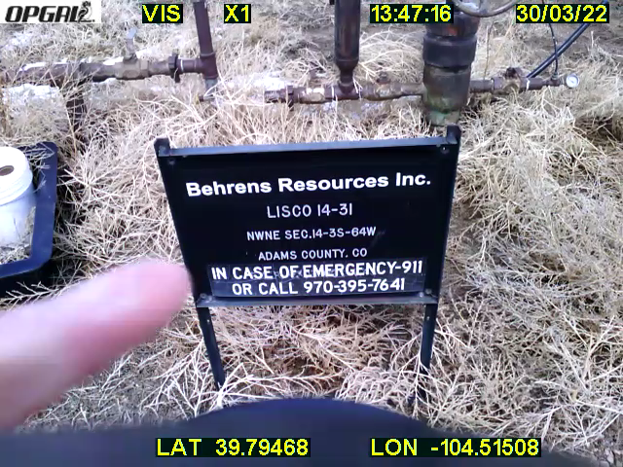
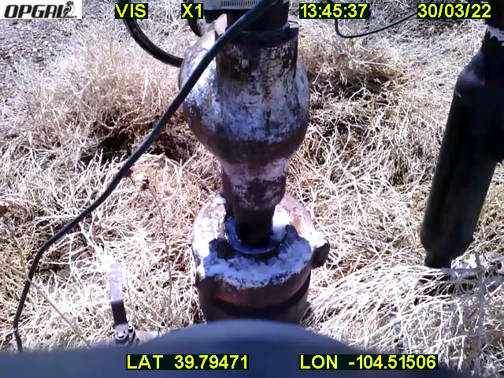
Inspection Photos
Location Name: C Lisco 14-31
Location ID:320104
Video #1 of packing leaking at well head.
Video #2 of packing leaking at well head.

