Slide 1
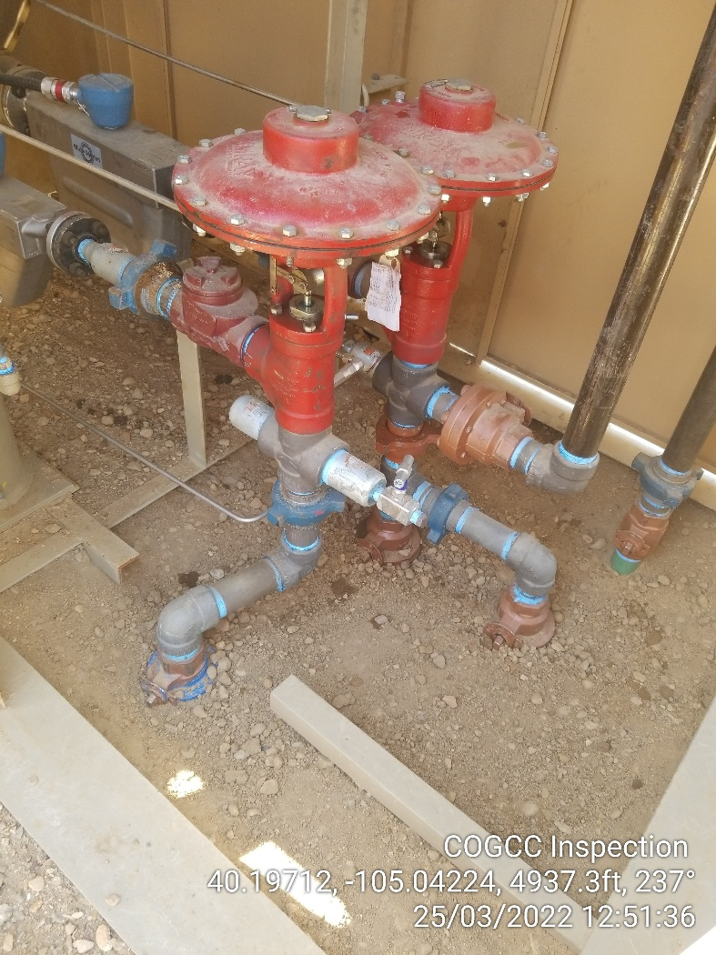
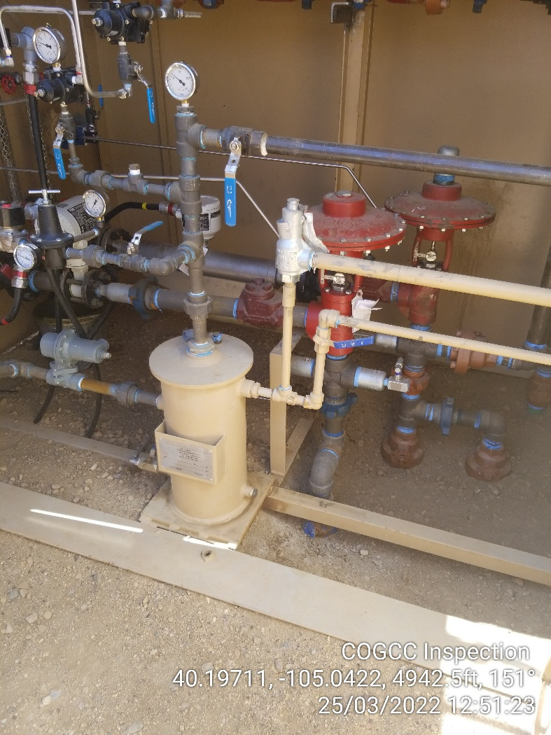

Inspection Photos
Location Name: Cub-Creek Knight Pad
Facility ID: 457362
Photo 1 – Staining from drips inside separator shed. Note: Separators are inside lined containment.
Photo 2 – Staining from drips inside separator shed. Note: Separators are inside lined containment.

Slide 2
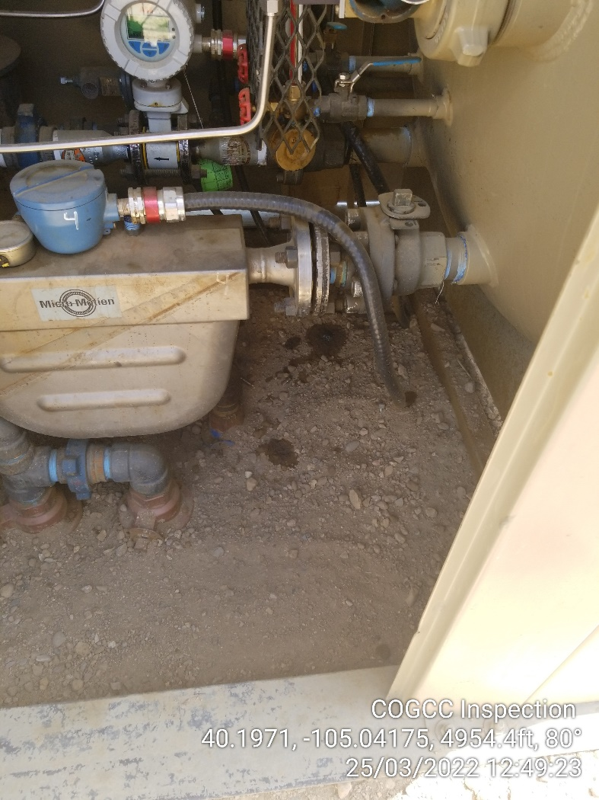
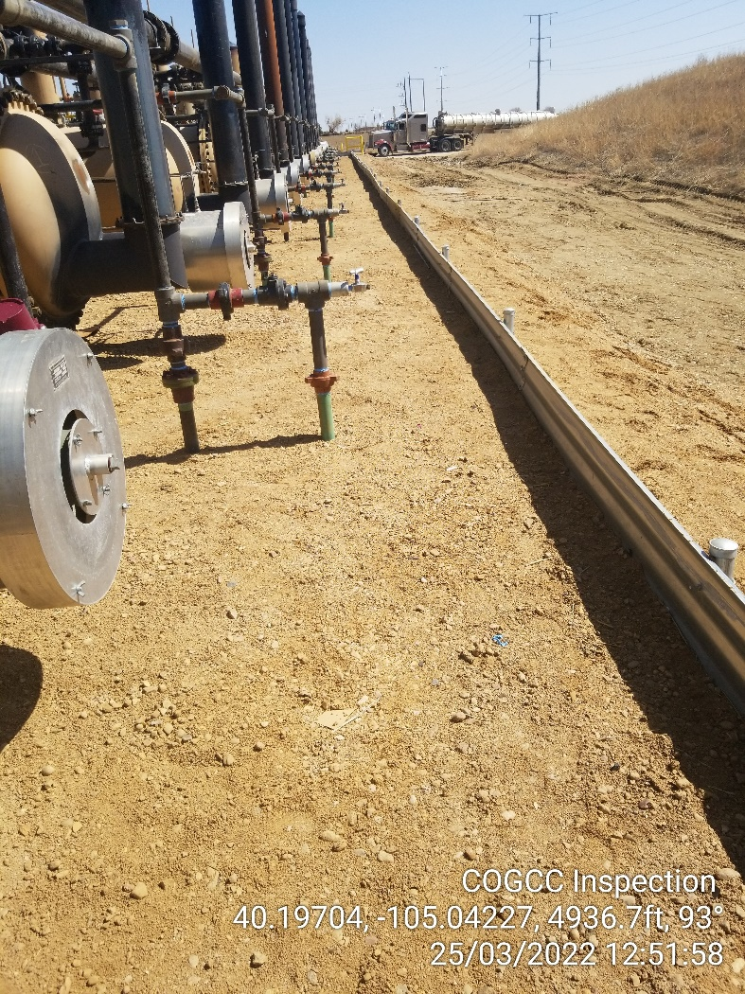
Inspection Photos
Location Name: Cub-Creek Knight Pad
Facility ID: 457362
Photo 3 – Staining from drips inside separator shed. Note: Separators are inside lined containment.
Photo 4 – Lined containment berm around all separators.

Slide 3
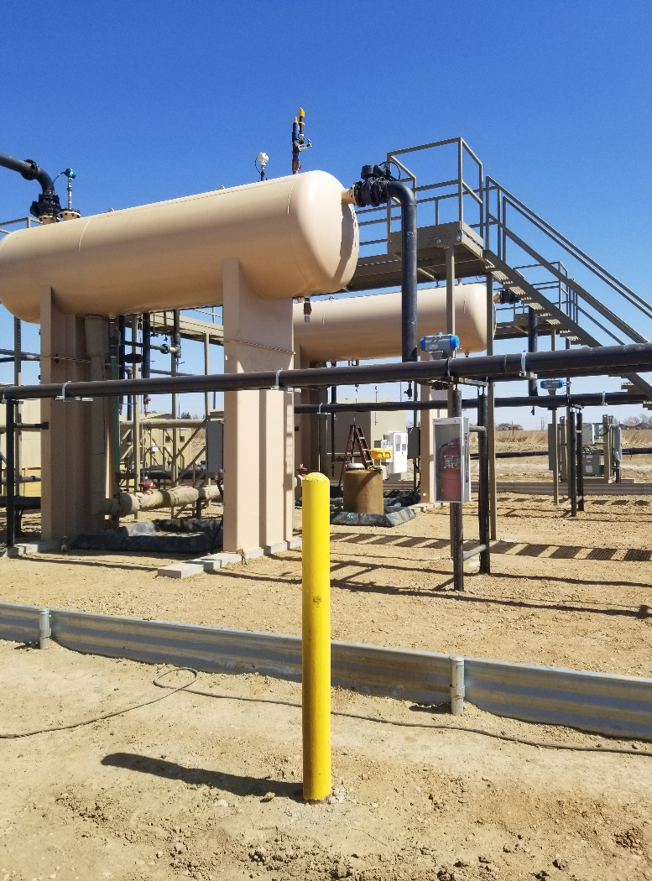
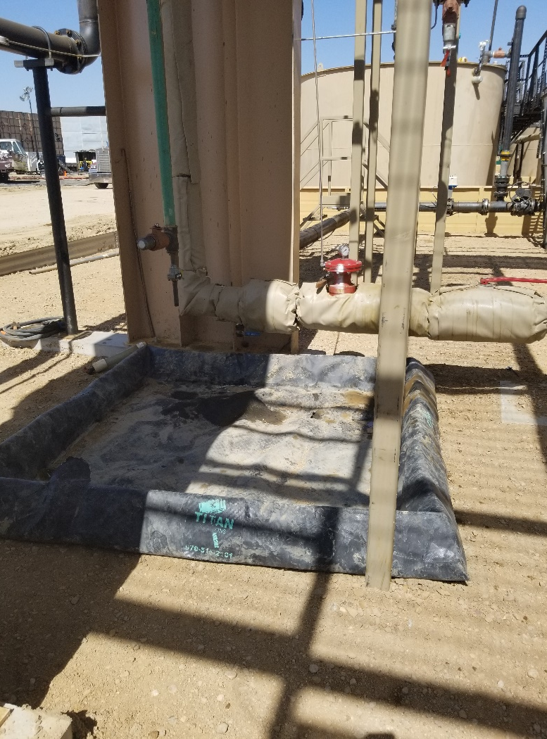
Inspection Photos
Location Name: Cub-Creek Knight Pad
Facility ID: 457362
Photo 5 – Production area inside lined containment.
Photo 6 – Drip catch liners inside lined containment.

Slide 4
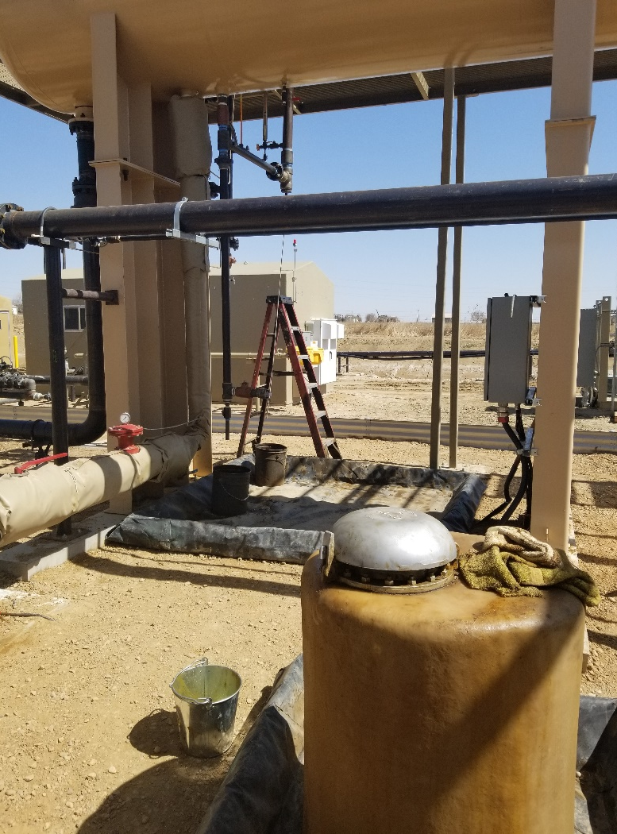
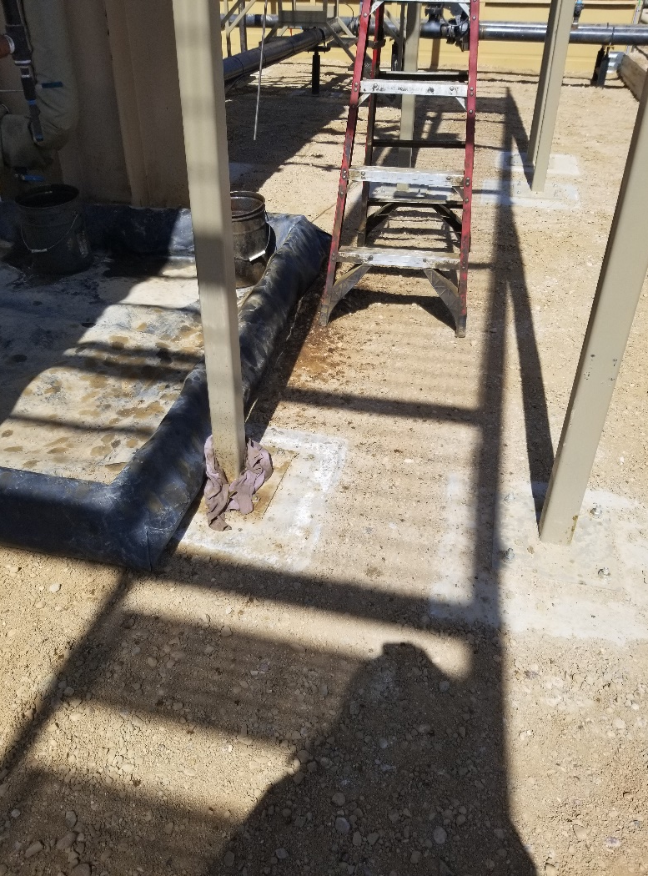
Inspection Photos
Location Name: Cub-Creek Knight Pad
Facility ID: 457362
Photo 7 – Drip catch liners inside lined containment.
Photo 8 – Drip catch liners inside lined containment with staining adjacent to drip catch.

Slide 5
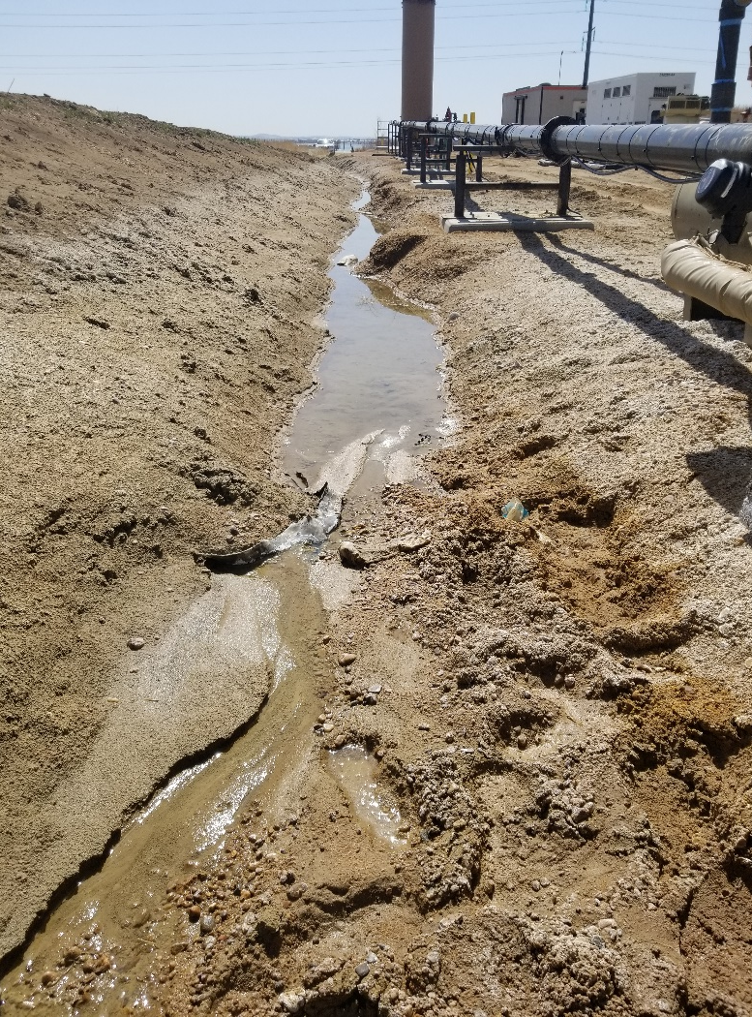
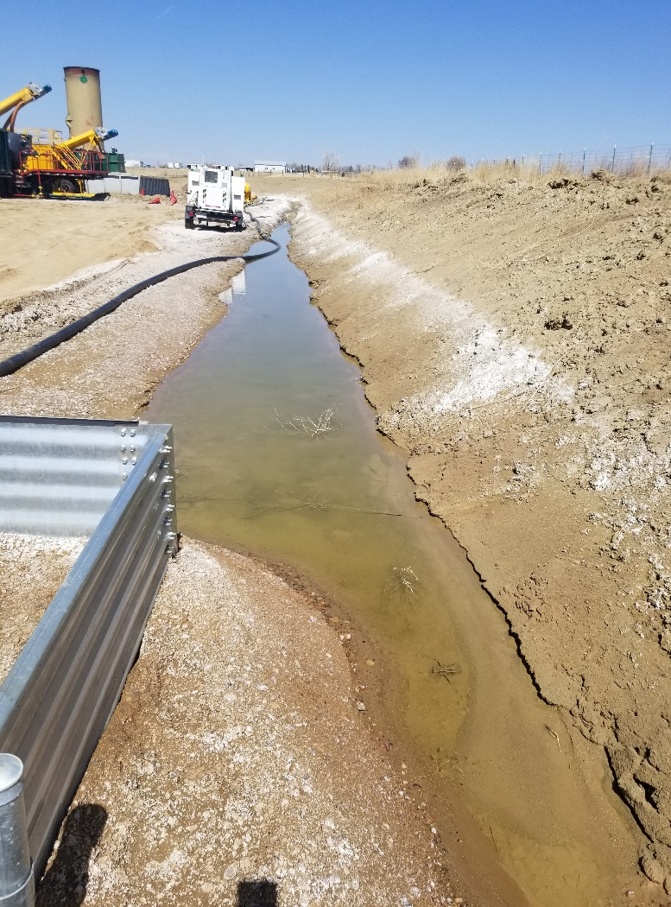
Inspection Photos
Location Name: Cub-Creek Knight Pad
Facility ID: 457362
Photo 9 – Perimeter stormwater controls, no sheen or staining observed.
Photo 10 – Perimeter stormwater controls, no sheen or staining observed.

Slide 6
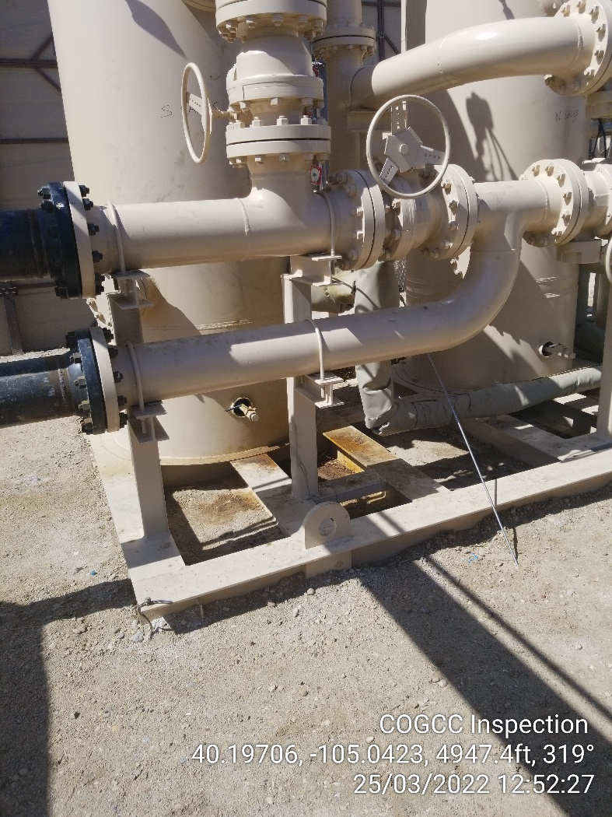
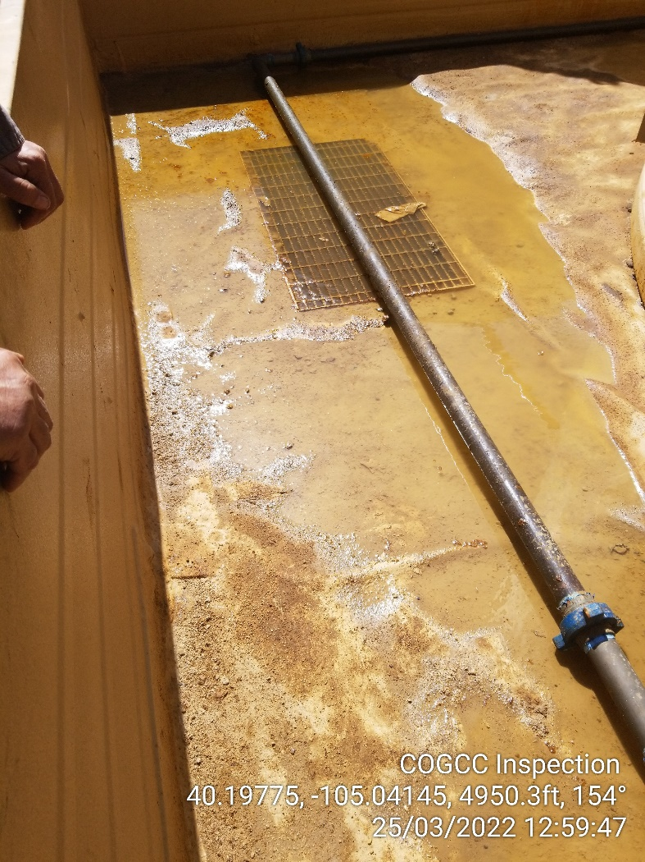
Inspection Photos
Location Name: Cub-Creek Knight Pad
Facility ID: 457362
Photo 11 – Staining beneath scrubber, not inside lined containment.
Photo 12 – Meltwater inside containment around production tanks. Hydrocarbon sheen and paraffin noted.

Slide 7
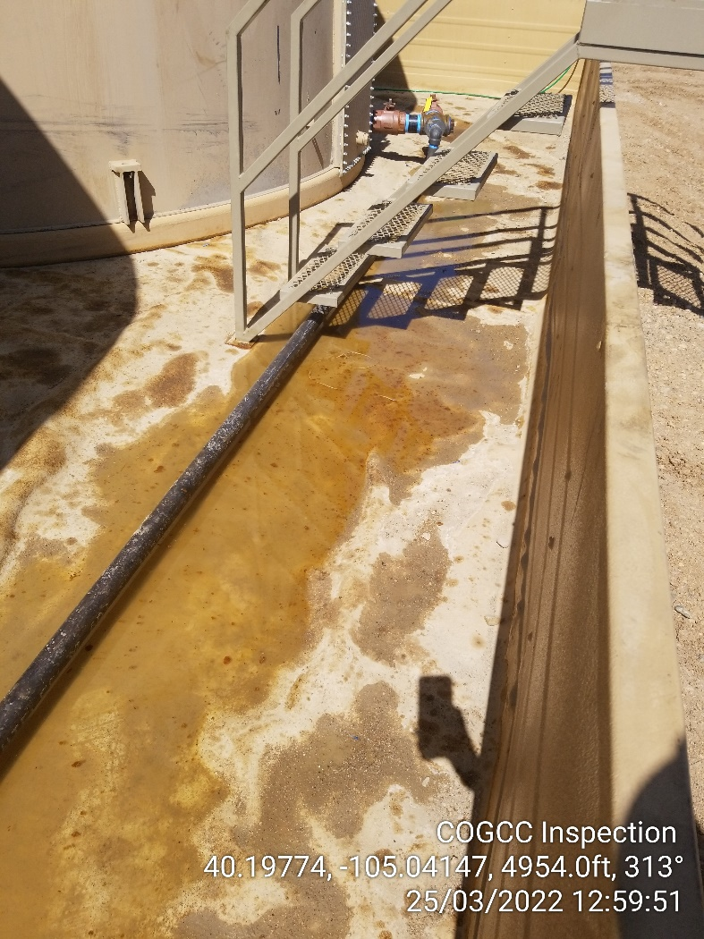
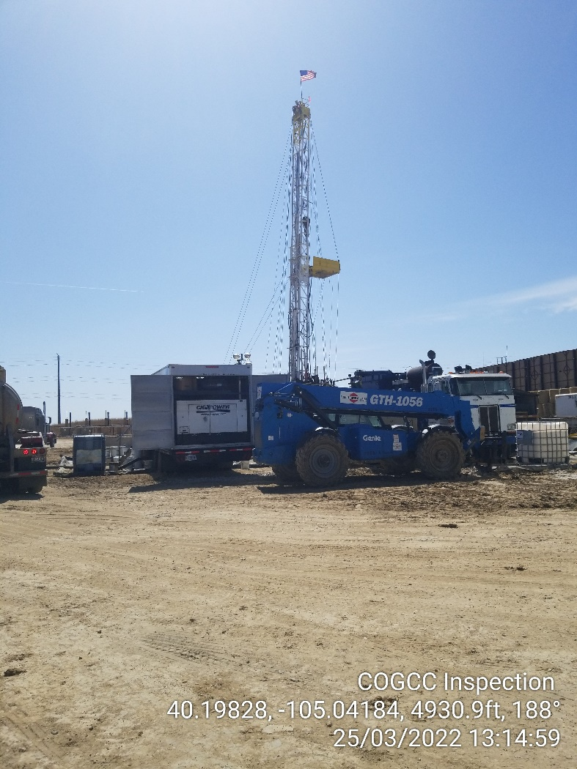
Inspection Photos
Location Name: Cub-Creek Knight Pad
Facility ID: 457362
Photo 13 – Meltwater inside containment around production tanks. Hydrocarbon sheen and paraffin noted.
Photo 14 – Workover rig was tripping out pipe at time of inspection.

Slide 8
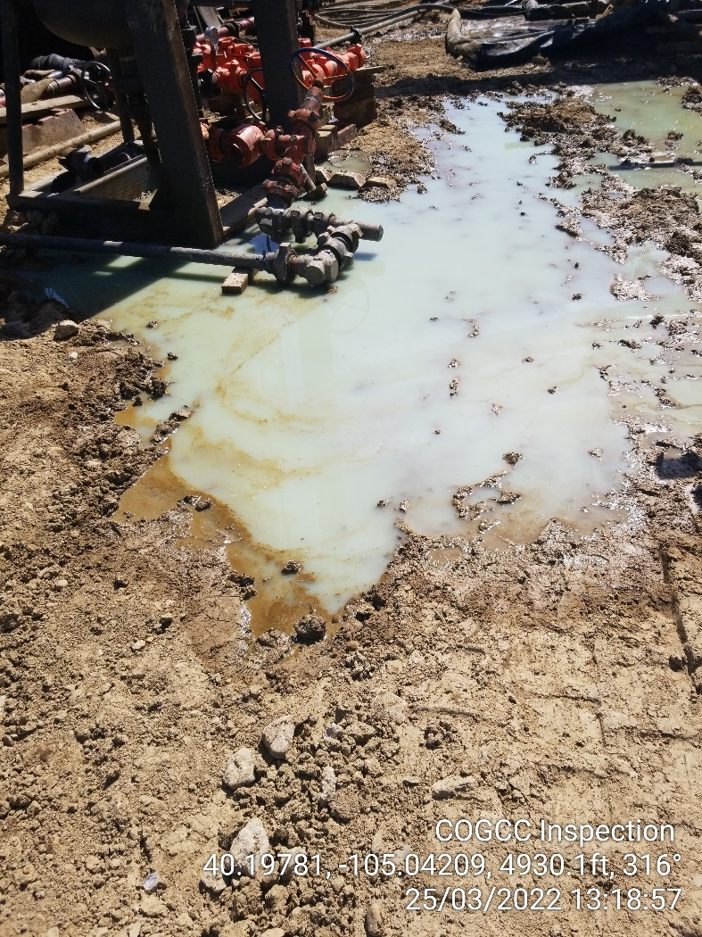
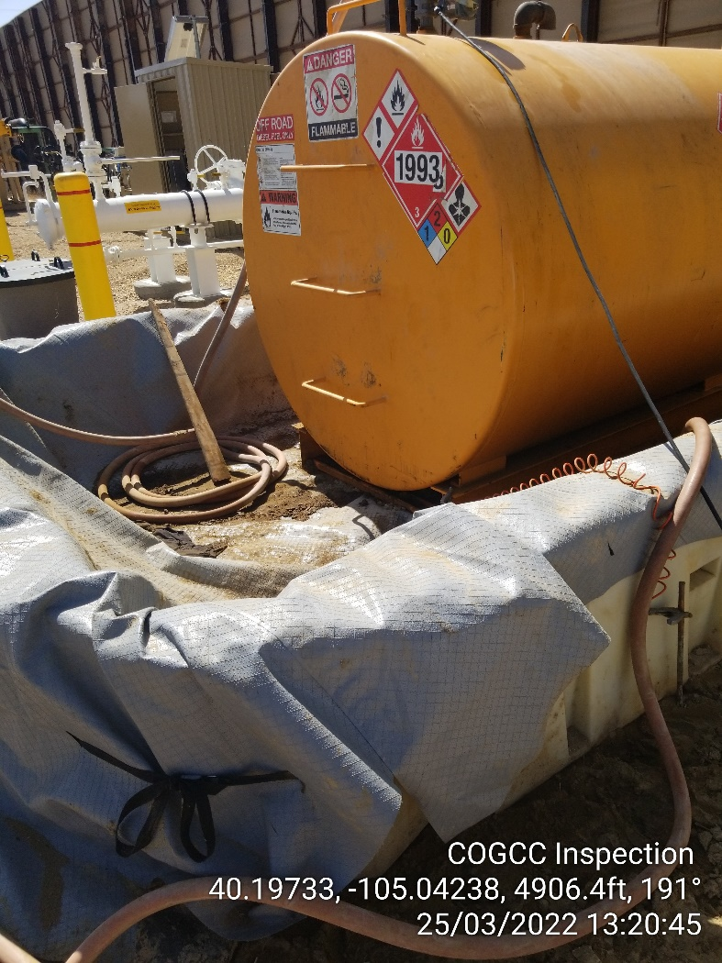
Inspection Photos
Location Name: Cub-Creek Knight Pad
Facility ID: 457362
Photo 15 – Water from pipe near workover rig and wellhead. Product observed on water.
Photo 2 – Chemicals inside containment were observed throughout inspection.

Slide 9
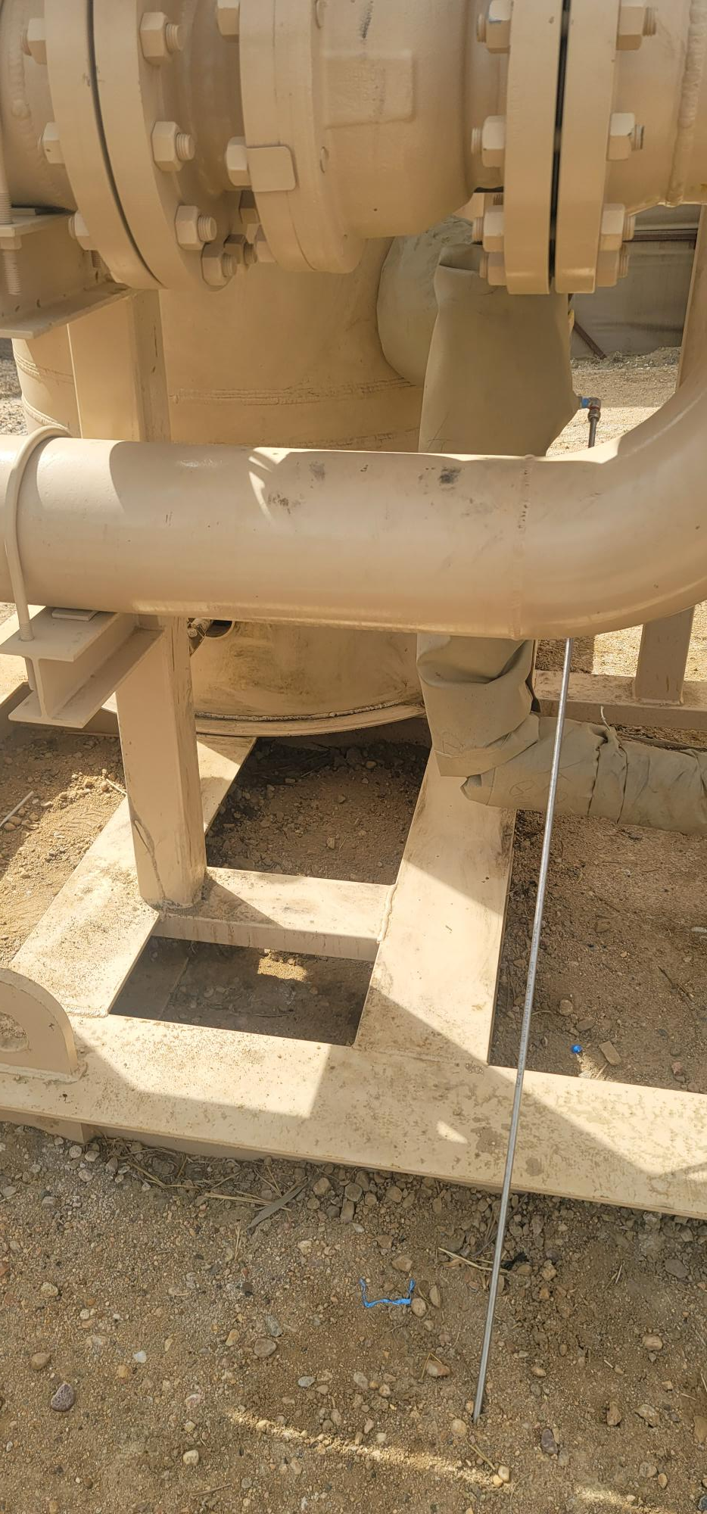
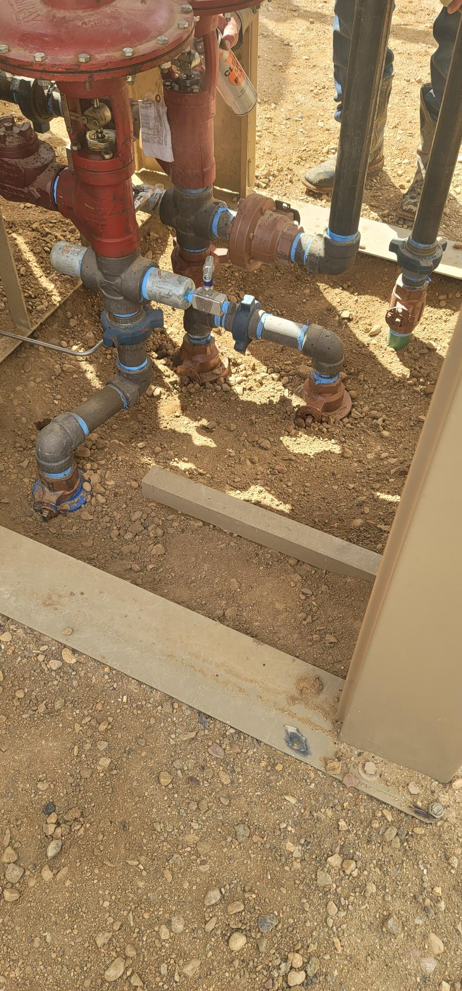
Inspection Photos
Location Name: Cub-Creek Knight Pad
Facility ID: 457362
Operator Provided Photo 1 – Staining at scrubber cleaned up.
Operator Provided Photo 2 – Staining at separator cleaned up

Slide 10
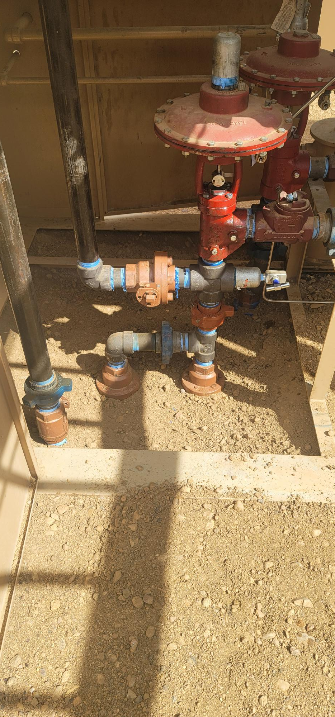
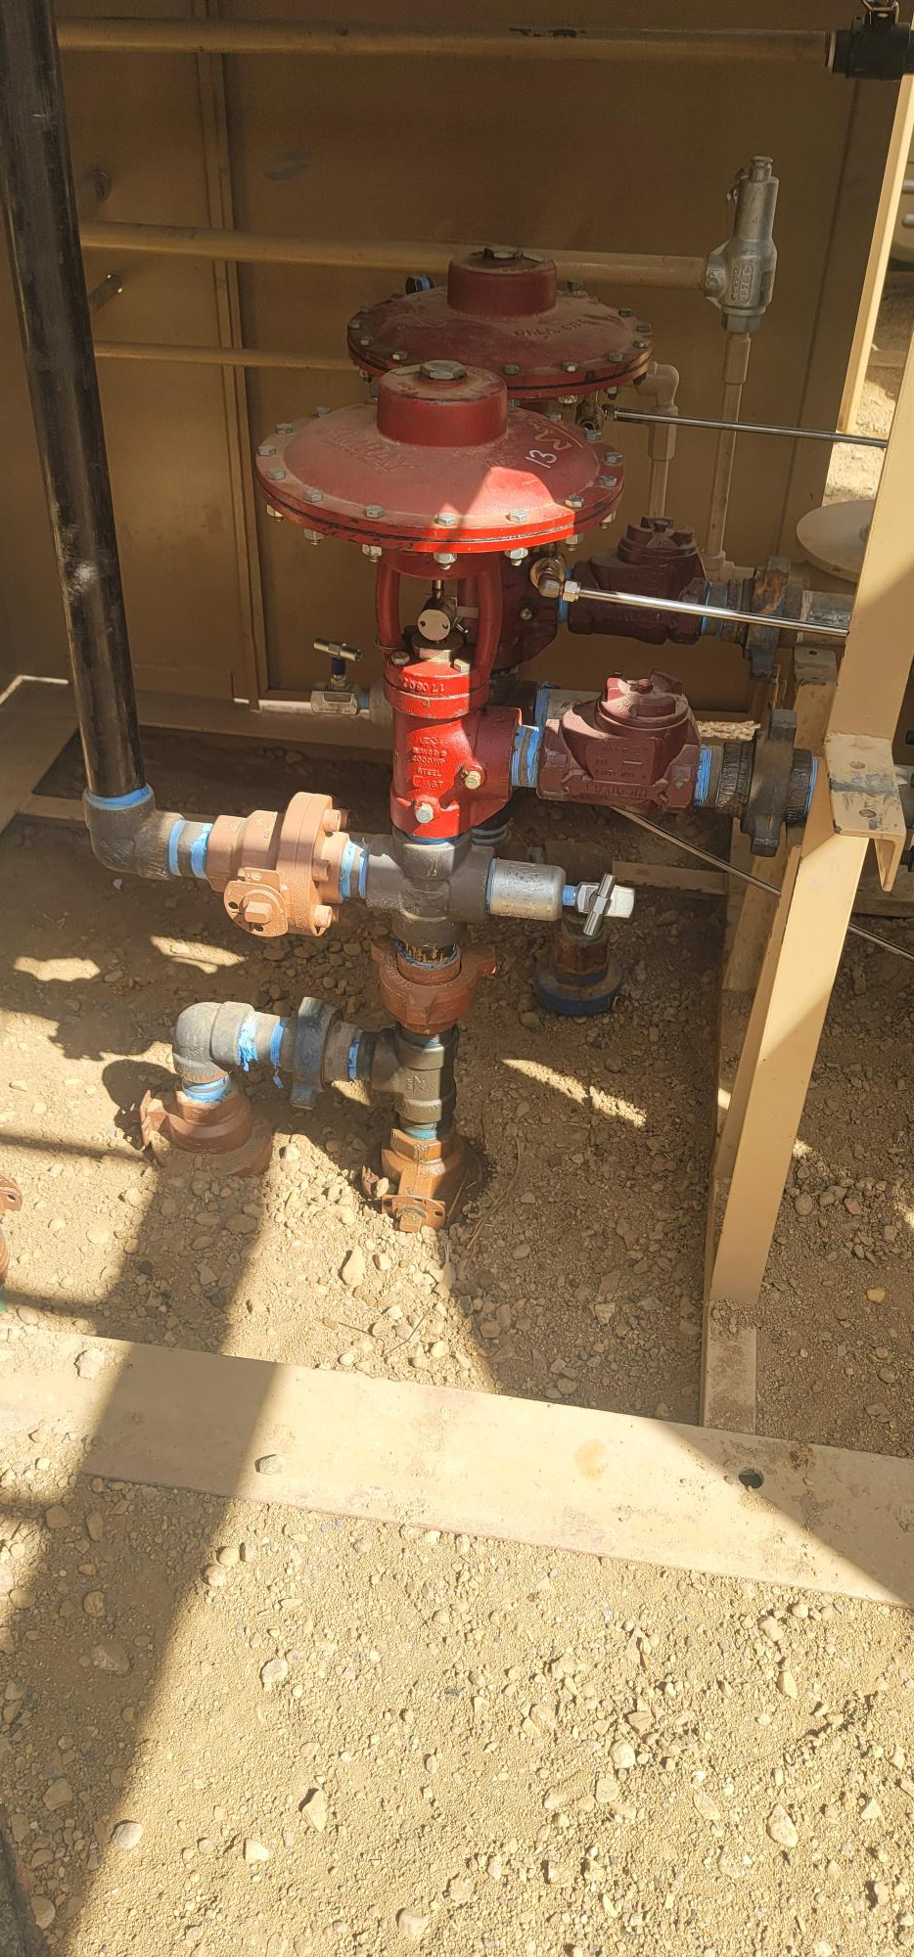
Inspection Photos
Location Name: Cub-Creek Knight Pad
Facility ID: 457362
Operator Provided Photo 3 – Staining at separator cleaned up
Operator Provided Photo 4 – Staining at separator cleaned up

Slide 11
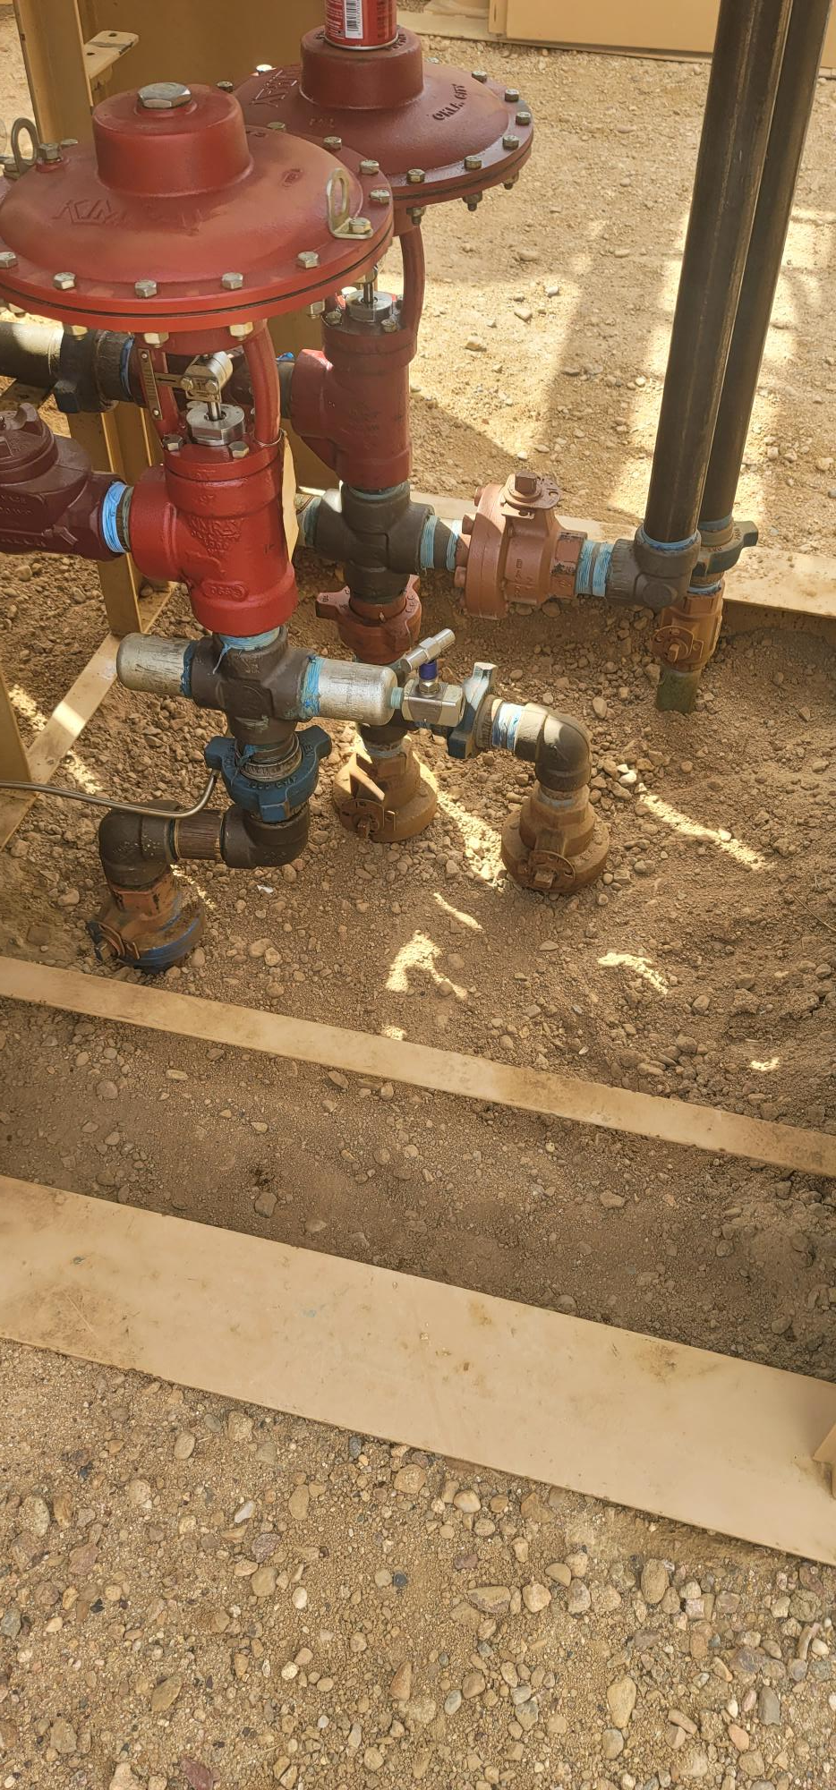
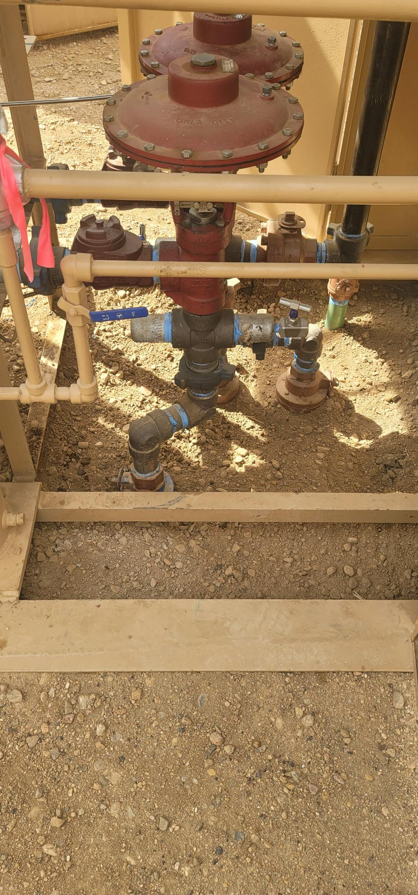
Inspection Photos
Location Name: Cub-Creek Knight Pad
Facility ID: 457362
Operator Provided Photo 5 – Staining at separator cleaned up
Operator Provided Photo 6 – Staining at separator cleaned up

Slide 12
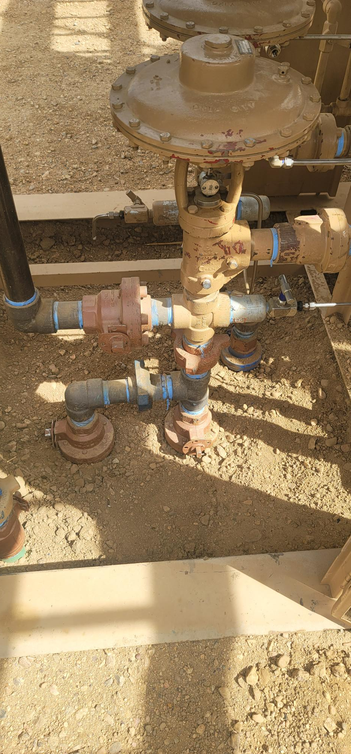
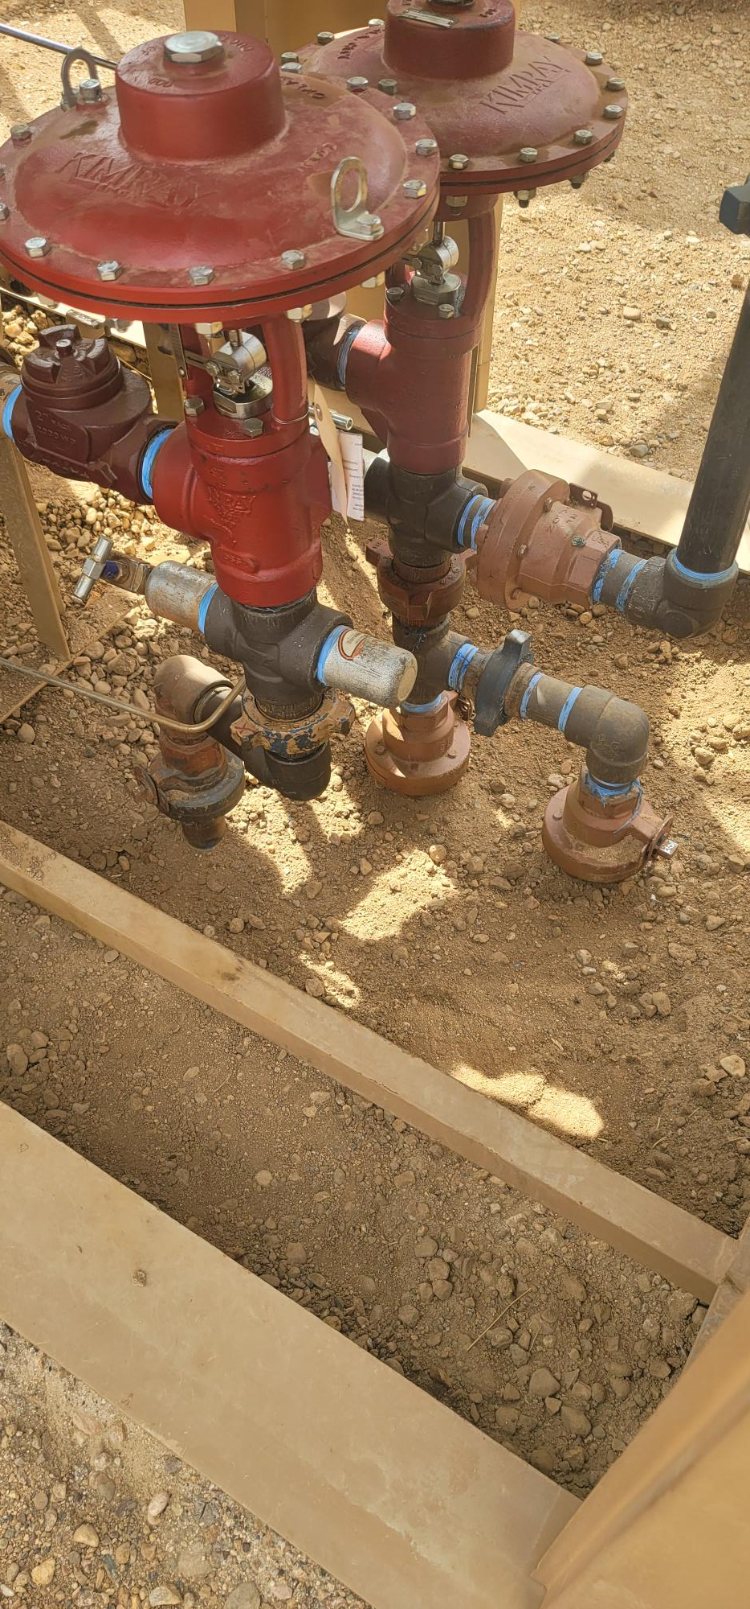
Inspection Photos
Location Name: Cub-Creek Knight Pad
Facility ID: 457362
Photo 1 – Site overview, silt fence damaged by wind, fencing down.
Photo 2 – Excavation. Fencing down.

Slide 13
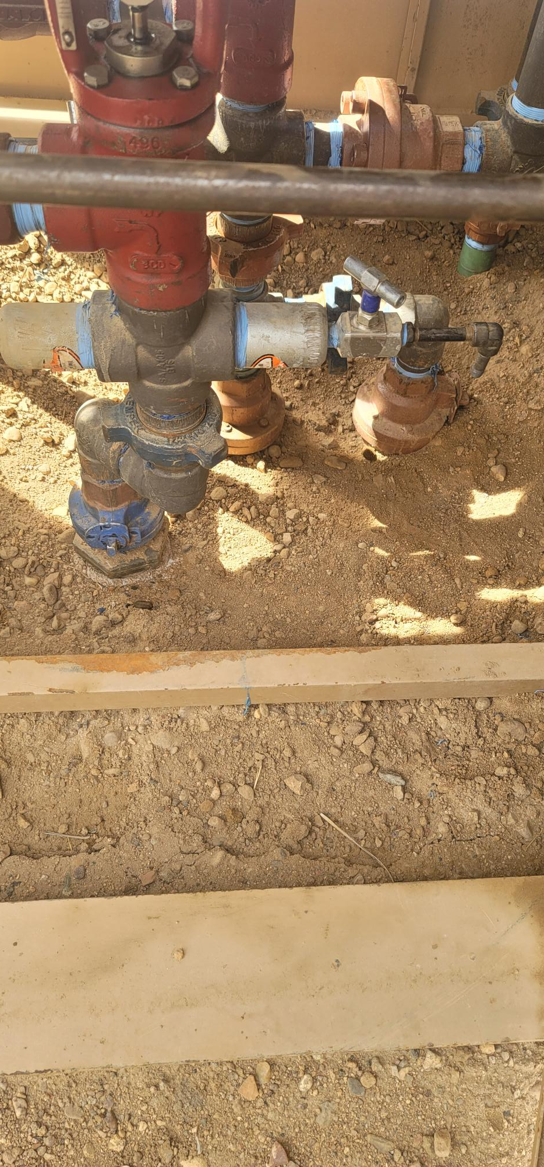
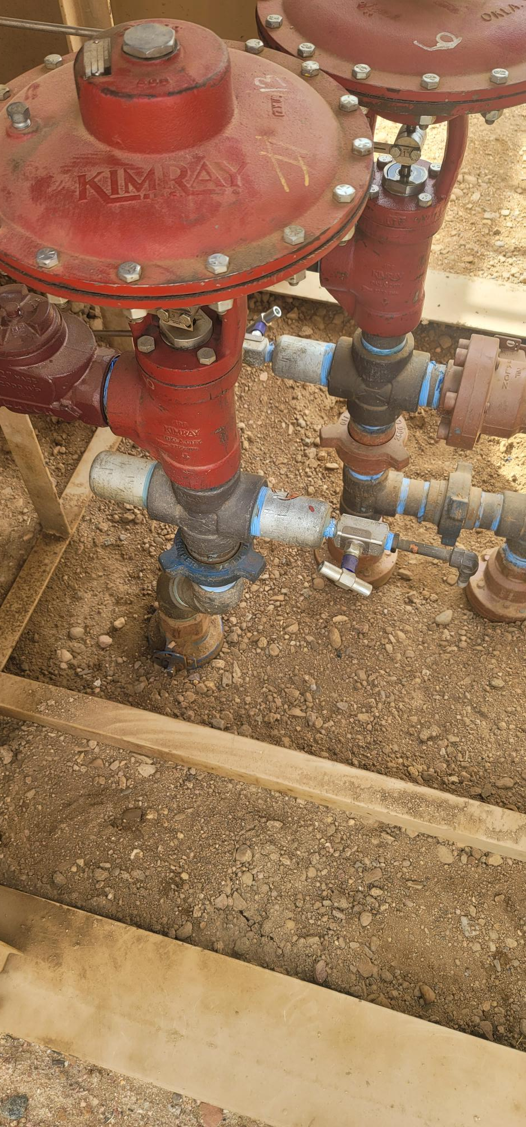
Inspection Photos
Location Name: Cub-Creek Knight Pad
Facility ID: 457362
Photo 1 – Site overview, silt fence damaged by wind, fencing down.
Photo 2 – Excavation. Fencing down.

Slide 14
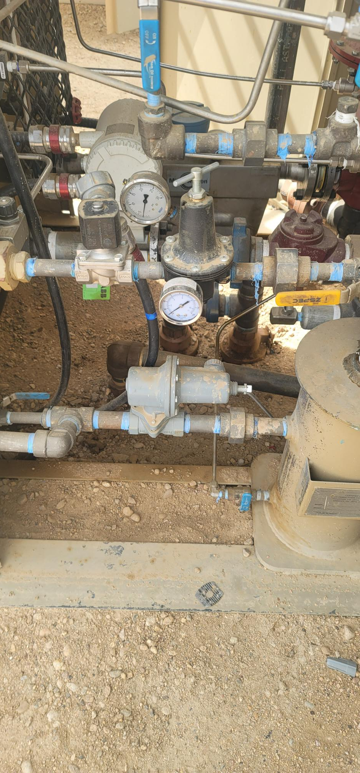
Inspection Photos
Location Name: Cub-Creek Knight Pad
Facility ID: 457362
Operator Provided Photo 7 – Staining at separator cleaned up

