Slide 1
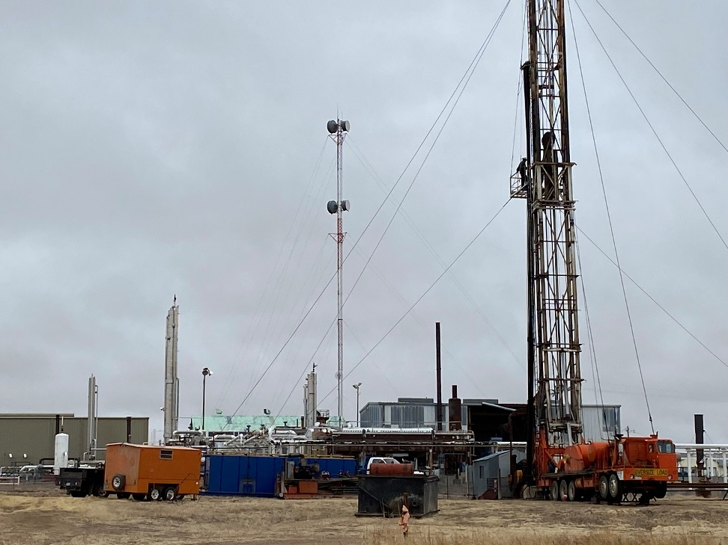
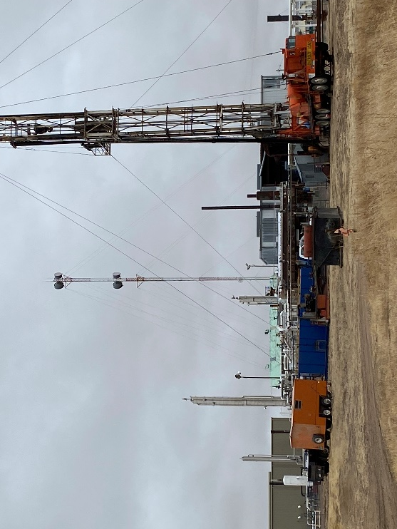
Operator: Chaco Energy
Location Name: Ziegler A2
Location ID: 075-06132
MIRU – Rig On Site - WO
MIRU - SI

