Slide 1
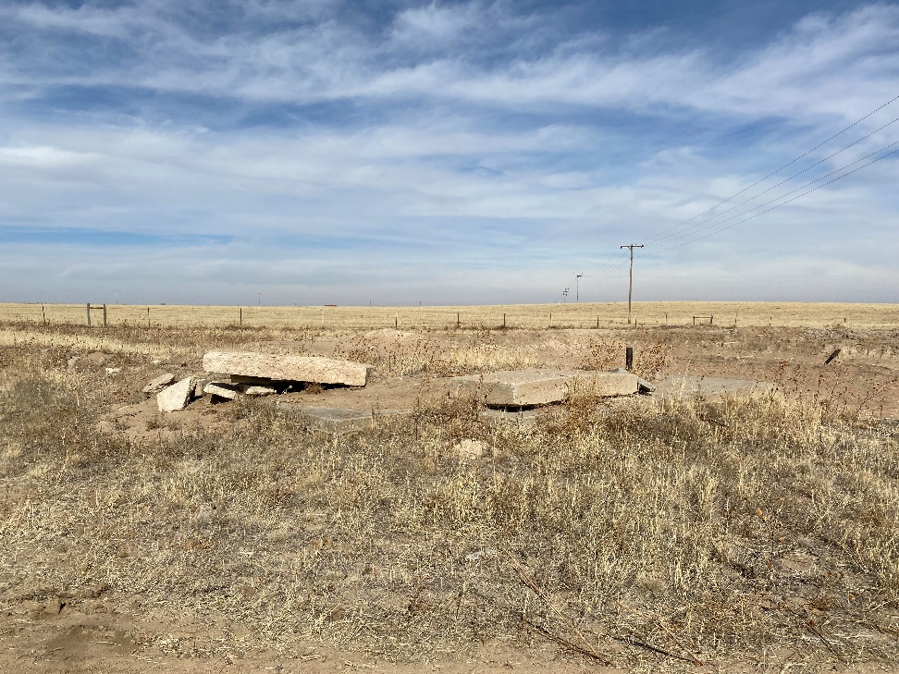
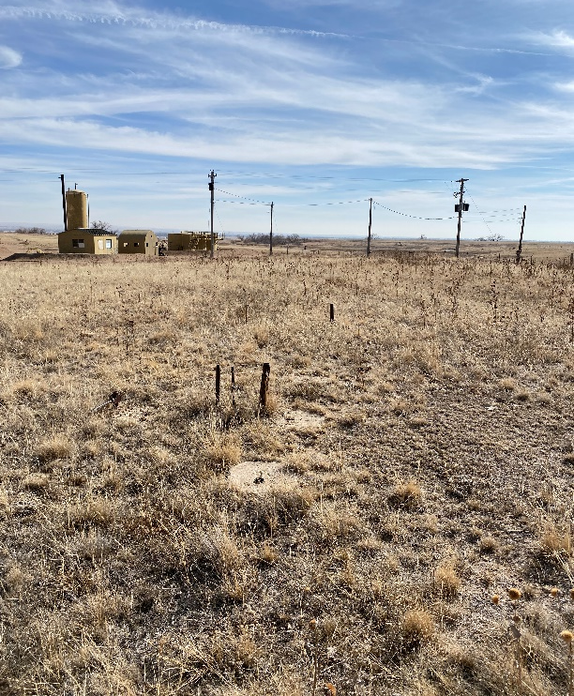
Operator: KP Kauffman Co.
Location Name: Knudsen #7
Location ID: 075-07533
Concrete debris
Abandoned pad/lines

Slide 2
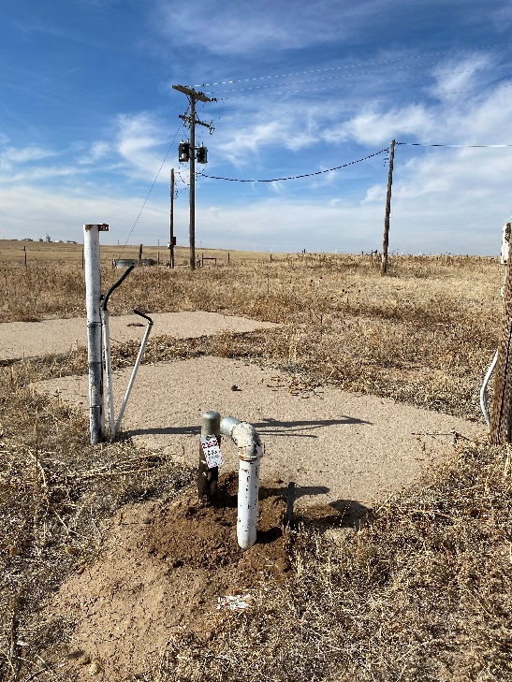
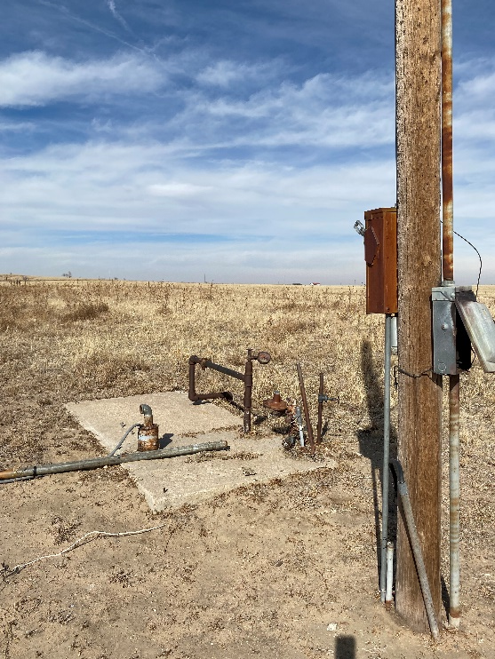
Operator: KP Kauffman Co.
Location Name: Knudsen #7
Location ID: 075-07533
Concrete debris (abandoned pad), risers from abandoned transfer lines, abandoned electrical poles/equipment.
Abandoned pad/transfer lines, electrical poles/equipment.

Slide 3
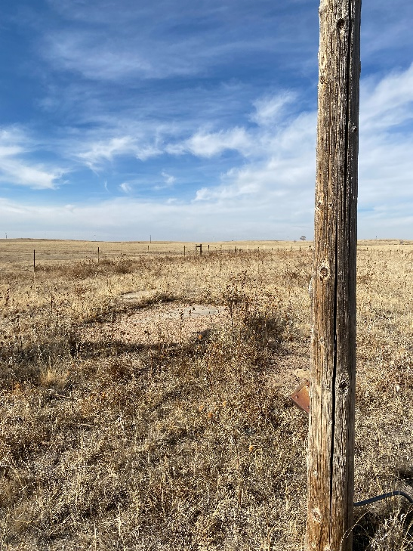
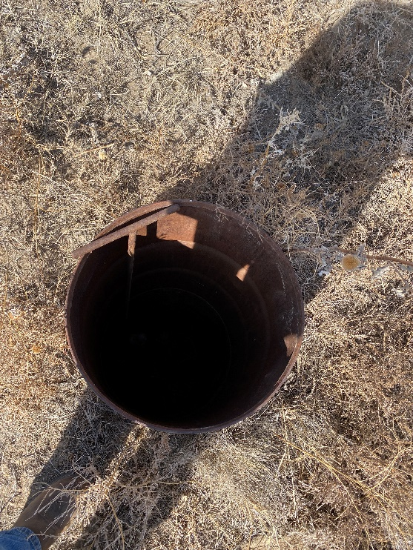
Operator: KP Kauffman Co.
Location Name: Knudsen #7
Location ID: 075-07533
Abandoned electrical poles/equipment. Soil degradation.
Abandoned valve pit, open hole (approx. 6’ deep)

Slide 4
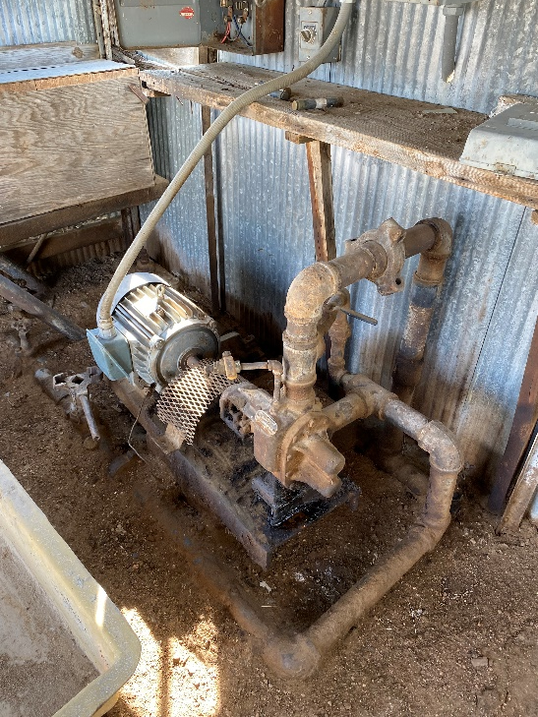
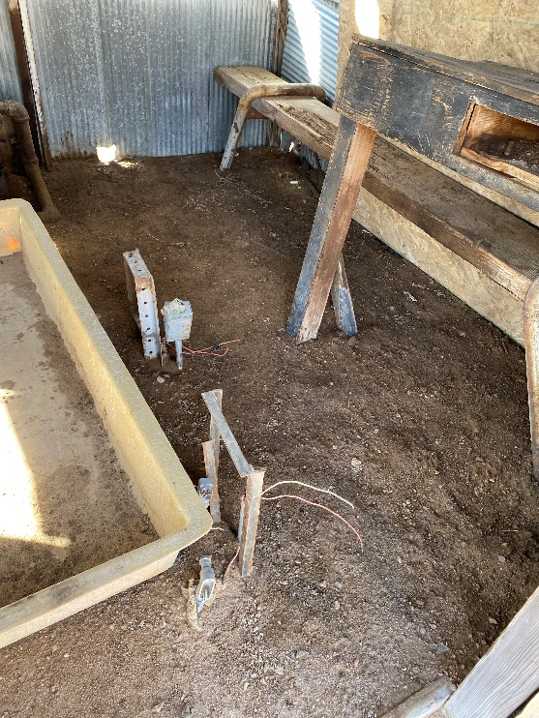
Operator: KP Kauffman Co.
Location Name: Knudsen #7
Location ID: 075-07533
Stained/Saturated soils on soils within current transfer pump shed.
Stained/Saturated soils within current transfer pump shed.

