Slide 1
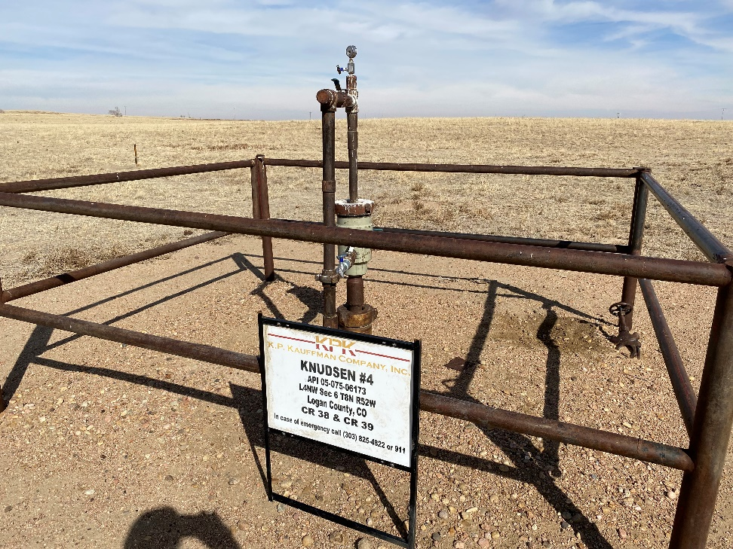
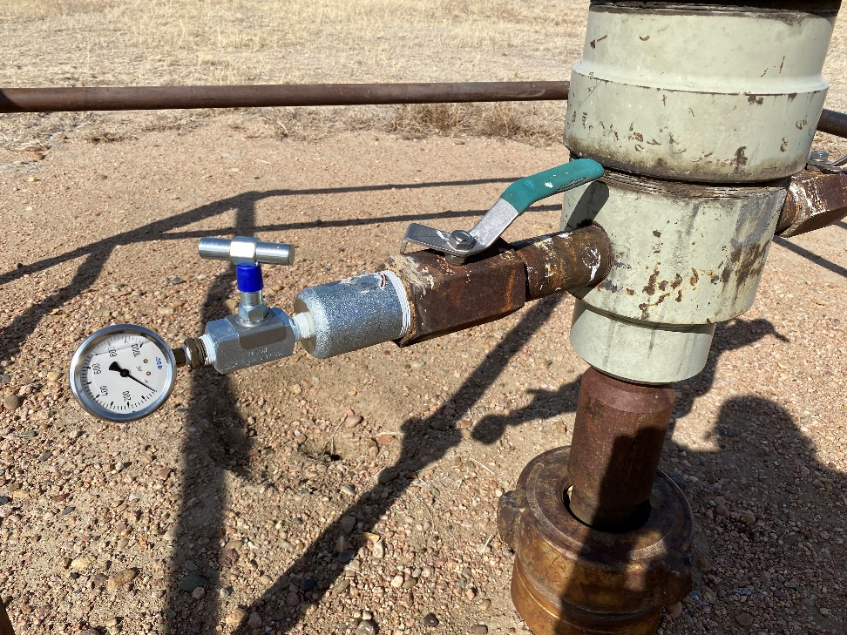
Operator: KP Kauffman Co.
Location Name: Knudsen #4
Location ID: 075-06173
Sign @ Wellhead
Casing pressure gauge in place

