Slide 1
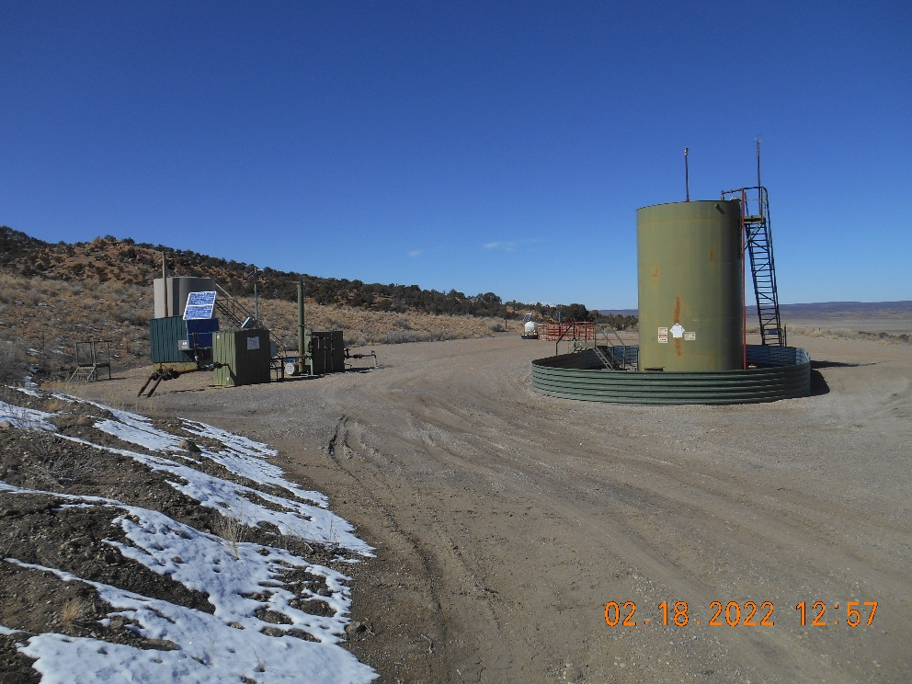
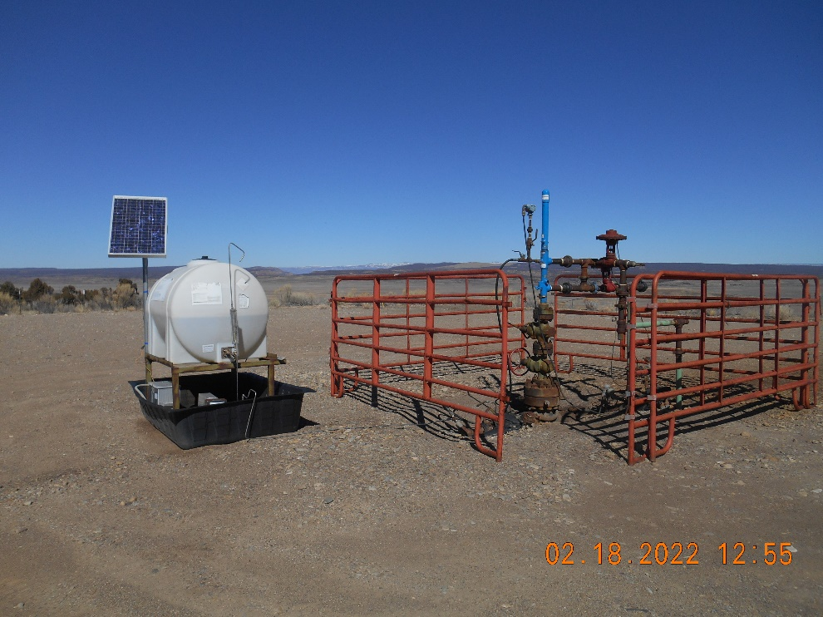
PARADOX UPSTREAM LLC - 10453
API# 05-113-06100 ANDY’S MESA FEDERAL #24
Inspection Date : 2/18/2022
Location overview looking NW.
Wellhead with fencing
Inspection Doc # 693804092

Slide 2
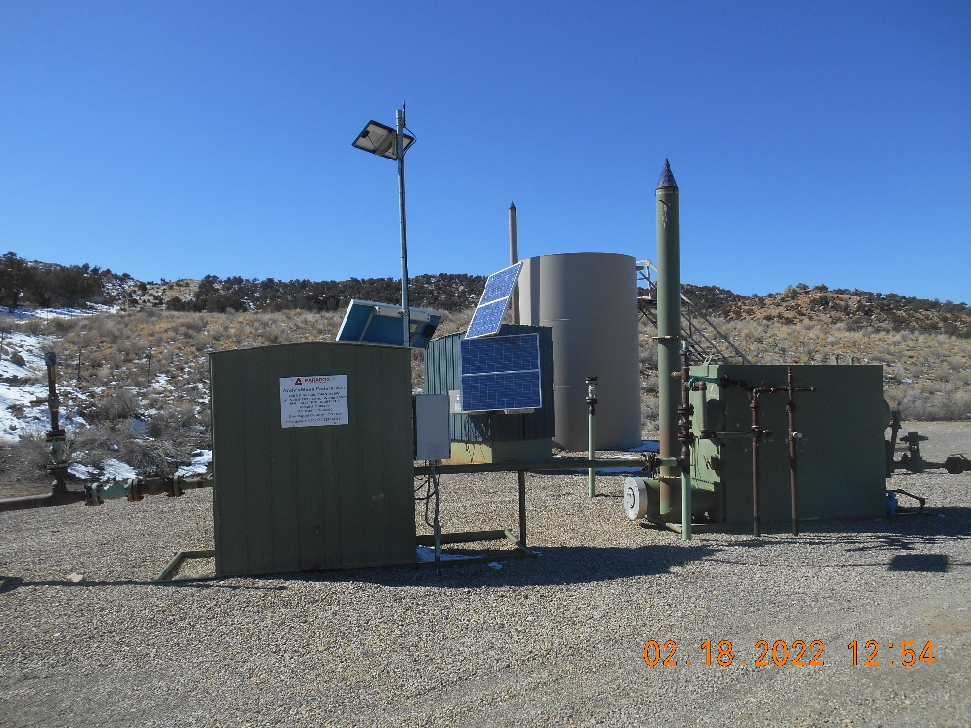
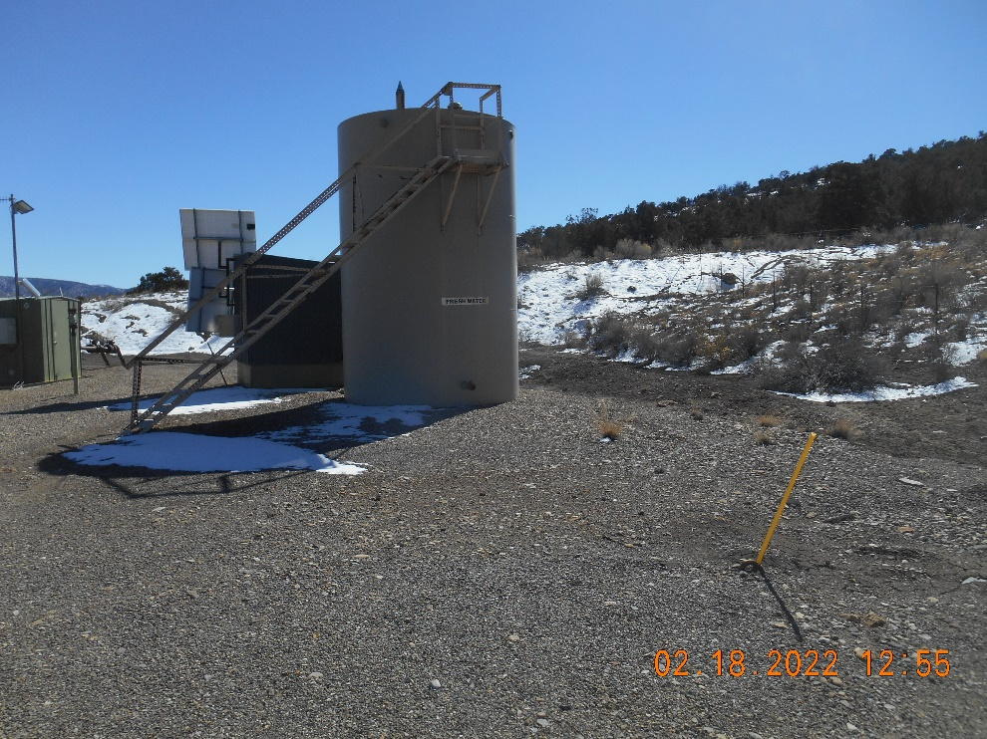
PARADOX UPSTREAM LLC - 10453
API# 05-113-06100 ANDY’S MESA FEDERAL #24
Inspection Date : 2/18/2022
Meter housing with sign and Separator
Fresh water tank
Inspection Doc # 693804092

Slide 3
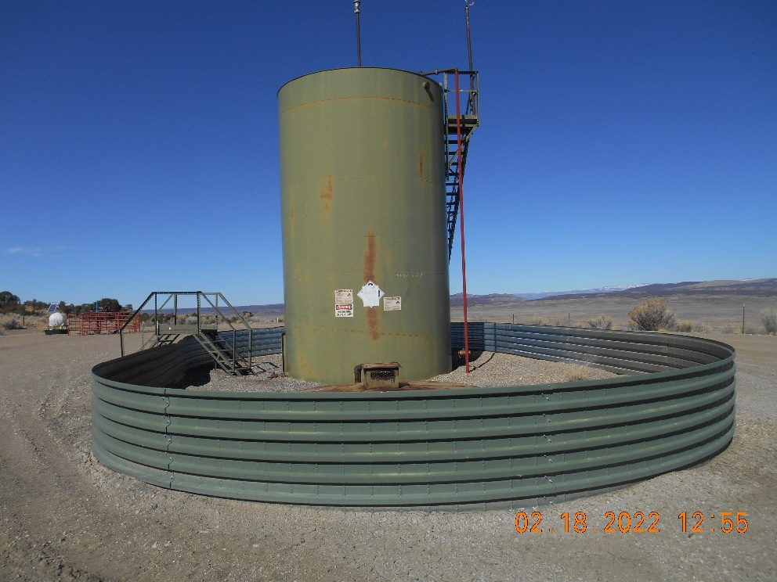
PARADOX UPSTREAM LLC - 10453
API# 05-113-06100 ANDY’S MESA FEDERAL #24
Inspection Date : 2/18/2022
Produced water and Condensate tank battery
Inspection Doc # 693804092

