Slide 1
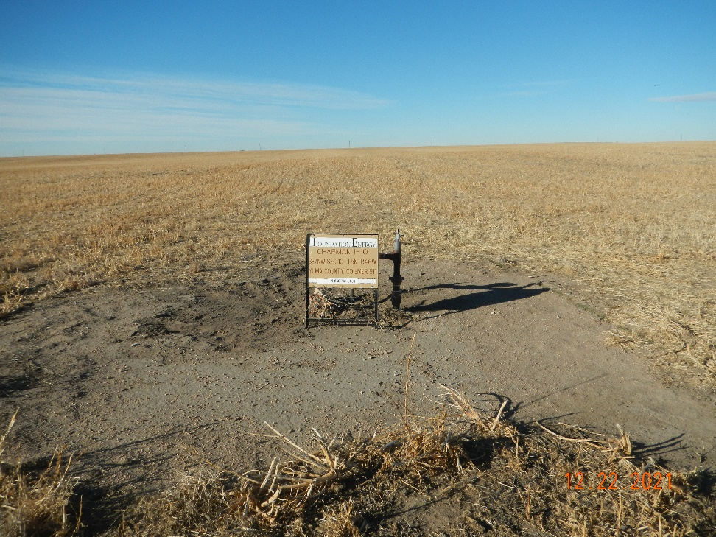
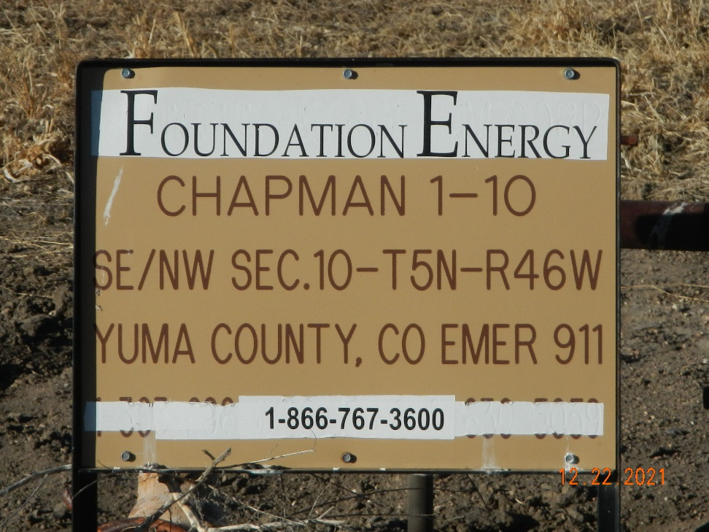
Operator: Foundation Energy Management LLC - 10112
Location Name: Chapman 1-10
Location ID: 125-06070
Sign @ Wellhead
Sign

