Slide 1
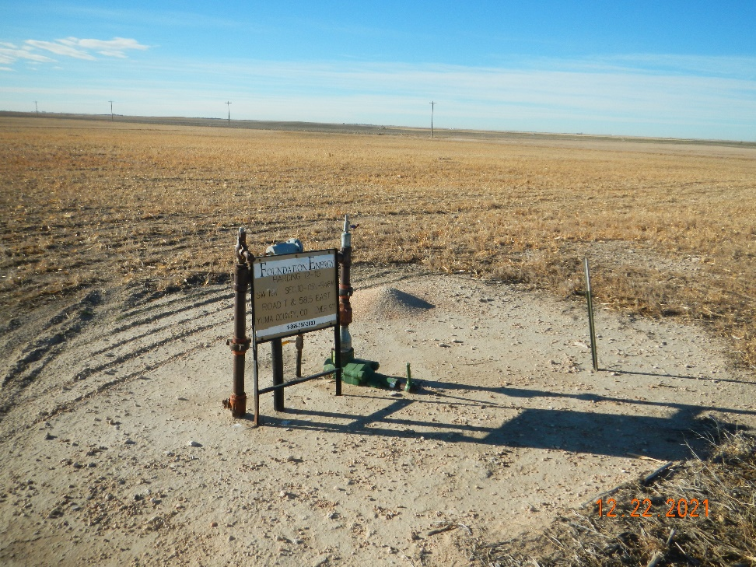
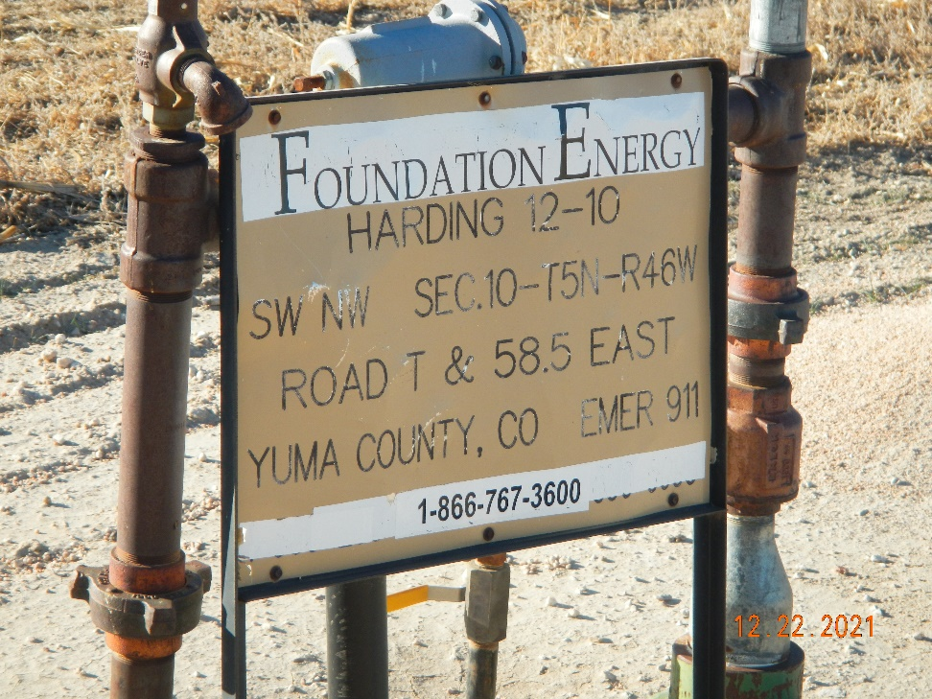
Operator: Foundation Energy Management LLC - 10112
Location Name: Harding 12-10
Location ID: 125-11351
Sign @ Wellhead
Sign

