Slide 1
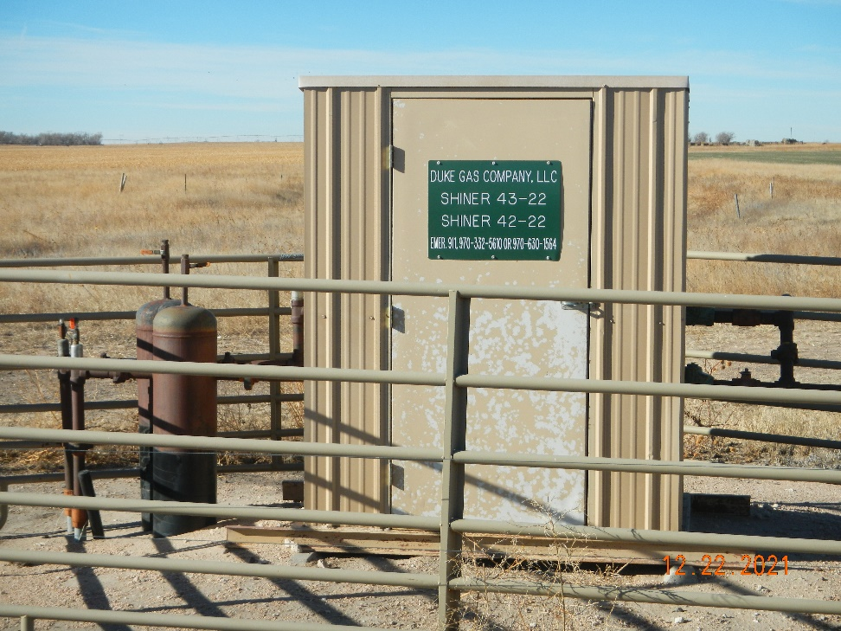
Operator: Duke Gas Co. LLC 25255
Location Name: Shriner 43-22
Location ID: 125-11389
Sign @ MR
Sign

