Slide 1
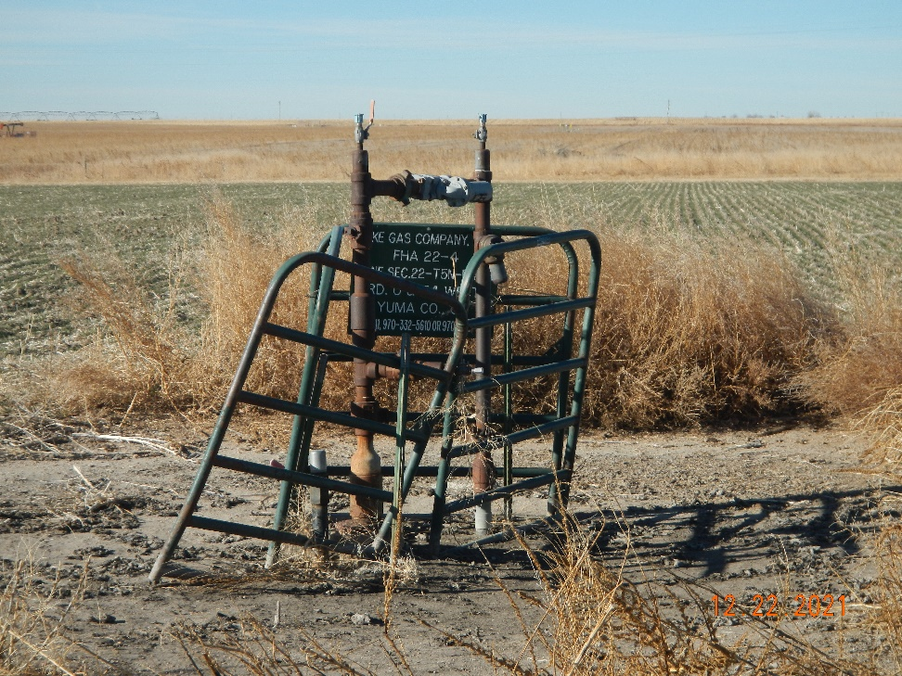
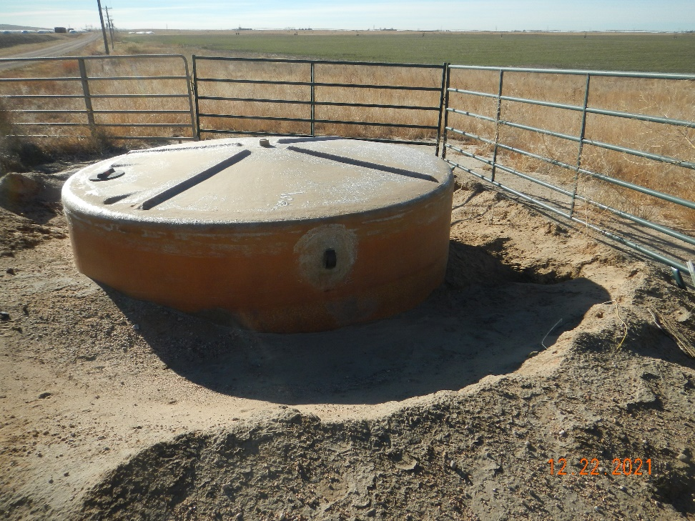
Operator: Duke Gas Co. LLC 25255
Location Name: FHA 22-4
Location ID: 125-08841
Wellhead - fence
Berm conditions @ PW tank

