Slide 1
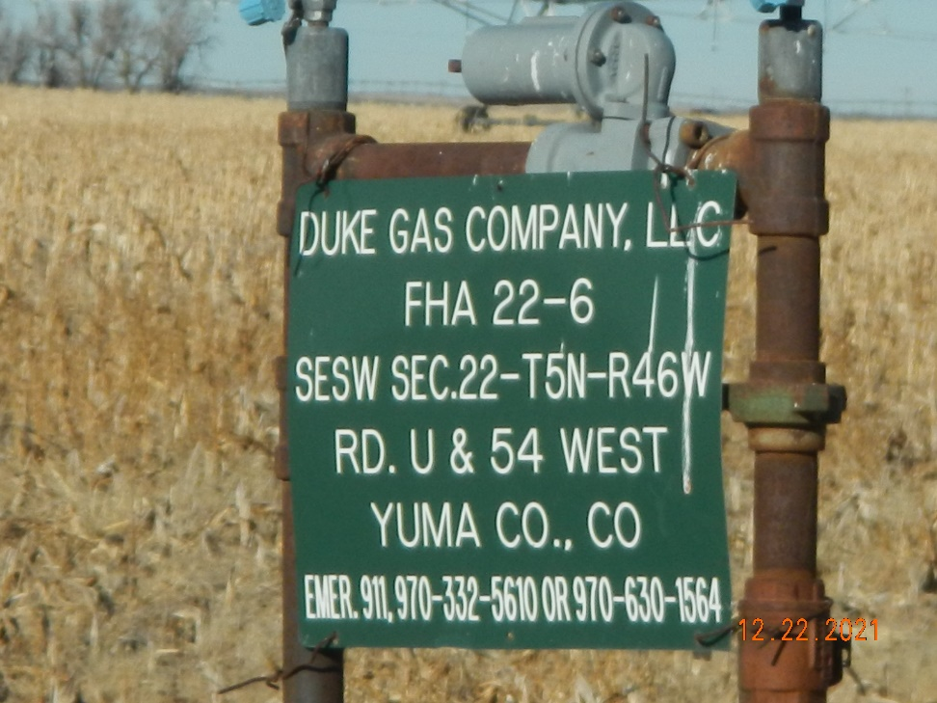
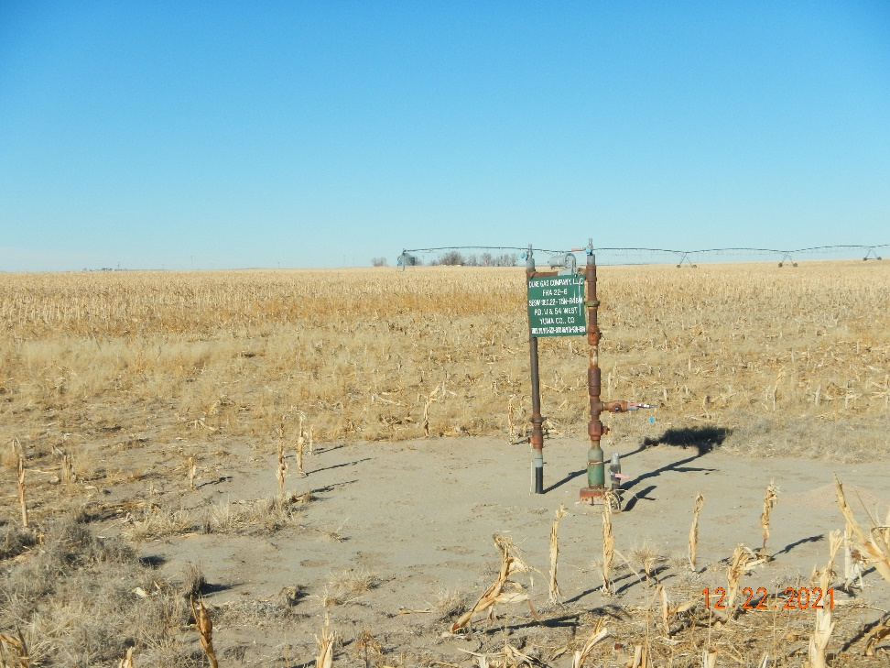
Operator: Duke Gas Co. LLC 25255
Location Name: FHA 22-6
Location ID: 125-08840
Wellhead
SIGNAGE @ wellhead

