Slide 1
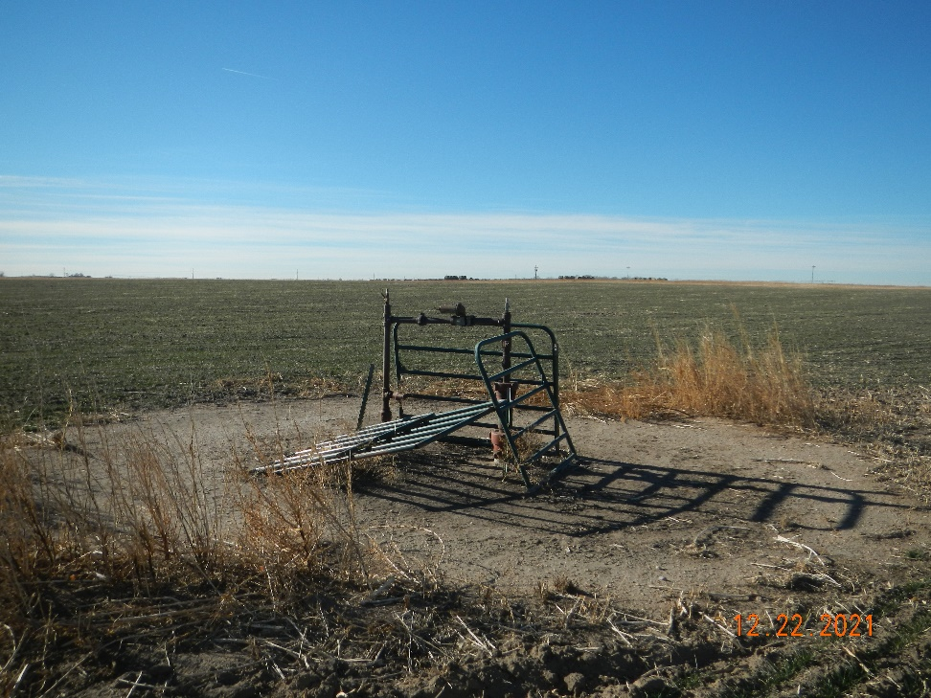
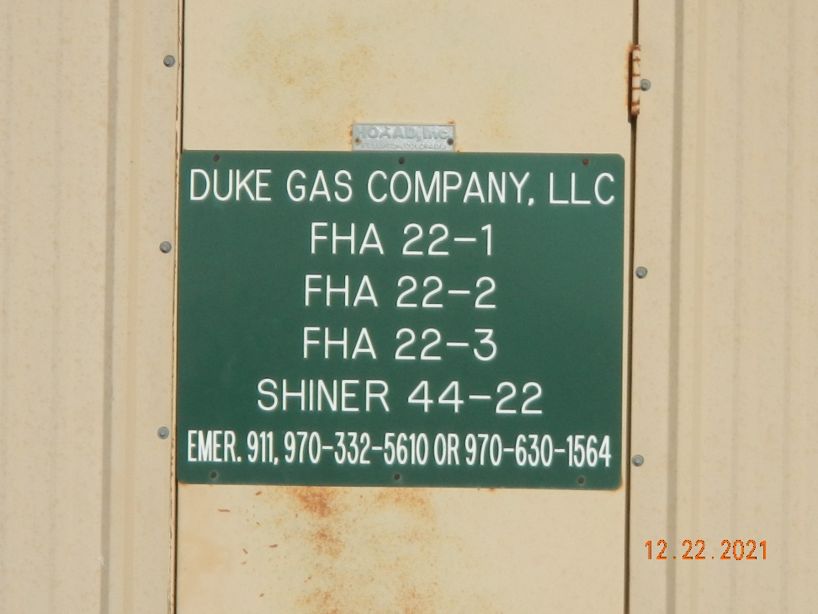
Operator: Duke Gas Co. LLC 25255
Location Name: FHA 22-1
Location ID: 125-07230
No well sign, fence disrepair
SIGNAGE @ MR

