Slide 1
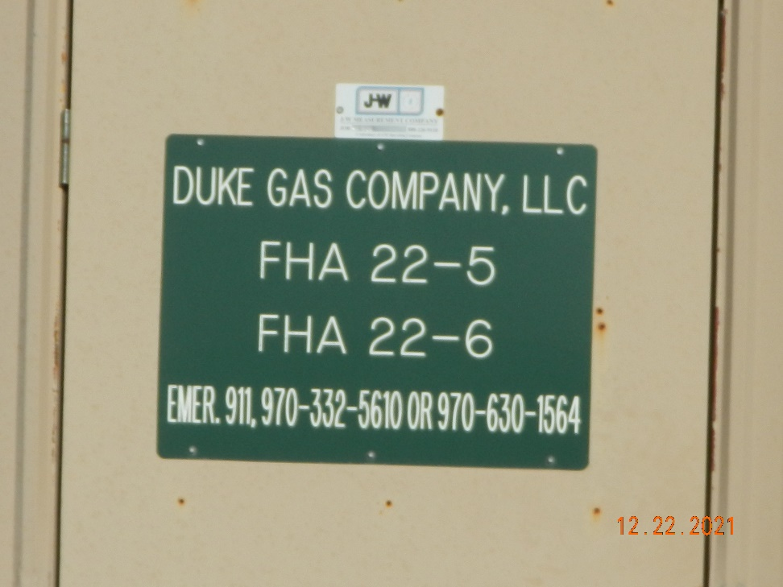
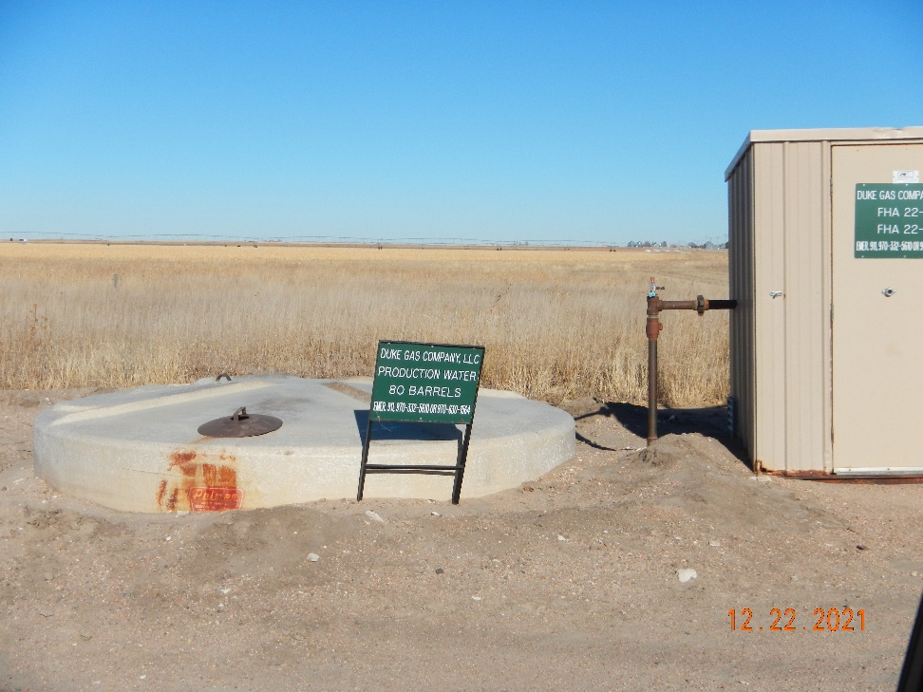
Operator: Duke Gas Co. LLC 25255
Location Name: FHA 22-5
Location ID: 125-08839
MR – Signage
SIGNAGE @ PW tank

