Slide 1
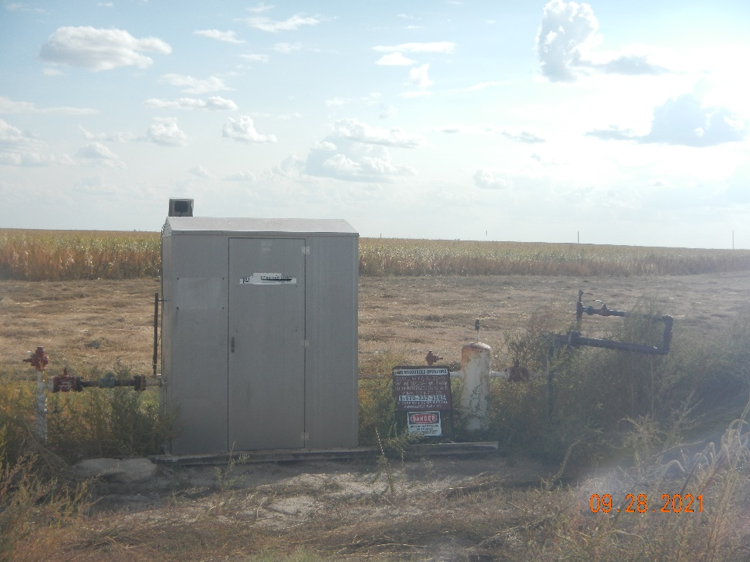
Operator: OWN
Location Name: STATE OF COLORADO 2
Location ID: 125-06157
MR - Signage
SEPARATOR

