Slide 1
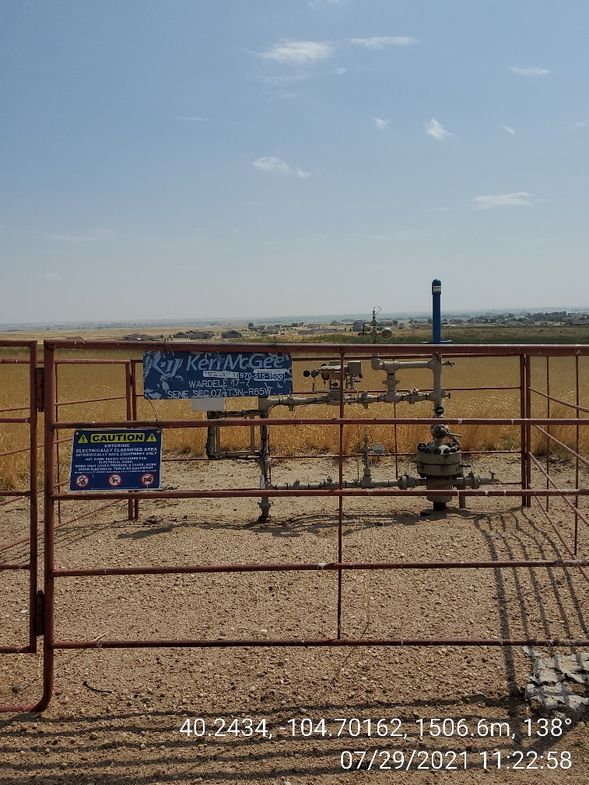
Inspection Photo
Location ID, Name: 332688, WARDELL-63N65W 7SWNE
Photo 1
05-123-23211
WARDELL 17-7

