Slide 1
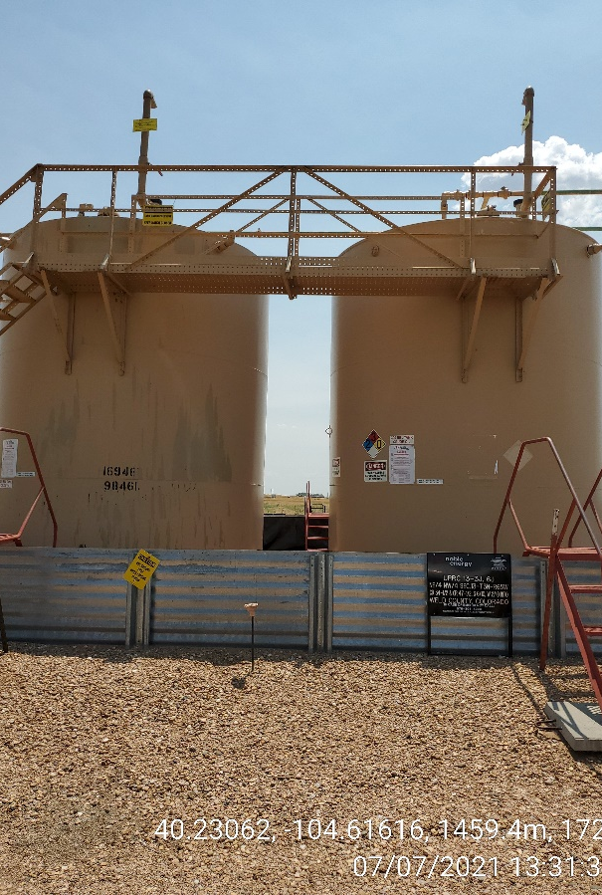
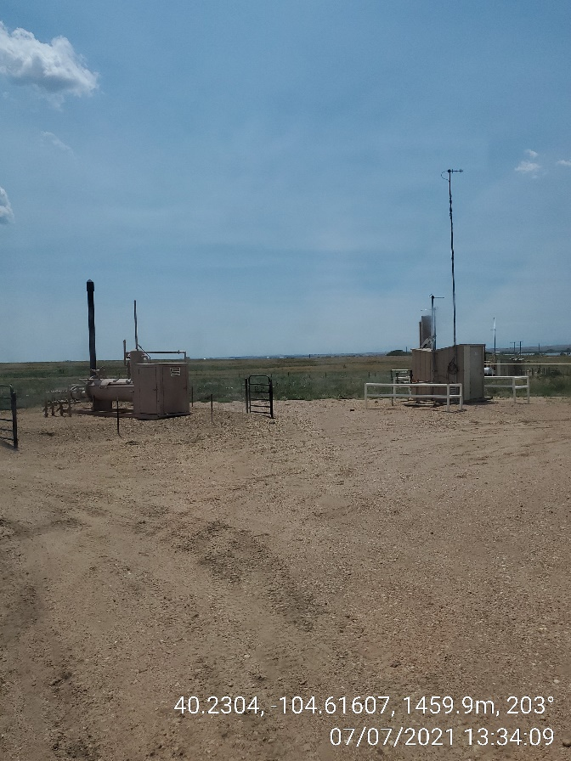
Inspection Photos
Location ID, Name: 329377, UPRC-63N65W 13NENW
Photo 1
Battery
Photo 2
Production Equipment

