Slide 1
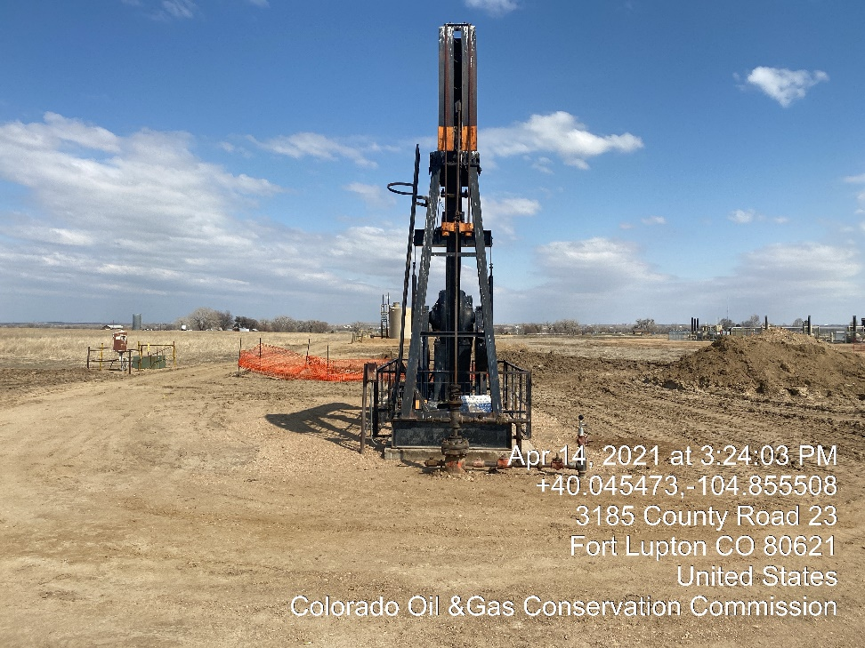
Inspection Photos
Location Name: KPK Kieffer George W UT B#1A
Location ID:
Well head valves closed Tagged out well head

