Slide 1
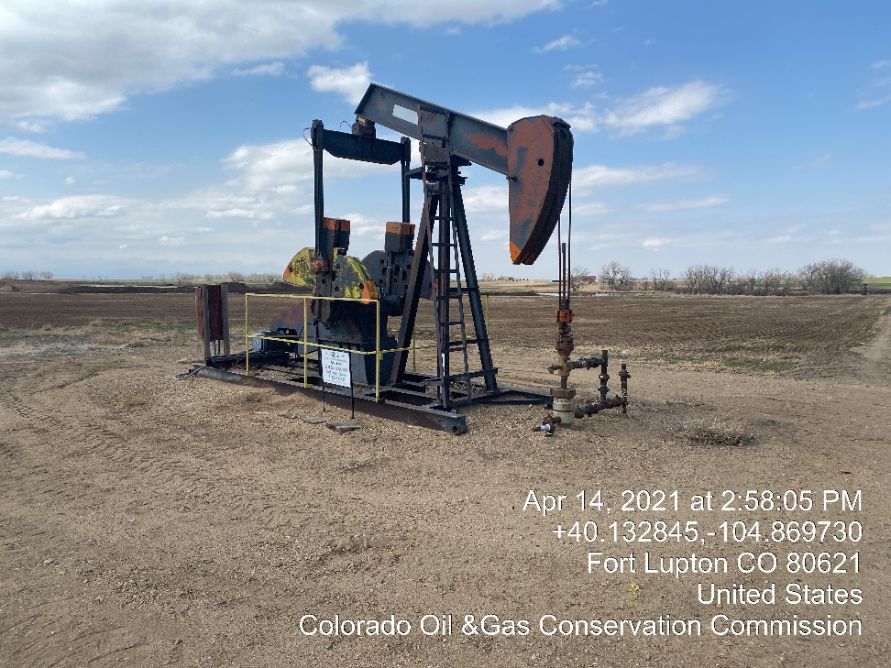
Inspection Photos
Location Name: KPK Parker 44-15
Location ID:
Well head valves closed Tagged out well head

