Slide 1
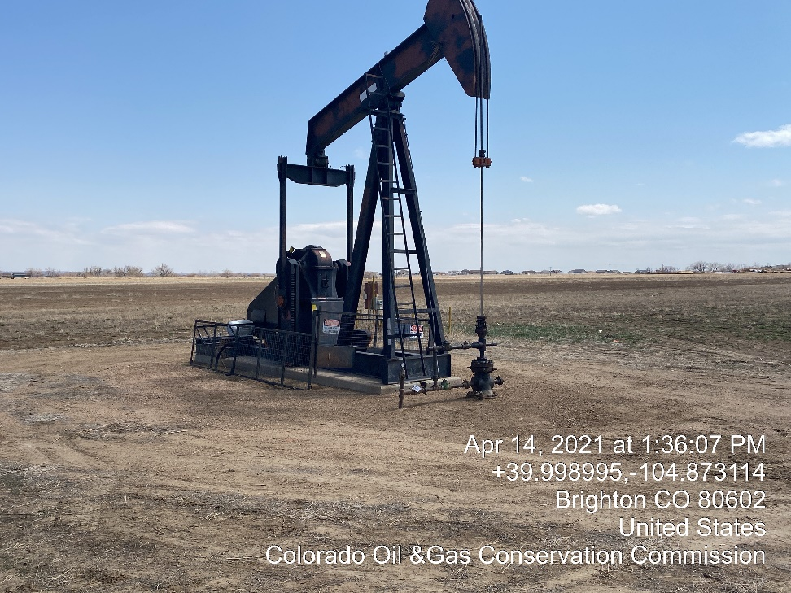
Inspection Photos
Location Name: KPK Weigandt John H A#1
Location ID: 05-001-08693
Well head valves closed Tagged out well head TA

