Slide 1
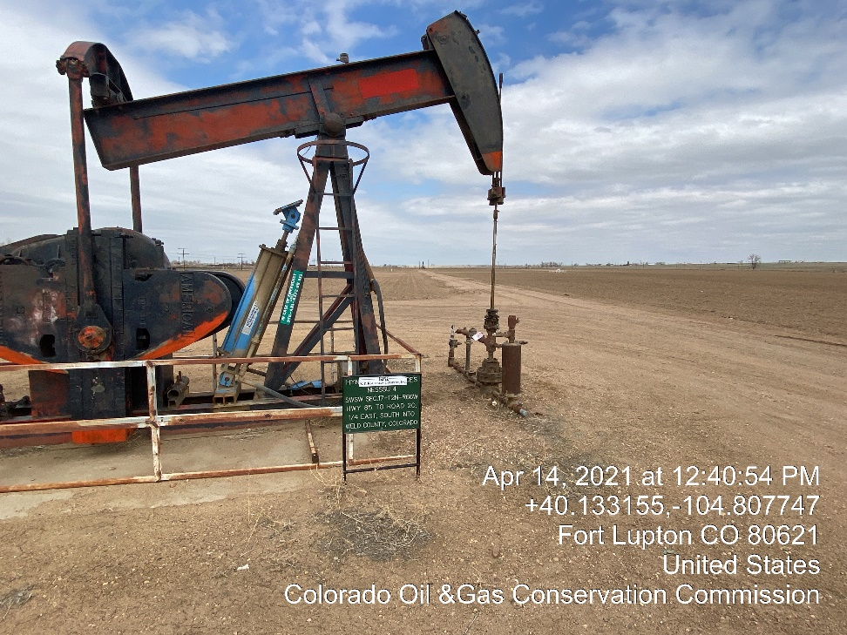
Inspection Photos
Location Name: KPK Nessu 4
Location ID: 05-123-07724
Well head valves closed Tagged out

