Slide 1

Foundation Energy Management LLC, Tustin 43-29
125-09143
Inspection #688310045
3/18/2021
Routine Inspection

Slide 2
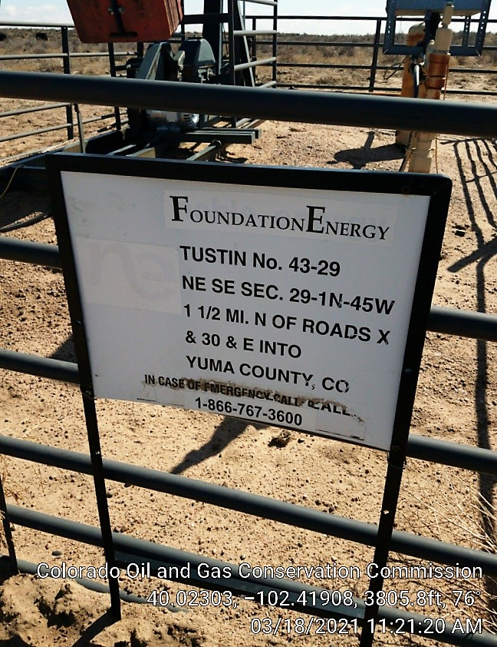

Slide 3
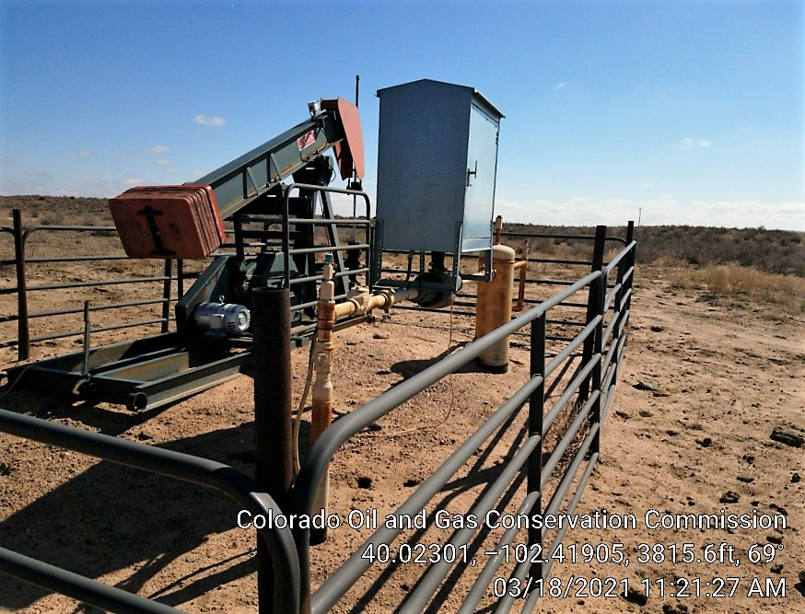

Slide 4
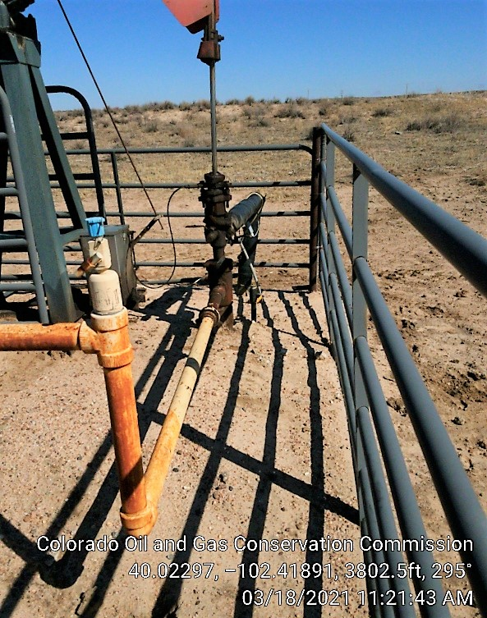

Slide 5
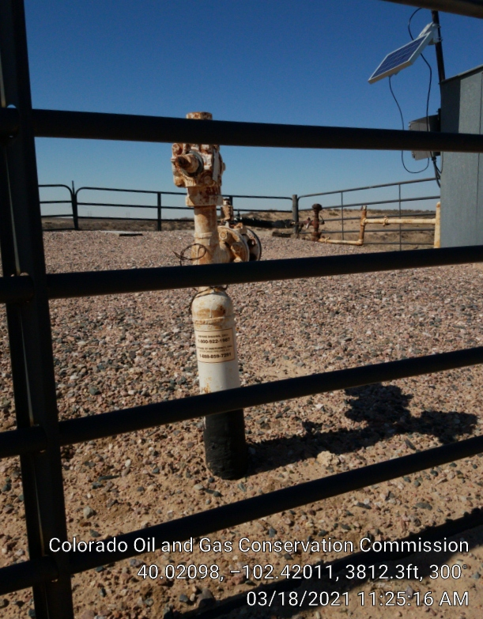

Slide 6
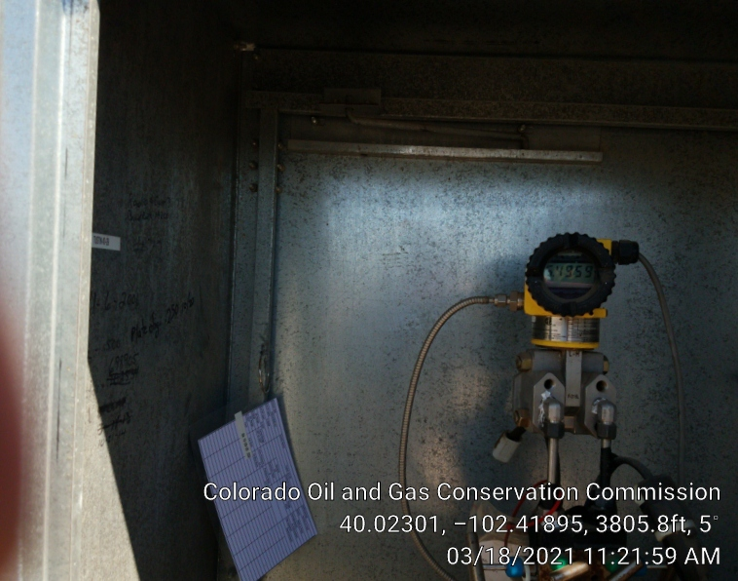

Slide 7


