Slide 1
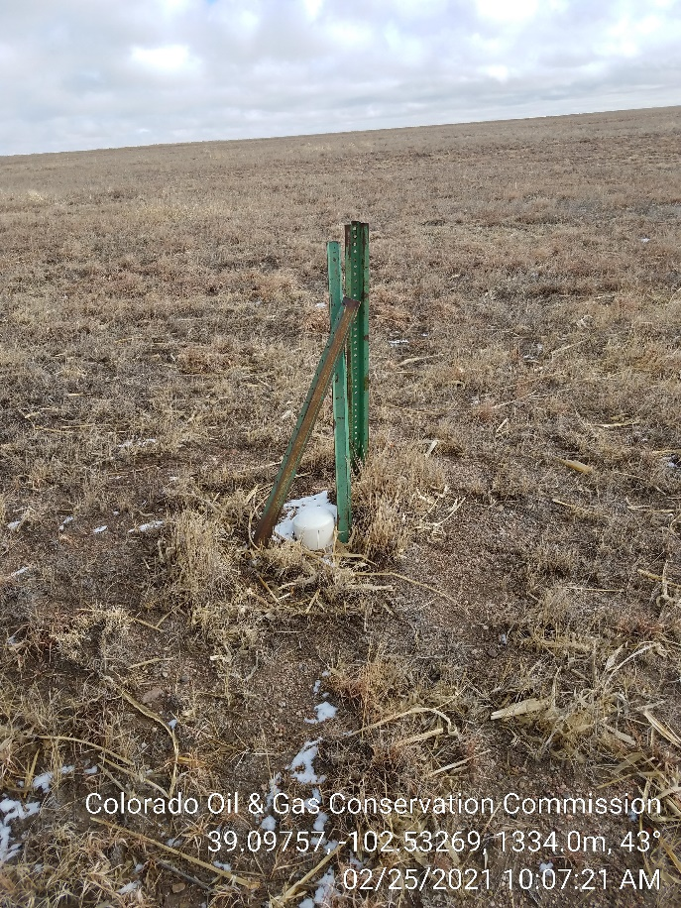
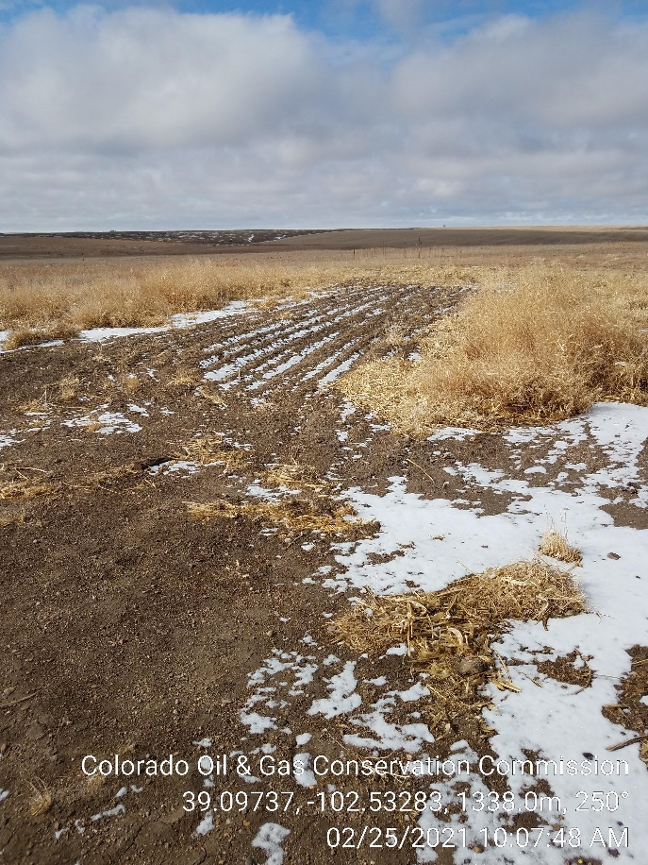
Inspection Photos
Operator: Citation Oil & Gas Corp -17180
Lease: Lowe 1-A
Facility ID/API, 213626 / 05-063-06185
1. Water shut off valve ?
2. Small area ripped where unit was set. Weeds and minimal desired vegetation across location.

