Slide 1
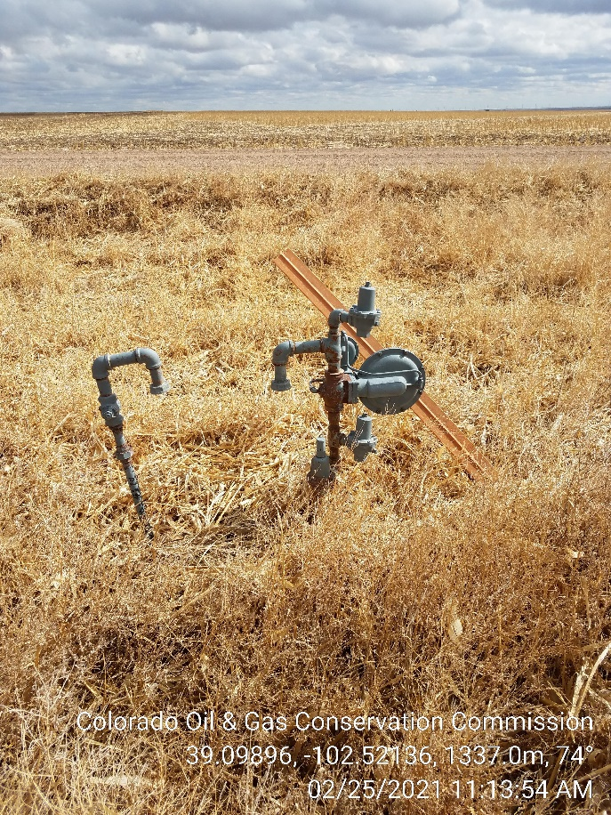
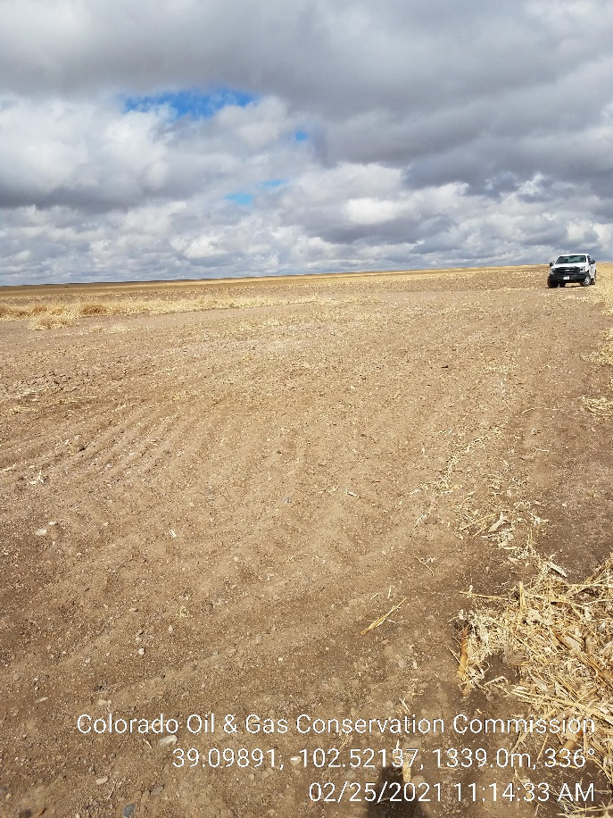
Inspection Photos
Operator: P O & G Operating LLC - 10634
Lease: Lowe 1-A, B-2 Battery site
Facility ID/API, 213484 / 05-063-06043
1. Gas supply risers
2. Battery site partially ripped (Incomplete).

Slide 2
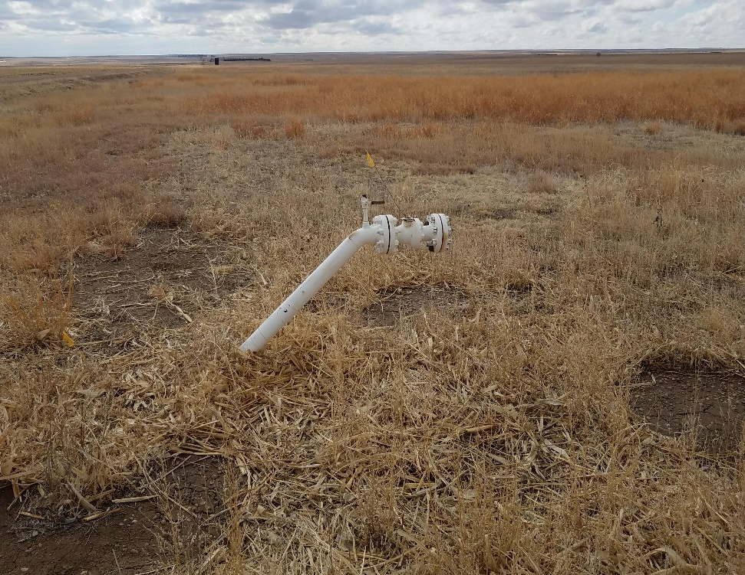
Inspection Photos
Operator: P O & G Operating LLC - 10634
Lease: Lowe 1-A, B-2 Battery site
Facility ID/API, 213484 / 05-063-06043
3. Pipeline riser still in place.

