Slide 1
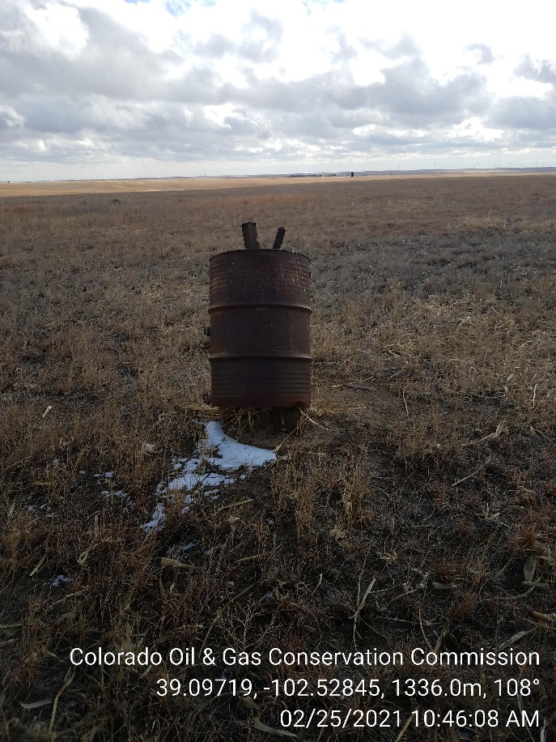
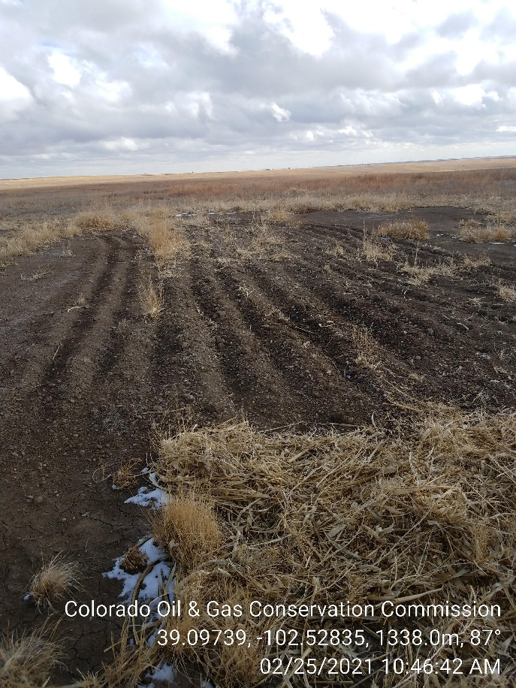
Inspection Photos
Operator: P O & G Operating LLC - 10634
Lease: Lowe B-2
Facility ID/API, 213633 / 05-063-06192
1. Water line shutoff ?
2. Area where unit was set is the only place ripped .

