Slide 1
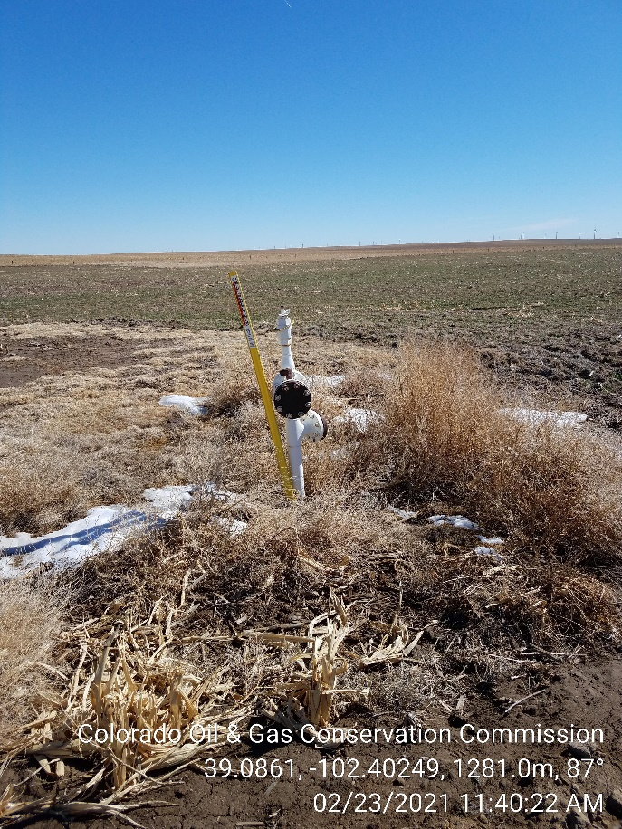
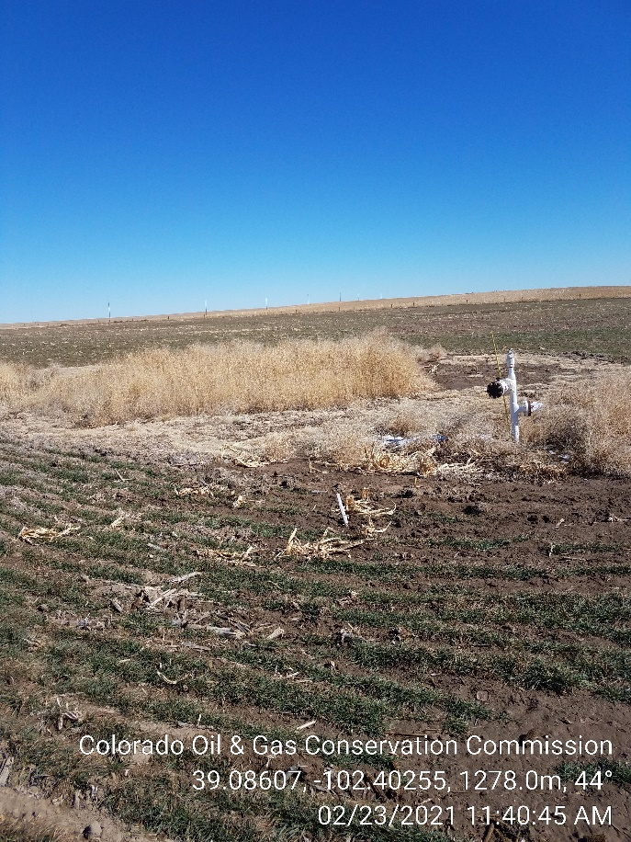
Inspection Photos
Operator: Citation Oil & Gas Corp -17180
Lease: Hicks B-1
Facility ID/API, 213484 / 05-063-06043
1. Pipeline Riser
2. Area with riser not ripped and farmed.

