Slide 1
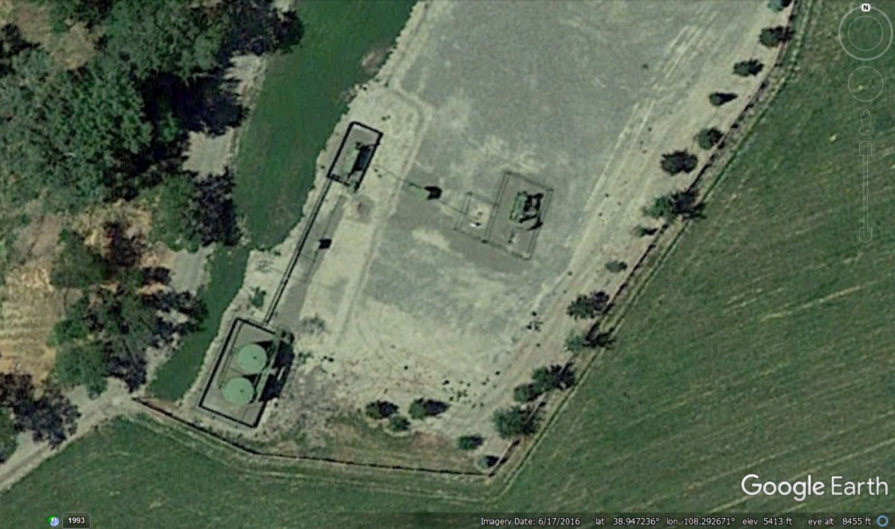
FRAM OPERATING LLC – 10310 Location ID # 334472
API # 05-077-08922 Jensen #1-3
API # 05-077-09311 Jensen #1-3-O
Inspection Date : 3/3/2021
← Separator
← Meters →
05-077-08922→
05-077-09311→
← Tank Battery
GoogleEarth view of location area.
Image date 6/17/2016.
Inspection Doc # 693802762

Slide 2
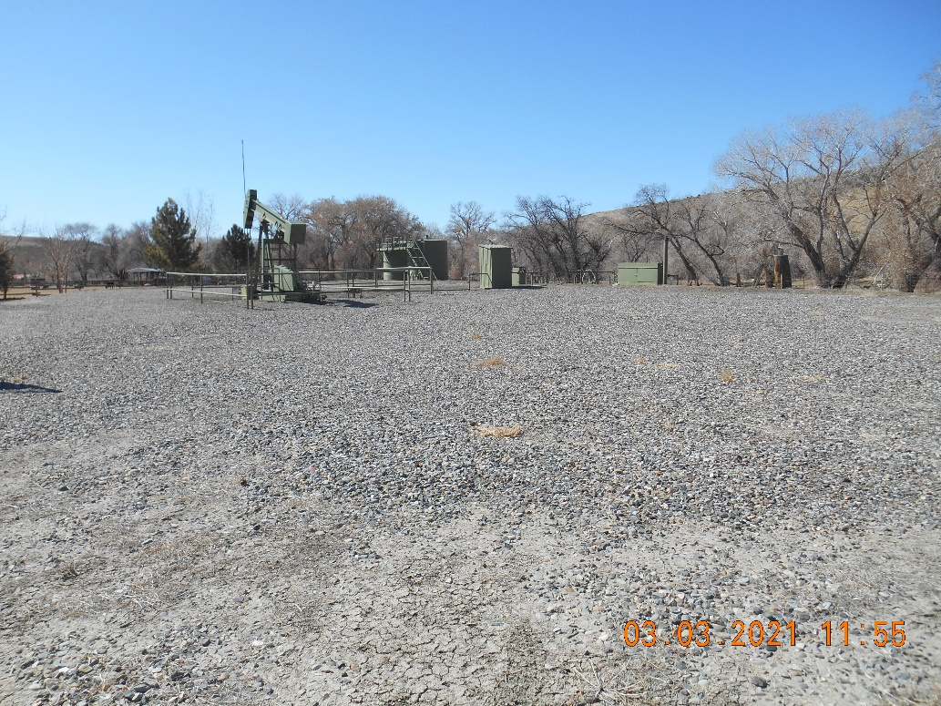
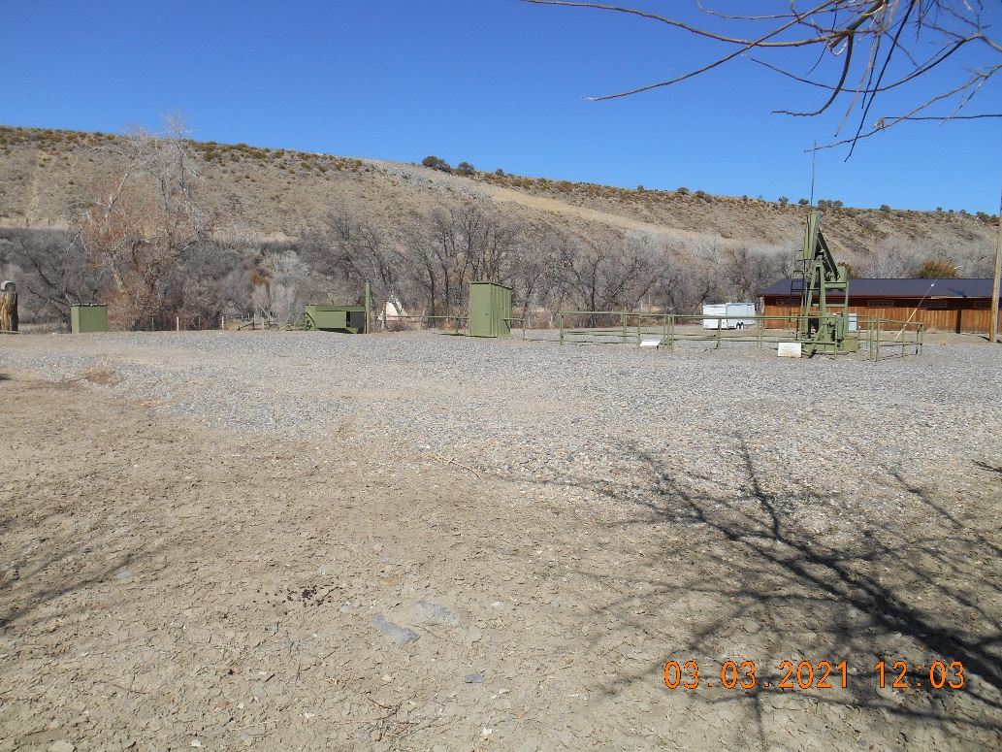
FRAM OPERATING LLC – 10310 Location ID # 334472
API # 05-077-08922 Jensen #1-3
API # 05-077-09311 Jensen #1-3-O
Inspection Date : 3/3/2021
Location entrance from NE corner looking SW
Location overview from SE corner looking N
Inspection Doc # 693802762

Slide 3
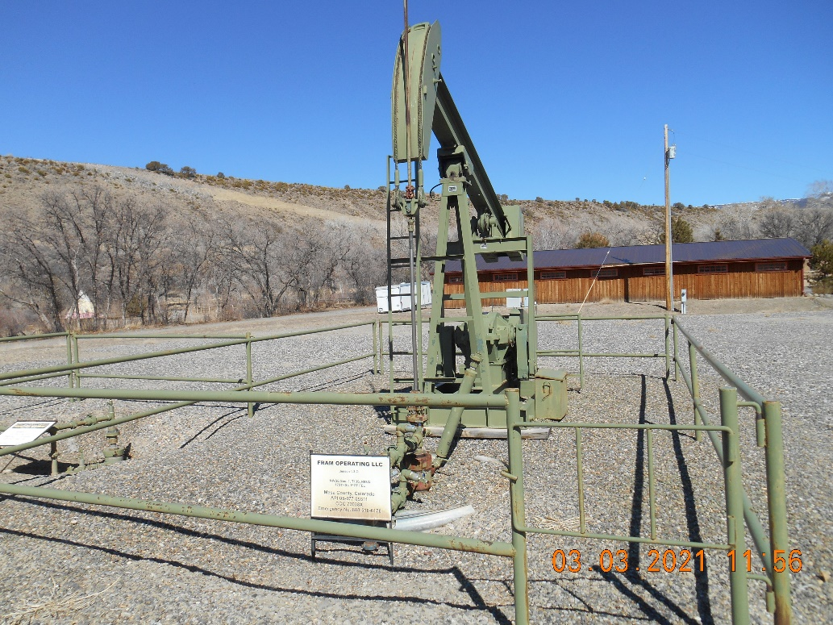
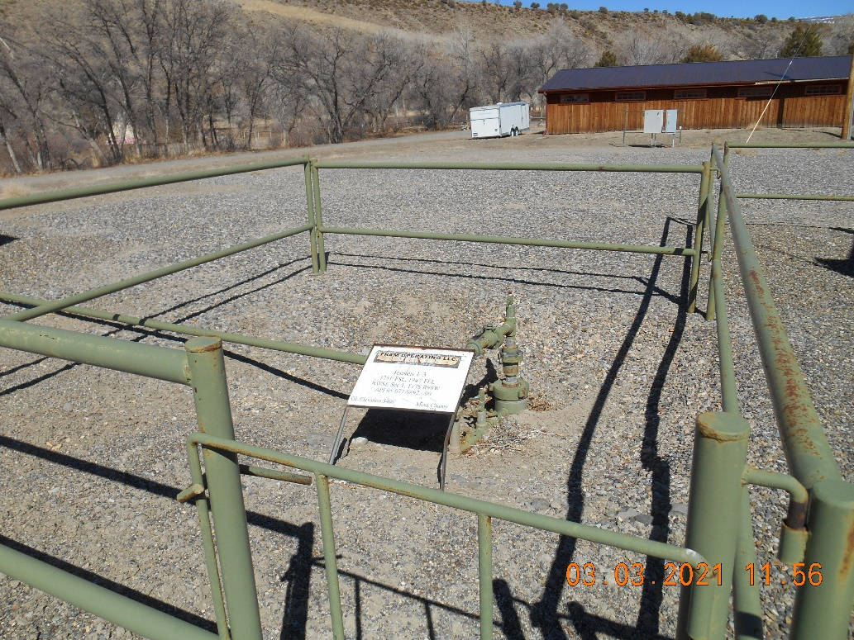
FRAM OPERATING LLC – 10310 Location ID # 334472
API # 05-077-08922 Jensen #1-3
API # 05-077-09311 Jensen #1-3-O
Inspection Date : 3/3/2021
API # 05-077-09311 Jensen #1-3-O
Wellhead with pump jack.
API # 05-077-08922 Jensen #1-3
Wellhead
Inspection Doc # 693802762

Slide 4
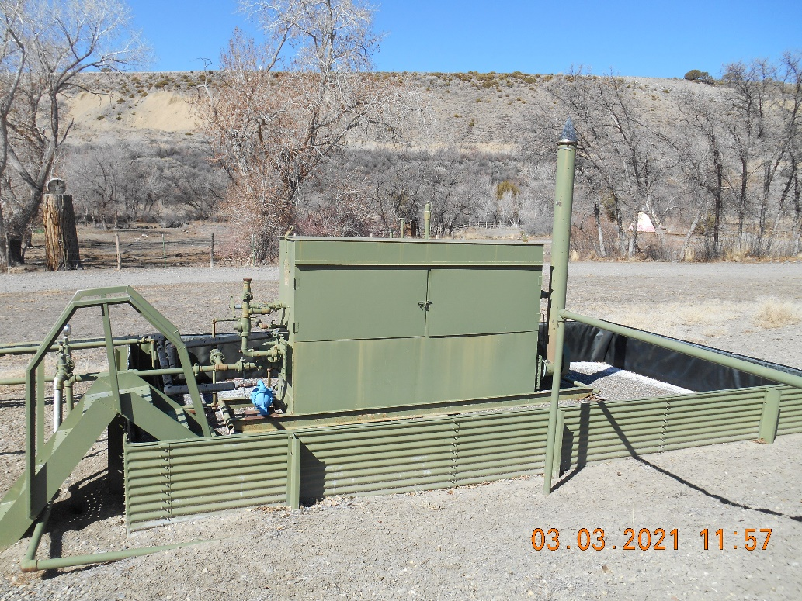
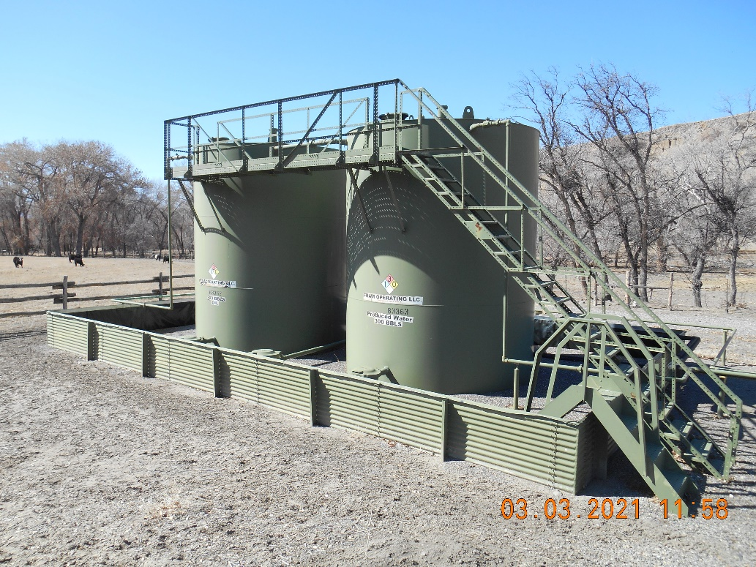
FRAM OPERATING LLC – 10310 Location ID # 334472
API # 05-077-08922 Jensen #1-3
API # 05-077-09311 Jensen #1-3-O
Inspection Date : 3/3/2021
Separator
Tank Battery
Inspection Doc # 693802762

Slide 5
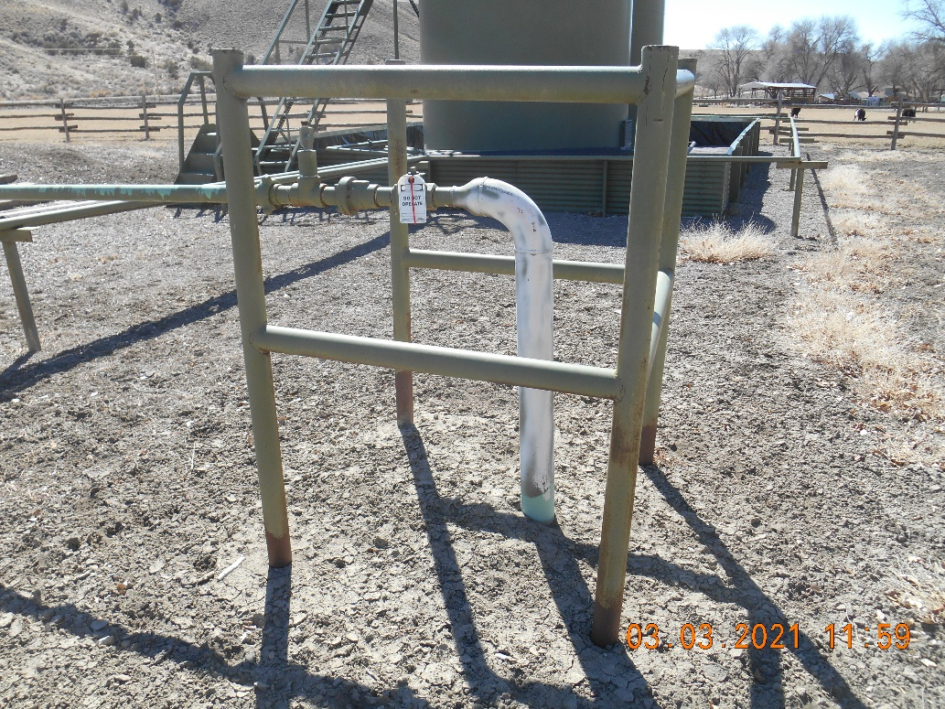
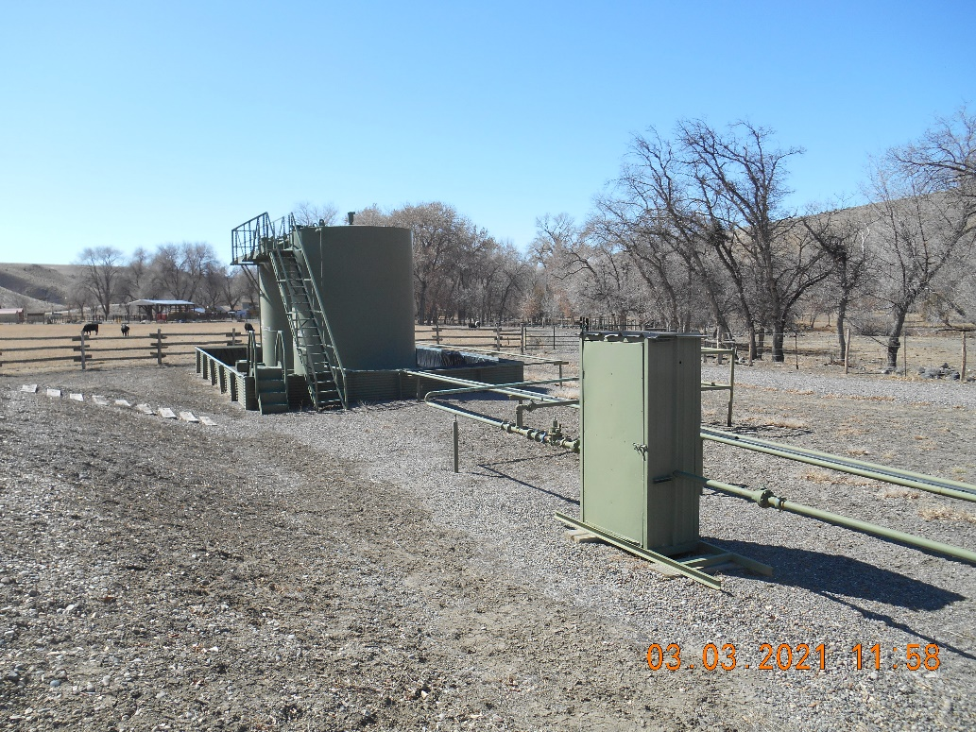
FRAM OPERATING LLC – 10310 Location ID # 334472
API # 05-077-08922 Jensen #1-3
API # 05-077-09311 Jensen #1-3-O
Inspection Date : 3/3/2021
4” gathering line riser. Locked out/tagged out.
Pipe barricade.
Meter housing. Looking SW.
Inspection Doc # 693802762

