Slide 1
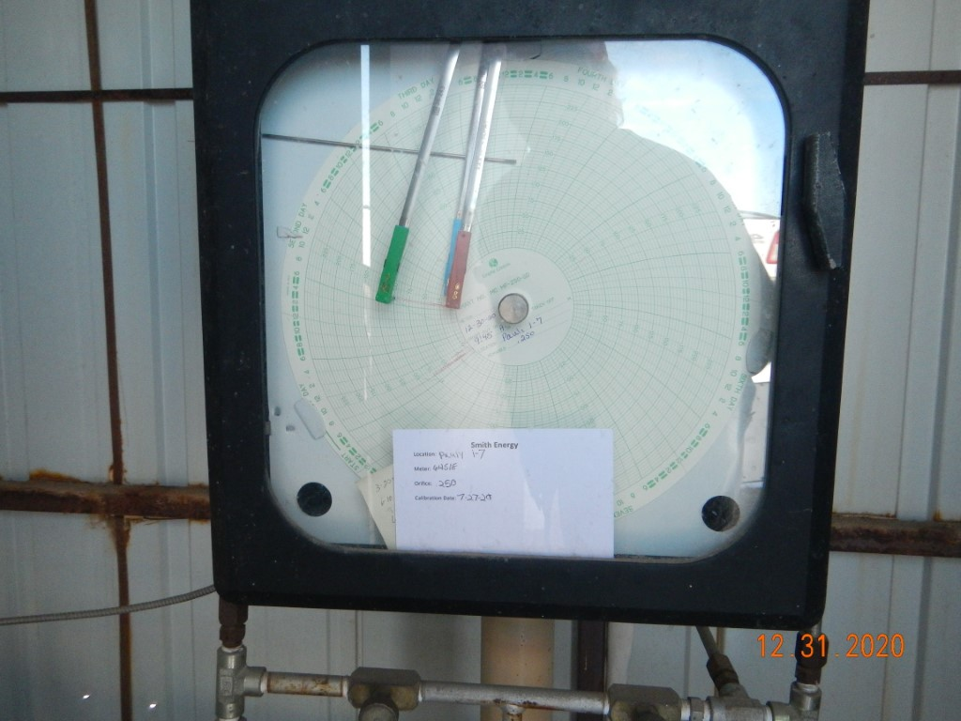
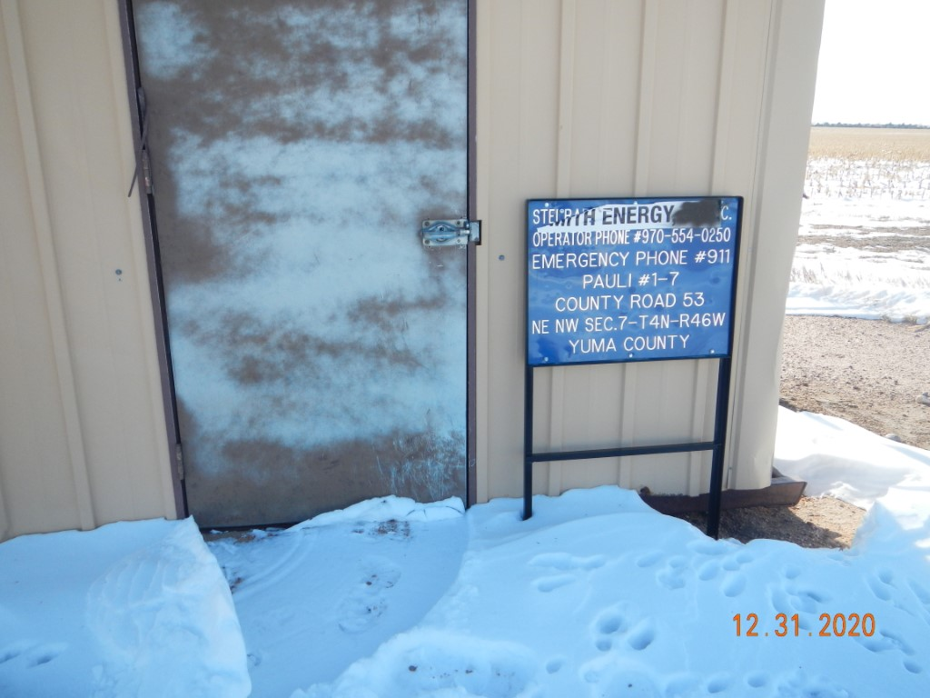
Operator Name: Smith Energy LLC
Facility Name: Pauli 3-7 Location ID# 125-09822
GMR-Calibration Cert.
GMR-Signage-Fence

