Slide 1
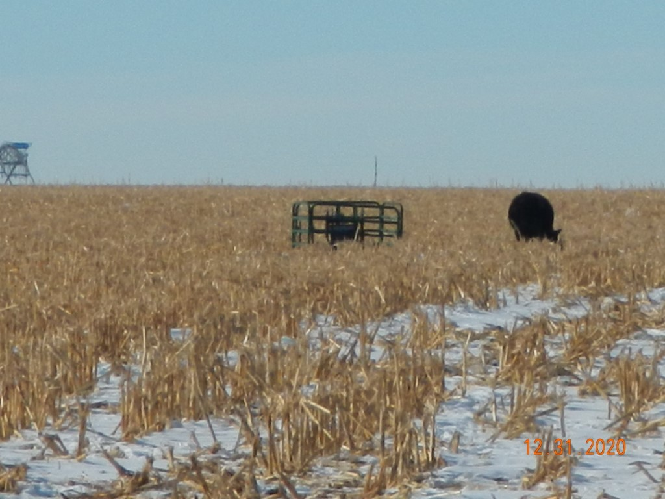
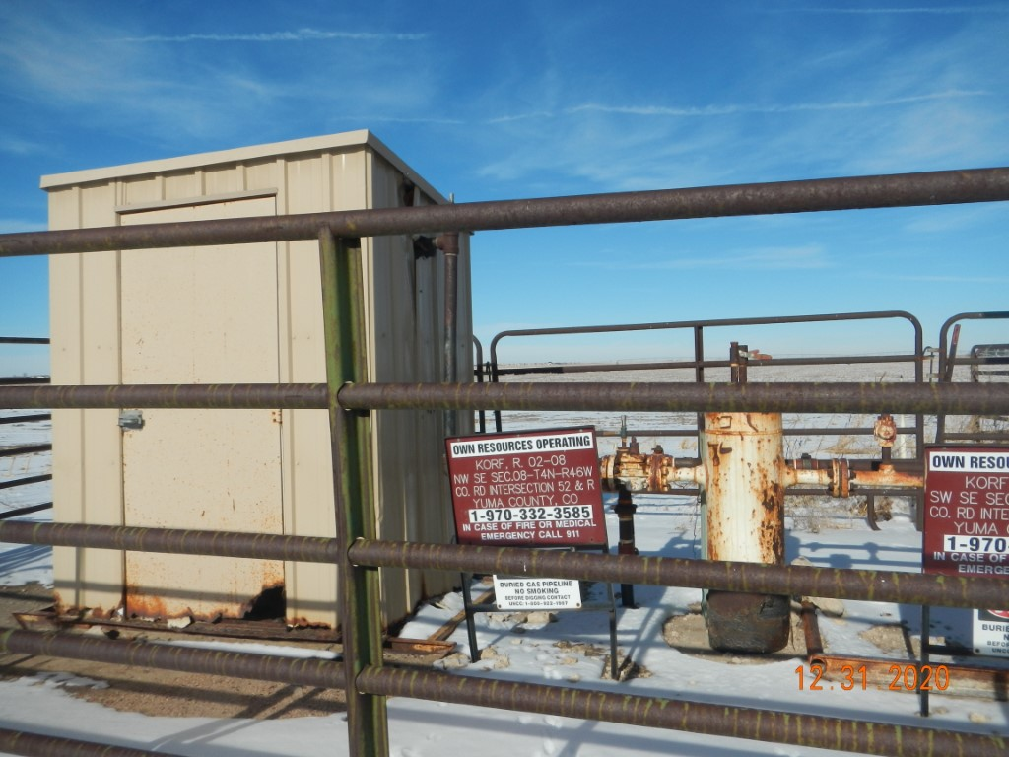
Operator Name: OWN
Facility Name: Korf 2-8 Location ID# 125-06181
Wellhead-Signage-Fence
Signage – fence – sep. @ GMR

